Slide 1

Online
Dispute
Resolution
Ethics

Slide 2

Online Mediator Ethical Standards
Notes:
Court disputes (low value civil cases: e.g. divorce, tenant)
Public disputes (e.g. Property Tax Appeals)
Insurance (e.g. AAA NYNF Process)
Product liability (e.g. Pharmaceuticals)
Consumer (e.g. Ombuds offices, UK CAA)
eCommerce disputes (payments, marketplaces, merchants)

Slide 3
Online
Mediator Ethical Standards
Accessible
Accountable
Competent
Confidential
Equal
Fair/Impartial/Neutral
Legal
Secure
Transparent

Slide 4
ICODR Standards
Accessible: ODR must be easy for parties to find and participate in and not limit their right to representation. ODR should be available through both mobile and desktop channels, minimize costs to participants, and be easily accessed by people with different physical ability levels.
Confidential: ODR must maintain the confidentiality of party communications in line with policies that must be made public around a) who will see what data, and b) how that data can be used.
Legal: ODR must abide by and uphold the laws in all relevant jurisdictions.
Secure: ODR providers must ensure that data collected and communications between those engaged in ODR is not shared with any unauthorized parties. Users must be informed of any breaches in a timely manner.

Slide 5
ICODR Standards
Equal: ODR must treat all participants with respect and dignity. ODR should enable often silenced or marginalized voices to be heard, and ensure that offline privileges and disadvantages are not replicated in the ODR process.
Fair/Impartial/Neutral: ODR must treat all parties equally and in line with due process, without bias or benefits for or against individuals, groups, or entities. Conflicts of interest of providers, participants, and system administrators must be disclosed in advance of commencement of ODR services.
Transparent: ODR providers must explicitly disclose in advance a) the form and enforceability of dispute resolution processes and outcomes, and b) the risks and benefits of participation. Data in ODR must be gathered, managed, and presented in ways to ensure it is not misrepresented or out of context.

Slide 6
Different Types of Accessibility
Convenience
Cost
Geography
Discoverability
Comprehensibility
Technology
Hospitality / Supportiveness

Slide 7
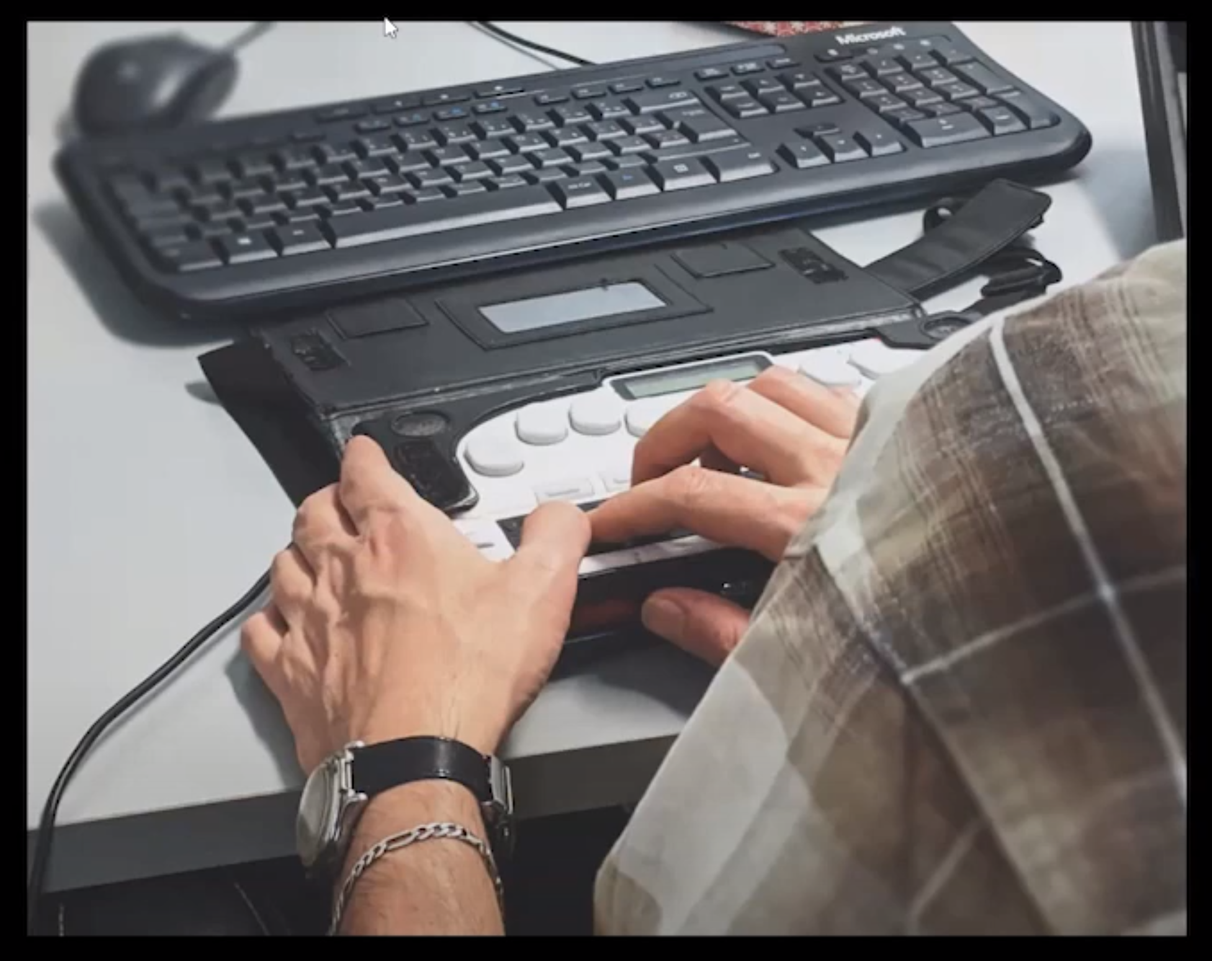
Accessibility for Persons with Disabilities
Best Practices
Putting accessibility in all RFPs for ODR Services
Training staff
Testing and maintaining your website (e.g. WAVE)
Using persons with disabilities as testers
Evaluate all stages of the ODR process
Hire people with disabilities on the team

Slide 8
Confidentiality / Security / Transparency
Confidential: ODR must maintain the confidentiality of party communications in line with policies that must be made public around a) who will see what data, and b) how that data can be used.
Secure: ODR providers must ensure that data collected and communications between those engaged in ODR is not shared with any unauthorized parties. Users must be informed of any breaches in a timely manner.
Transparent: ODR providers must explicitly disclose in advance a) the form and enforceability of dispute resolution processes and outcomes, and b) the risks and benefits of participation. Data in ODR must be gathered, managed, and presented in ways to ensure it is not misrepresented or out of context.

Slide 9
What types of tools are mediators using?
Email
Calendar invitations
Word documents
Skype calls
Google docs
Text messages
Social media platforms
These tools all have security concerns

Slide 10
Email security
Emails travel across multiple networks and servers before arriving in their intended audience’s inbox.
Emails aren't encrypted
Servers hold emails that are decades old, even after they're deleted
Once your password is compromised, all emails are accessible
Emails touch multiple devices (e.g. laptop, mobile, watch) each of which can be compromised
The sender cannot prevent recipients from further forwards

Slide 11
Secure text-based communication
Email/SMS notifications should never contain substantive communications
All substantive communications should be on a password-protected ODR platform
Require two factor authentication, or complex passwords, for platform access
Don’t email attachments – share documents in a password-protected file repository
Require parties to sign an agreement to mediate that outlines their responsibilities around data security

Slide 12
Videoconferencing security risks
Who has access?
  Zoom bombing
  Are all participants visible?
  Other people in the room, off camera
What is being recorded?
  Can the session be secretly recorded?
  Phone on record next to the speaker
Can someone intercept the video feed?
Who can control your local machine?
Is location tracked by the application?

Slide 13
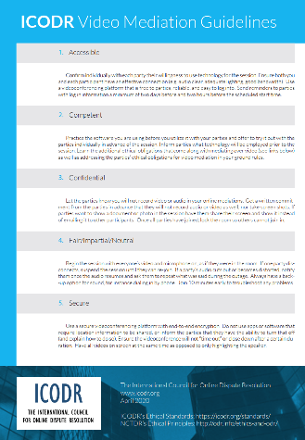
Odr security guidelines
ICODR is working on
ODR Security Guidelines
https://icodr.org
Notes:
Court disputes (low value civil cases: e.g. divorce, tenant)
Public disputes (e.g. Property Tax Appeals)
Insurance (e.g. AAA NYNF Process)
Product liability (e.g. Pharmaceuticals)
Consumer (e.g. Ombuds offices, UK CAA)
eCommerce disputes (payments, marketplaces, merchants)

Slide 14
ODR Practice Dilemma #1
A divorcing couple you are working with are having a very hard time reaching agreement, and their lack of progress is frustrating you. One night while you’re trying to get them to focus on the issues that need to be resolved, you enter the husband’s name into Google and discover that he spent time in prison for abusing the children of a girlfriend he had prior to his current wife. This is news to you, but it helps you to understand some of the hesitation the wife has in agreeing to visitation arrangements. What do you do?

Slide 15
ODR Practice Dilemma #2
You are mediating a workplace dispute over unpaid wages, and the former employee tells you in caucus that she’s so tight on money she can’t afford internet access in her house any more. She says she can use her phone, but soon after the frequency and length of her posts go way down, while the business owner keeps uploading more and more spreadsheets and posting messages every hour. Progress in the case slows to a crawl every day while you wait for the employee to respond, and the owner is getting frustrated. What do you do?

Slide 16
ODR Practice Dilemma #3
You are working with co-parents who have been separated for more than a year, and in the caucus space the wife informs you that she has started seeing someone new, but that she has not yet told the husband. You note the information but promise to keep it quiet. A week later, however, you accidentally post a message intended to be a private message to the wife in the caucus space for the husband, and the message refers to the boyfriend. You realize your mistake when the husband asks what you mean by the post and who the boyfriend is. What do you do?

Slide 17
ODR Practice Dilemma #4
Co-parents you are mediating have been stuck on vacation sharing for some time. Both the mother and the father insist on having the kids for Christmas, and neither will budge. One day, you get an email from the father’s attorney (who has not been participating in the mediation) saying that the father has been forwarding screen shots of the mediation discussions, and accusing you of bias in the way you have conducted the mediation. The attorney is threatening to file an ethics complaint with the court, where he will include the screen shots. What do you do?

Slide 18
ODR Practice Dilemma #5
The husband and wife you are mediating are just tearing into each other in the joint discussion, throwing around accusations of infidelity and uploading receipts that purport to prove marital affairs. You’ve urged them both to move into the caucus spaces and to stop communicating in the joint discussion, because this dialogue isn’t achieving anything, but they’re ignoring you. What do you do?

