Slide 1
Online Dispute Resolution: The State of the Art
Online Dispute Resolution: The State of the Art
Colin Rule SCU Law
Santa Clara, CA

Slide 2
Legal Aid Resolution Center
Diagnosis, triage, legal self-help, online support for dialogue, mediation, neutral decisions and beyond
Started with separation and divorce in The Netherlands, now expanding to the UK and Canada
Partnership:
Dutch Legal Aid Board
The Hague Institute for Innovations in Law
Modria
http://rechtwijzer.modria.com
(Rechtwijzer means “Signposts to justice”)

Slide 3
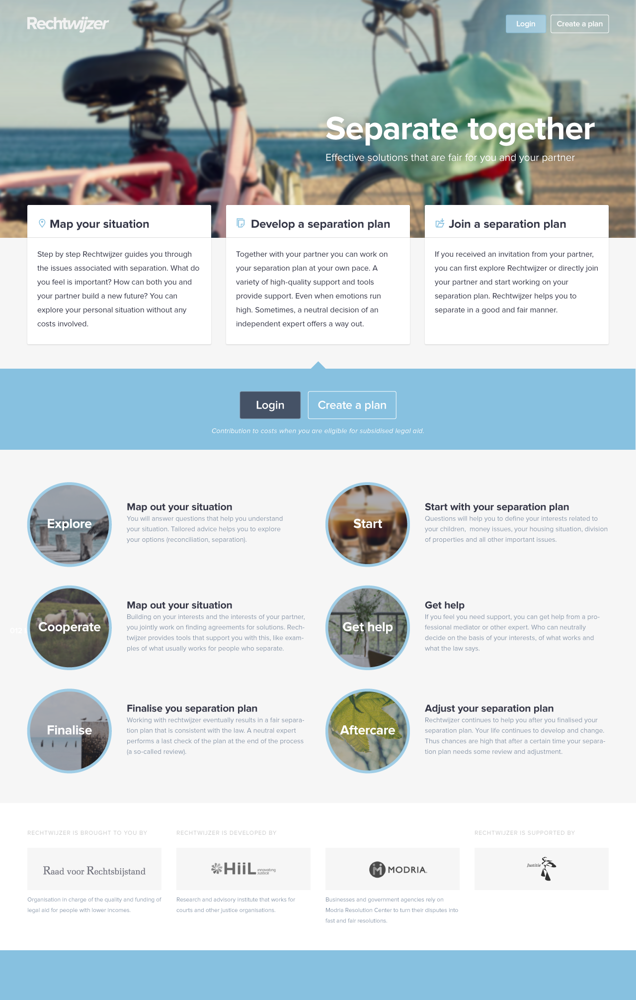

Slide 5
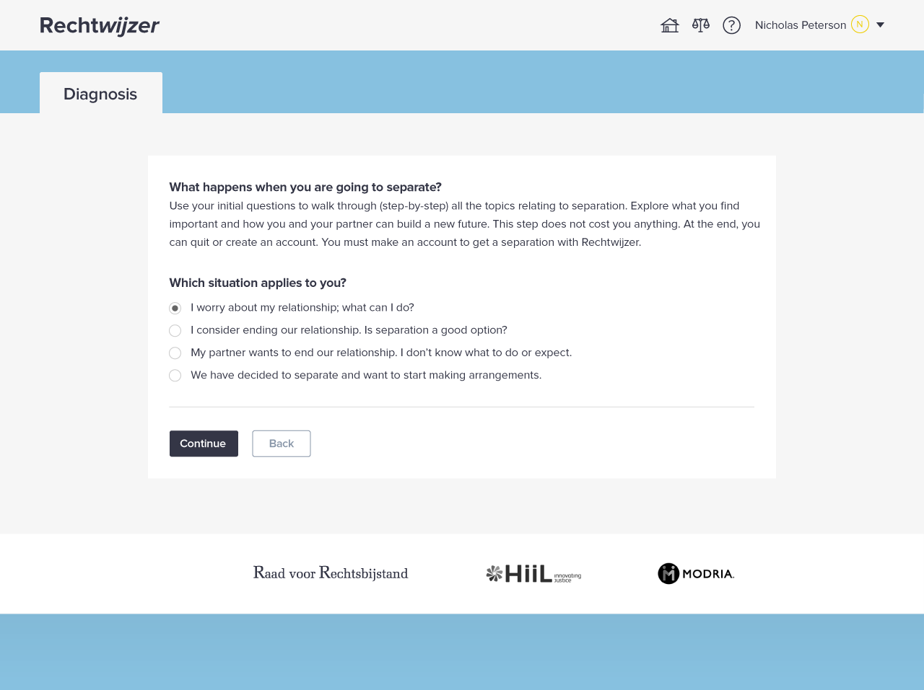
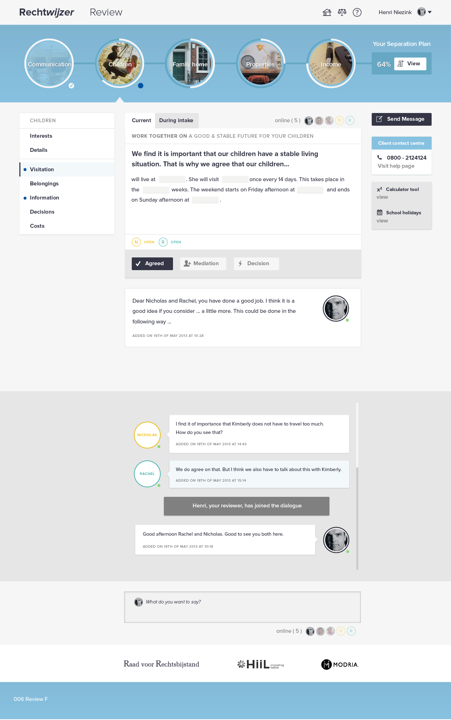

Slide 6
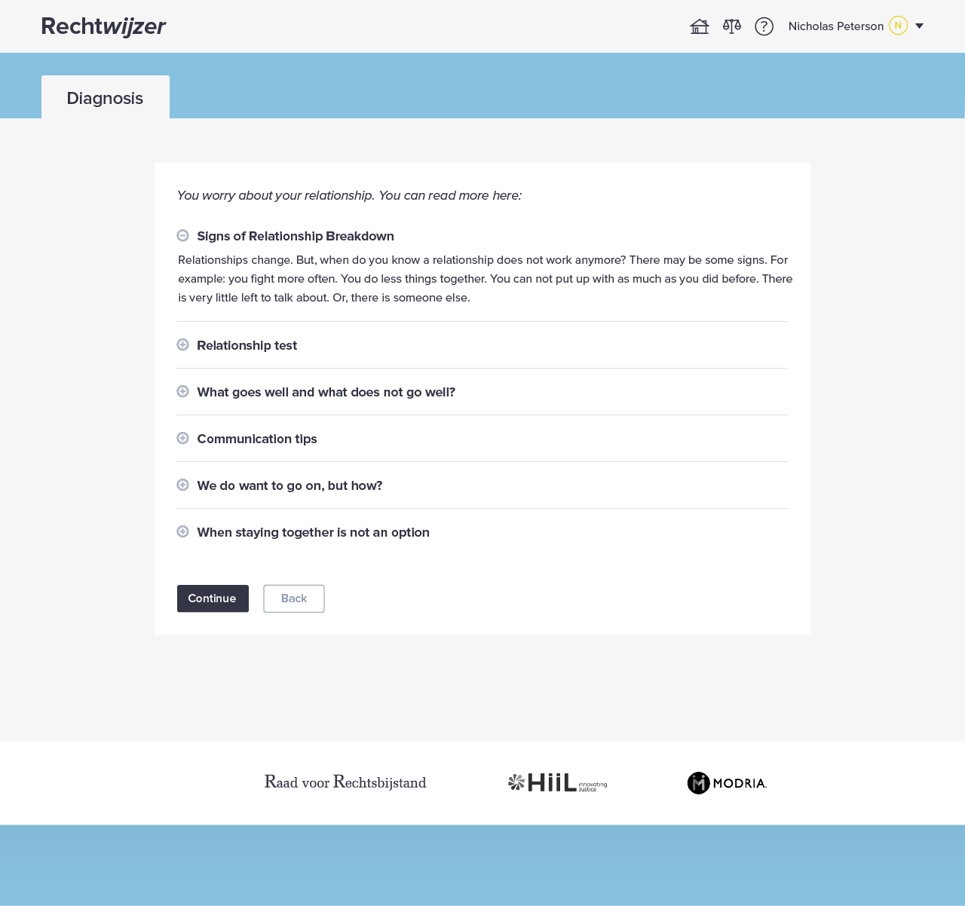

Slide 8
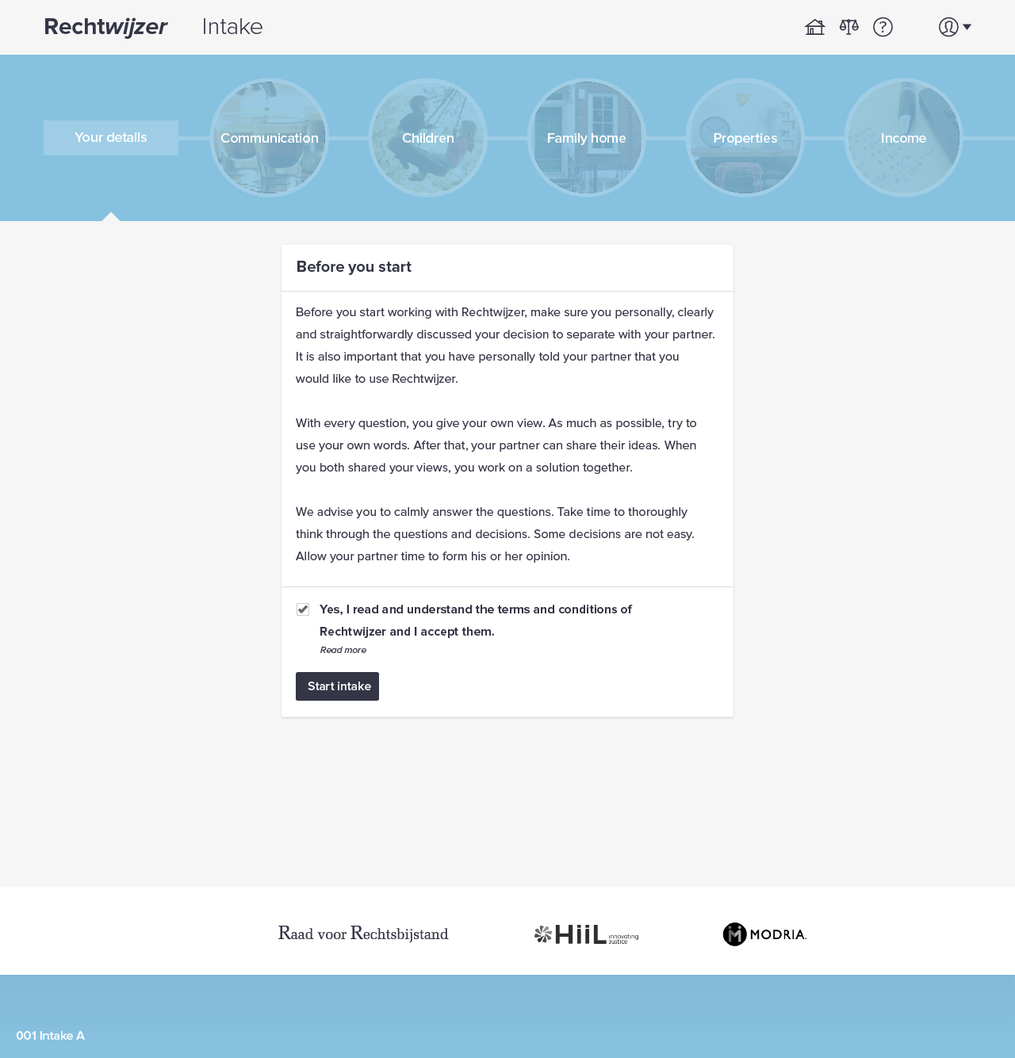

Slide 9
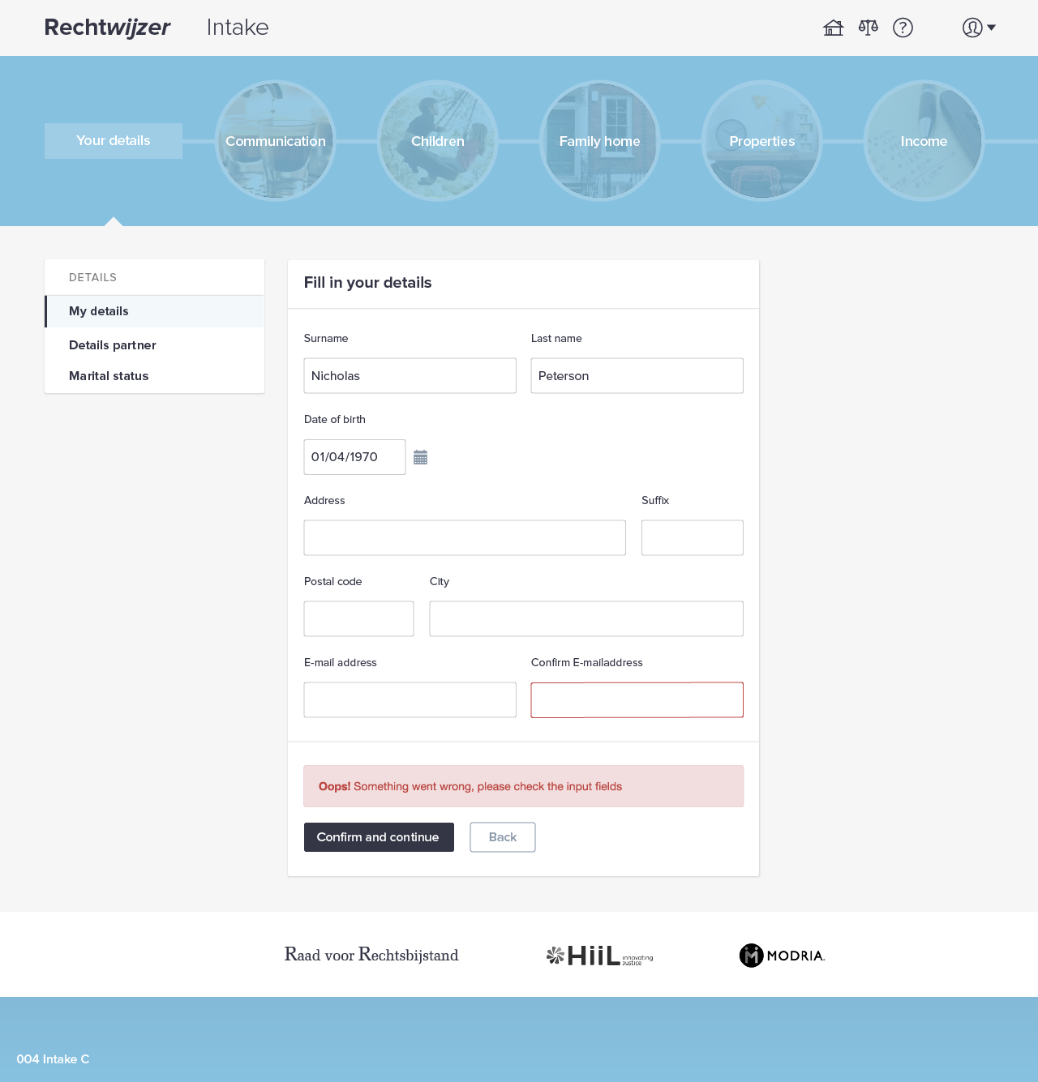

Slide 10
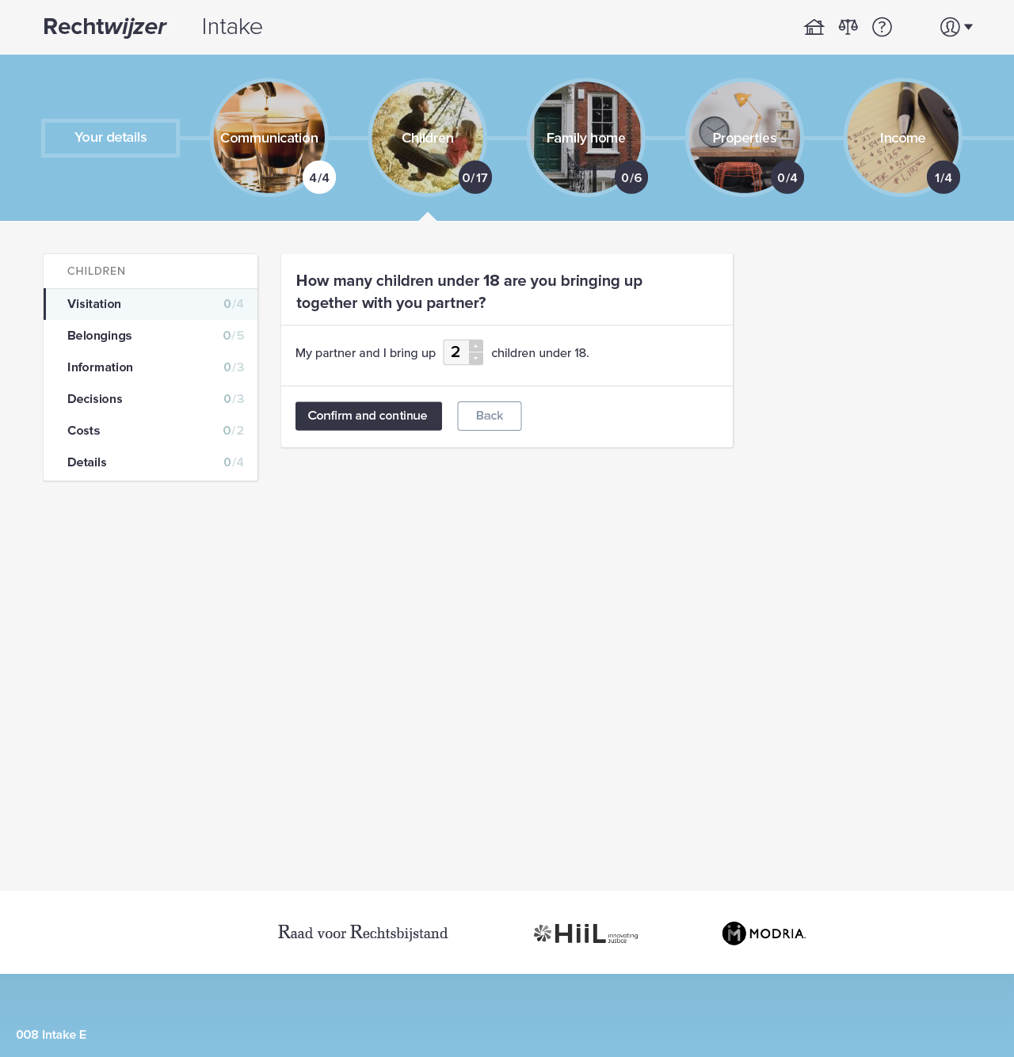

Slide 11
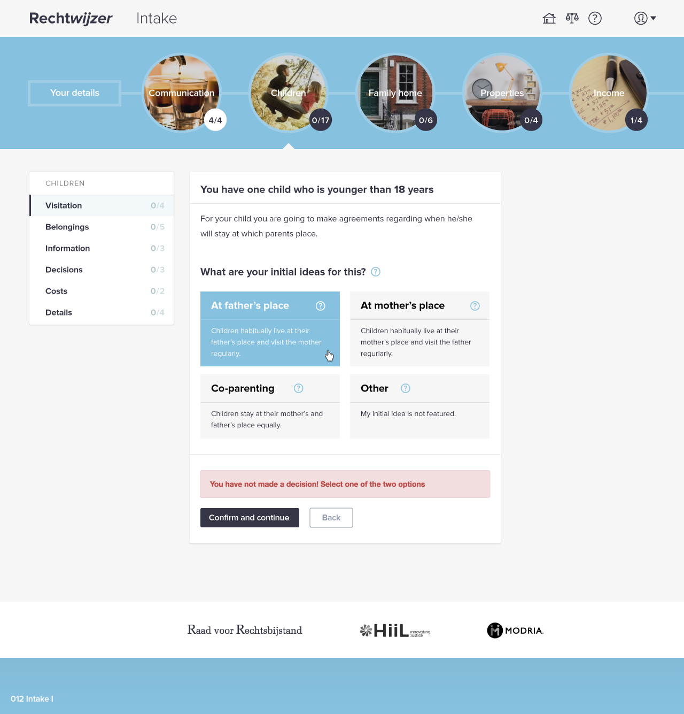

Slide 12
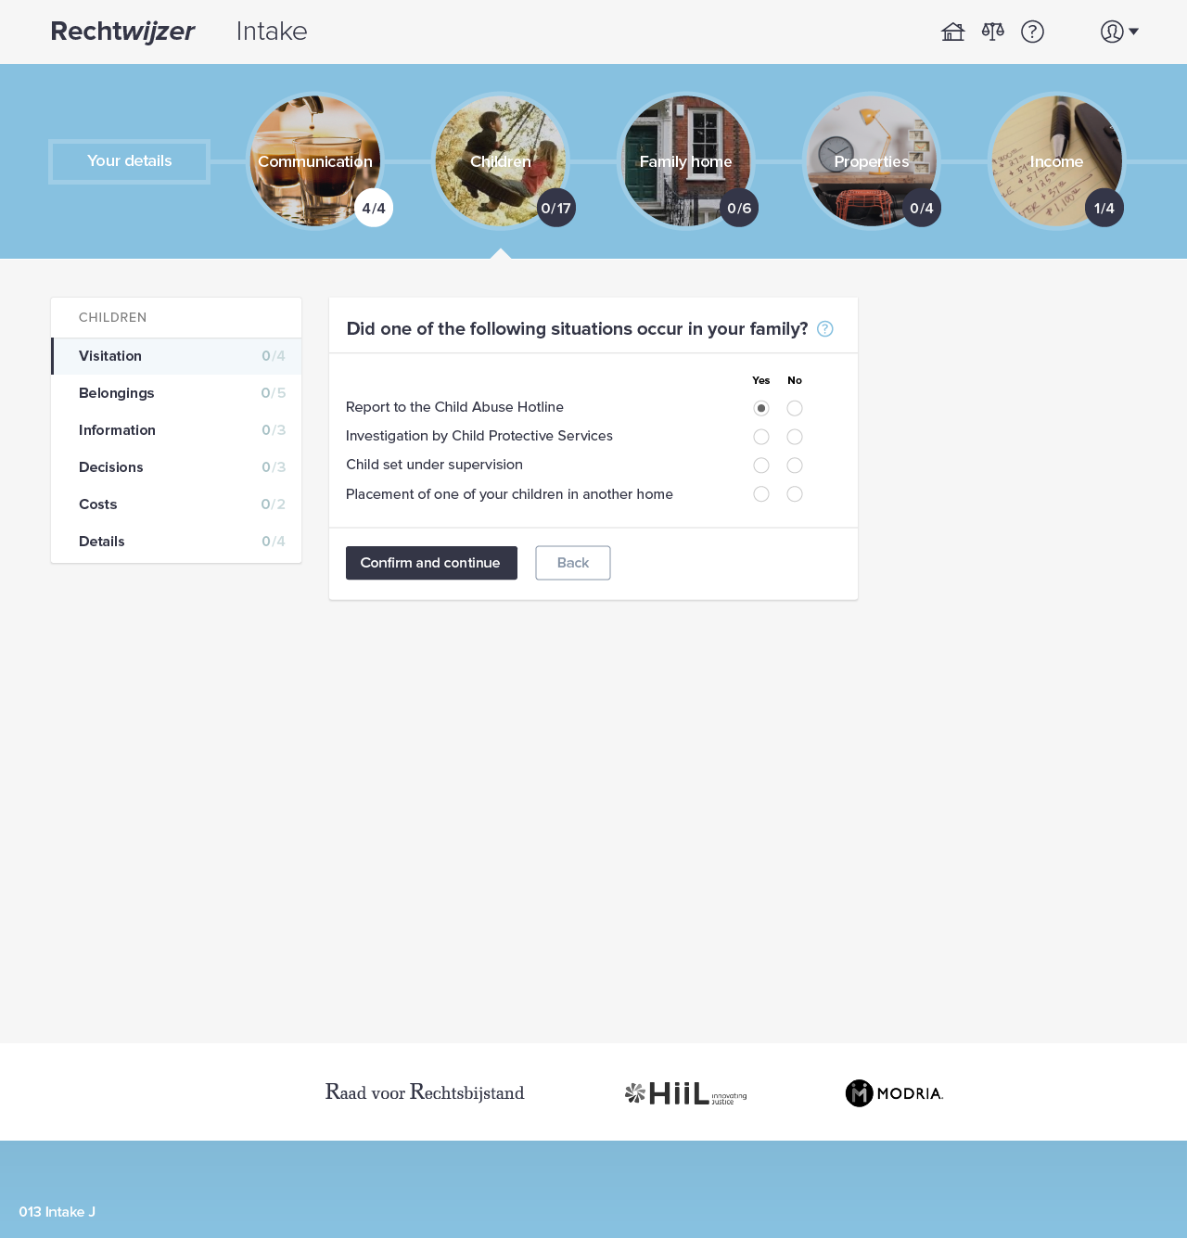

Slide 14
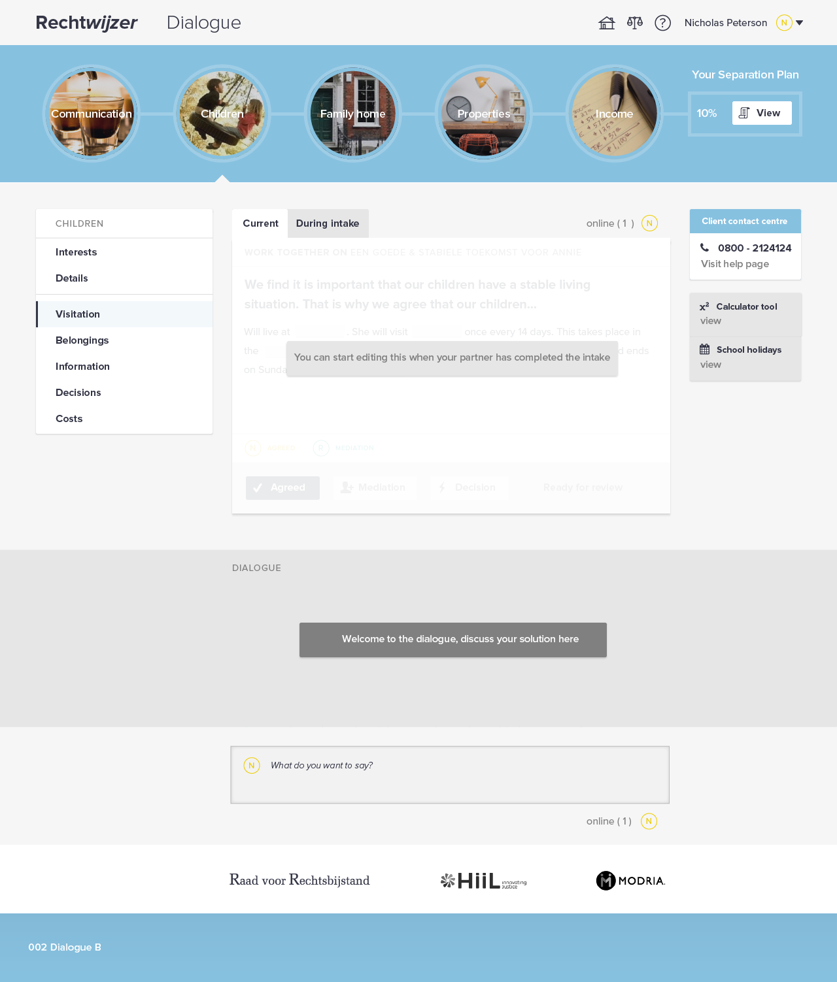

Slide 15
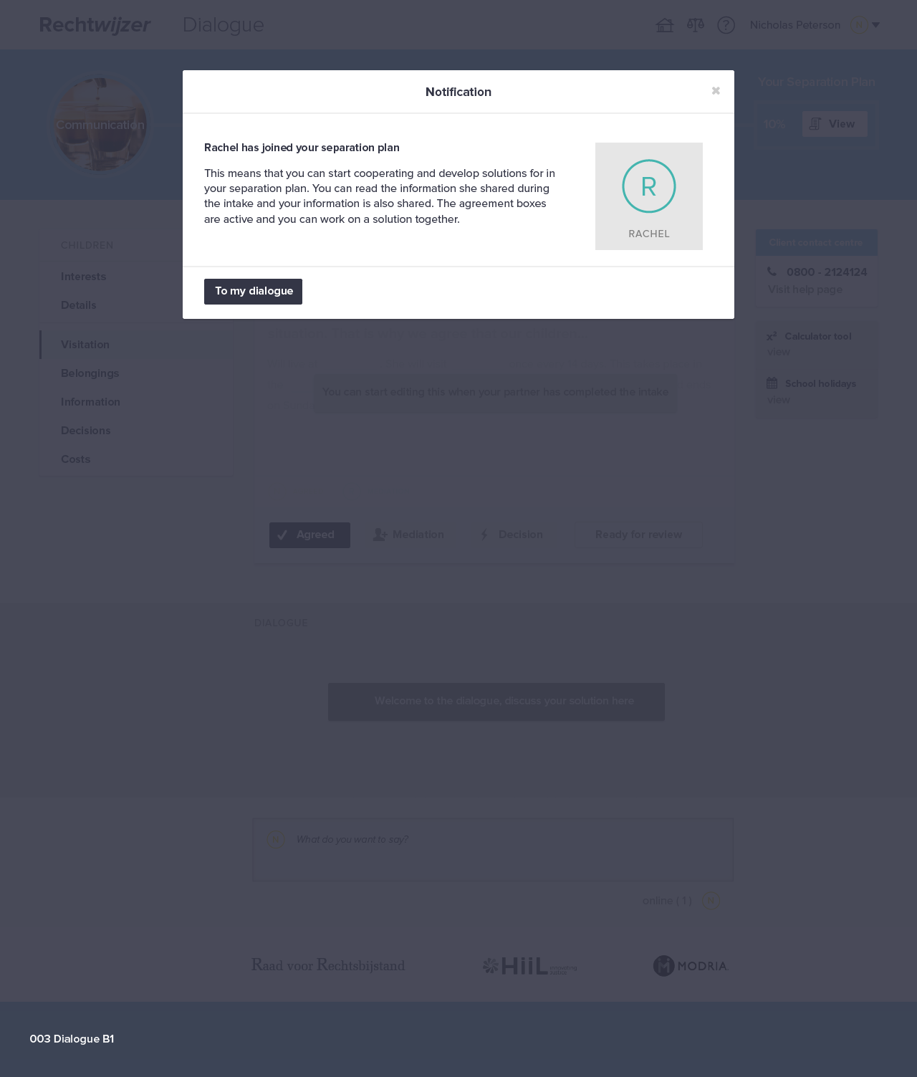

Slide 16
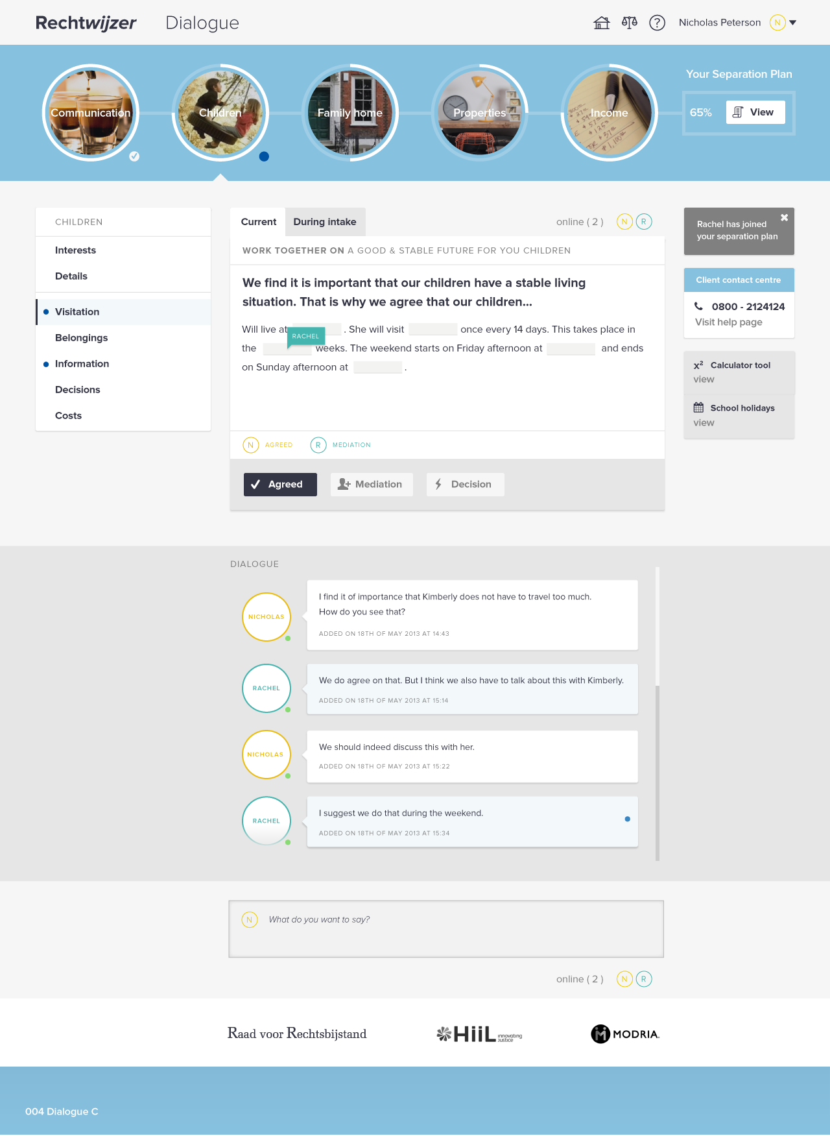

Slide 17
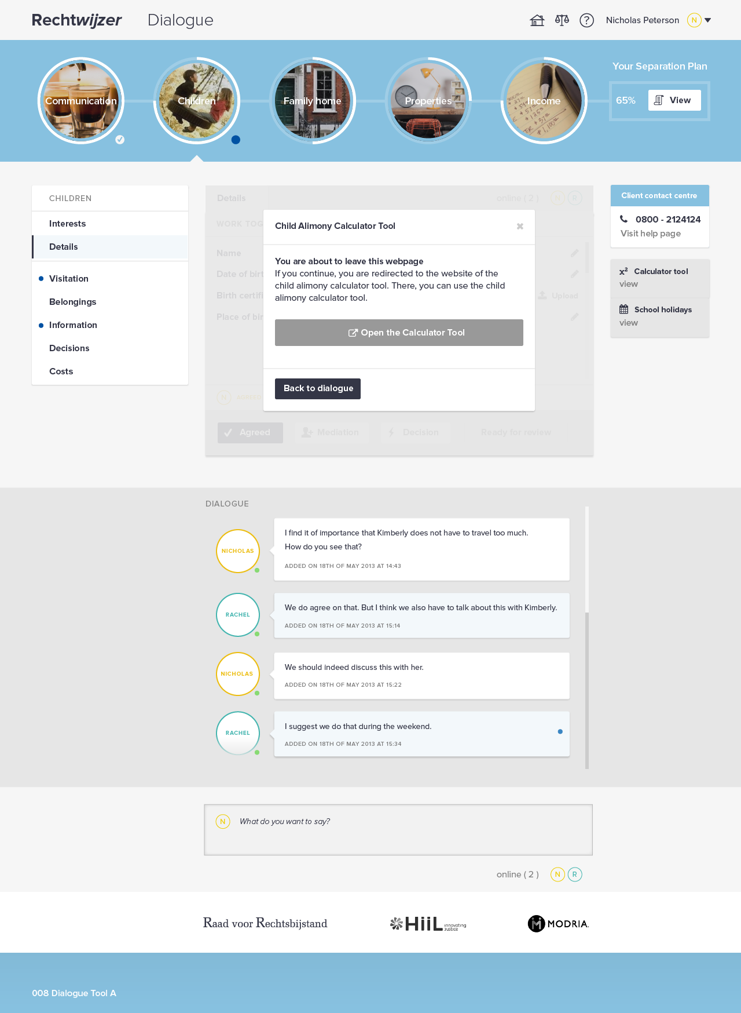

Slide 21
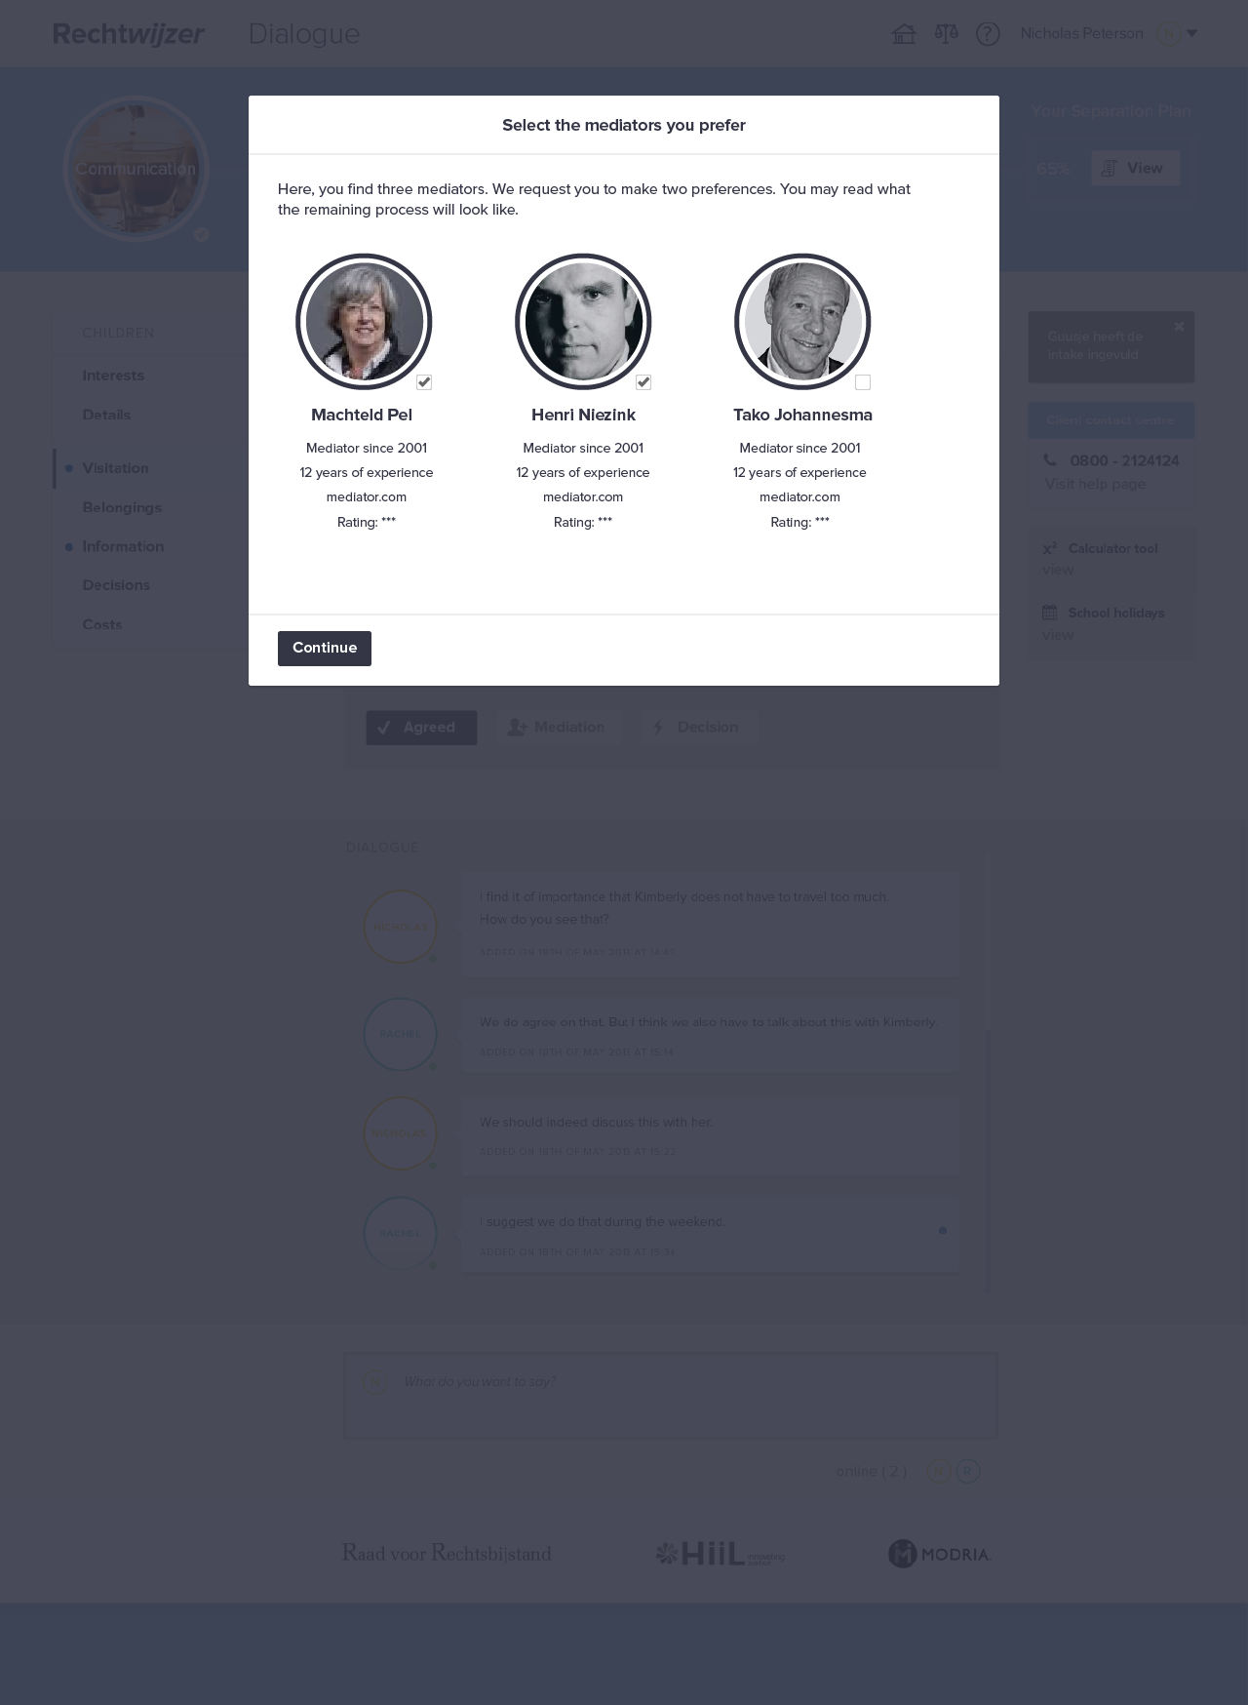

Slide 23
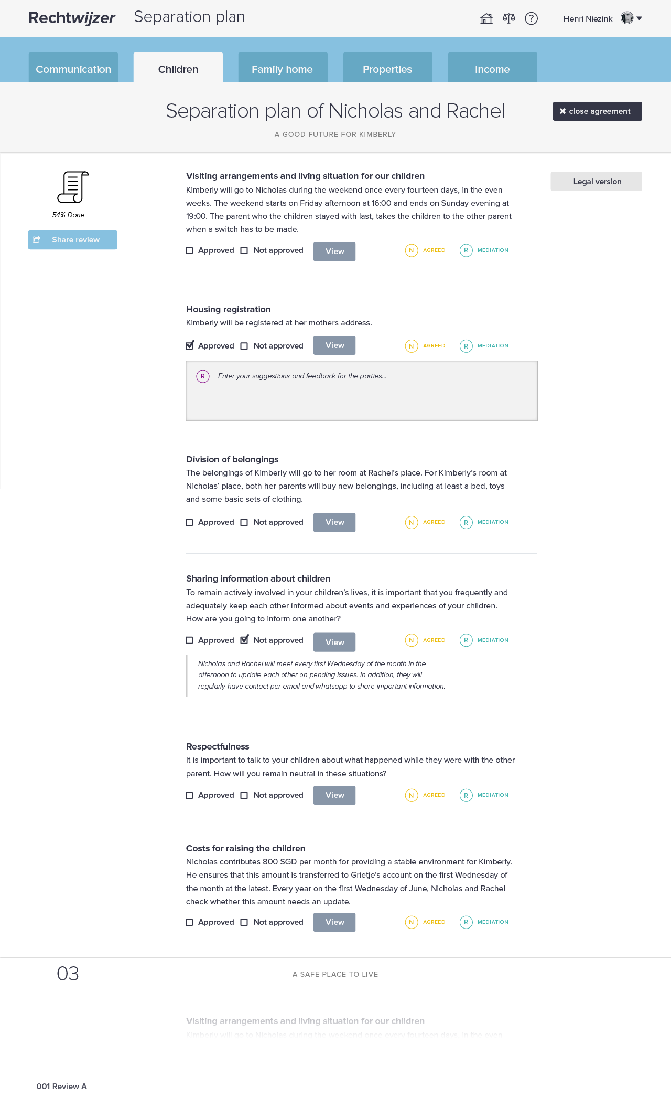

Slide 25
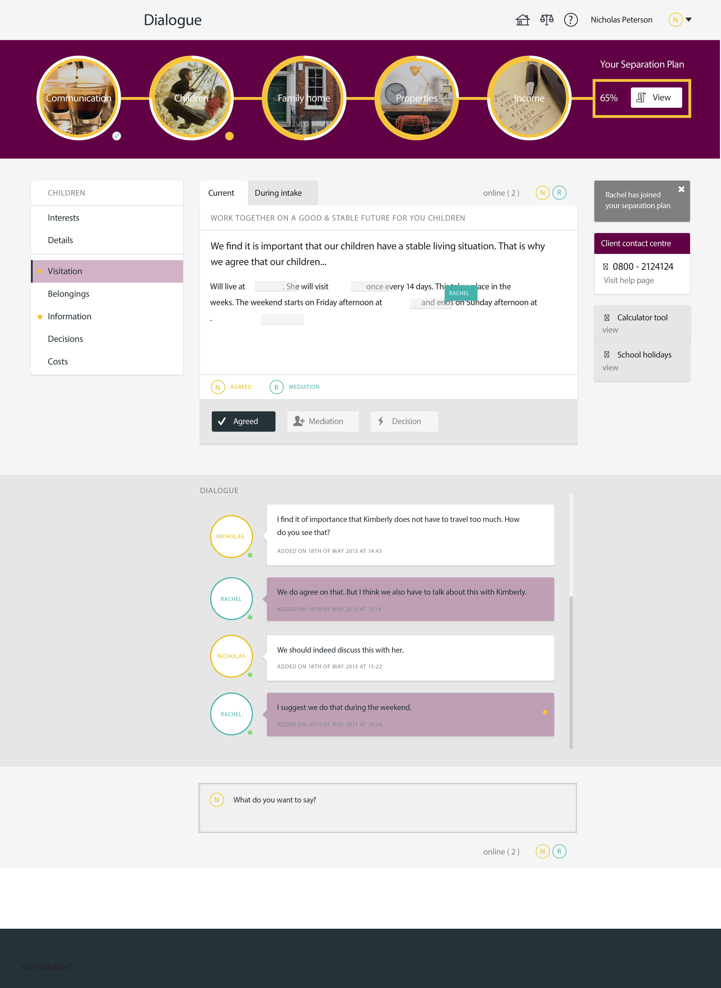

Slide 26
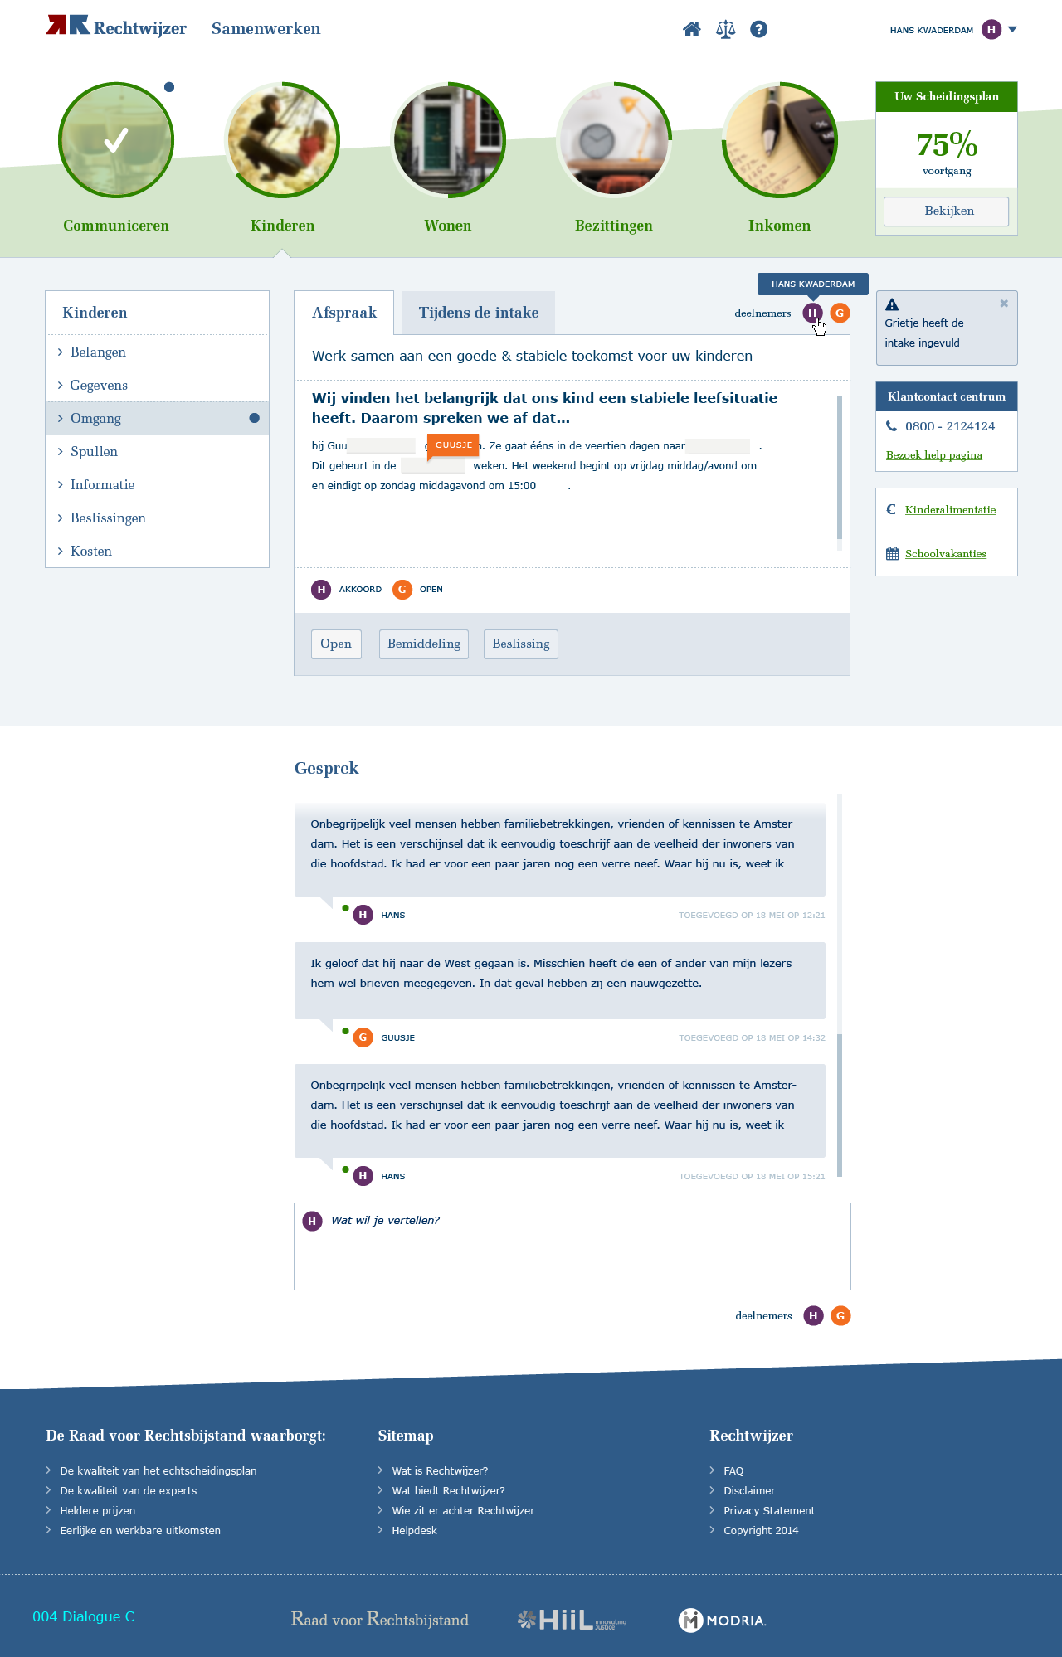

Slide 27
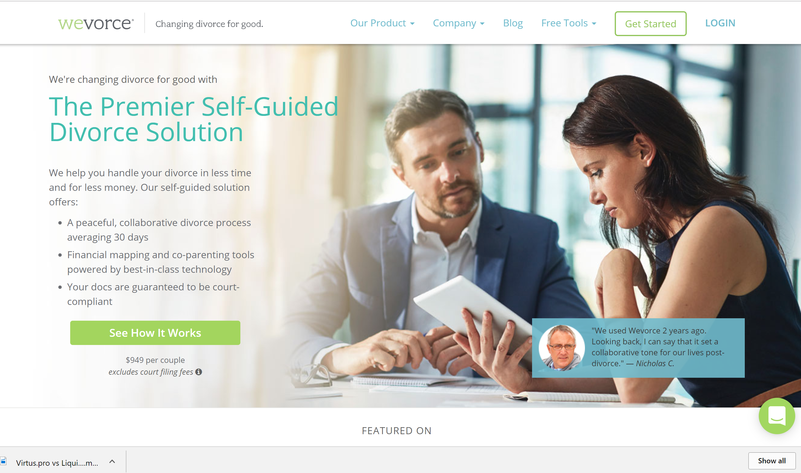
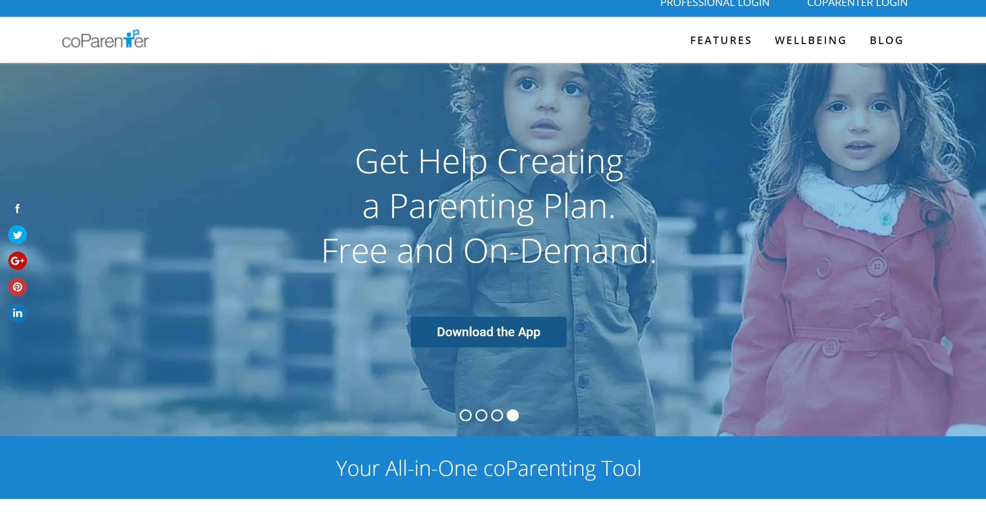
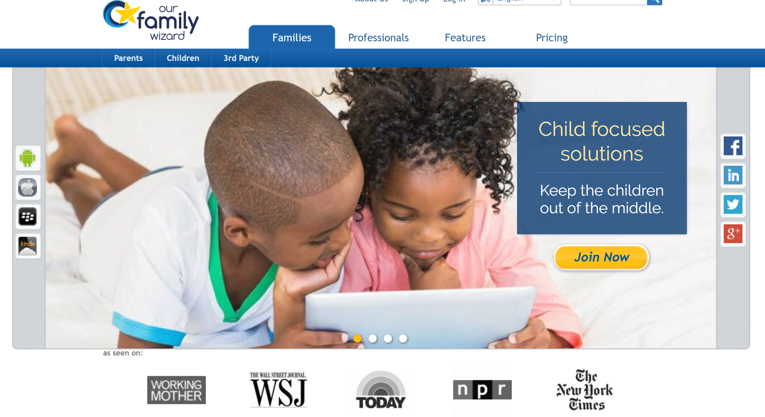
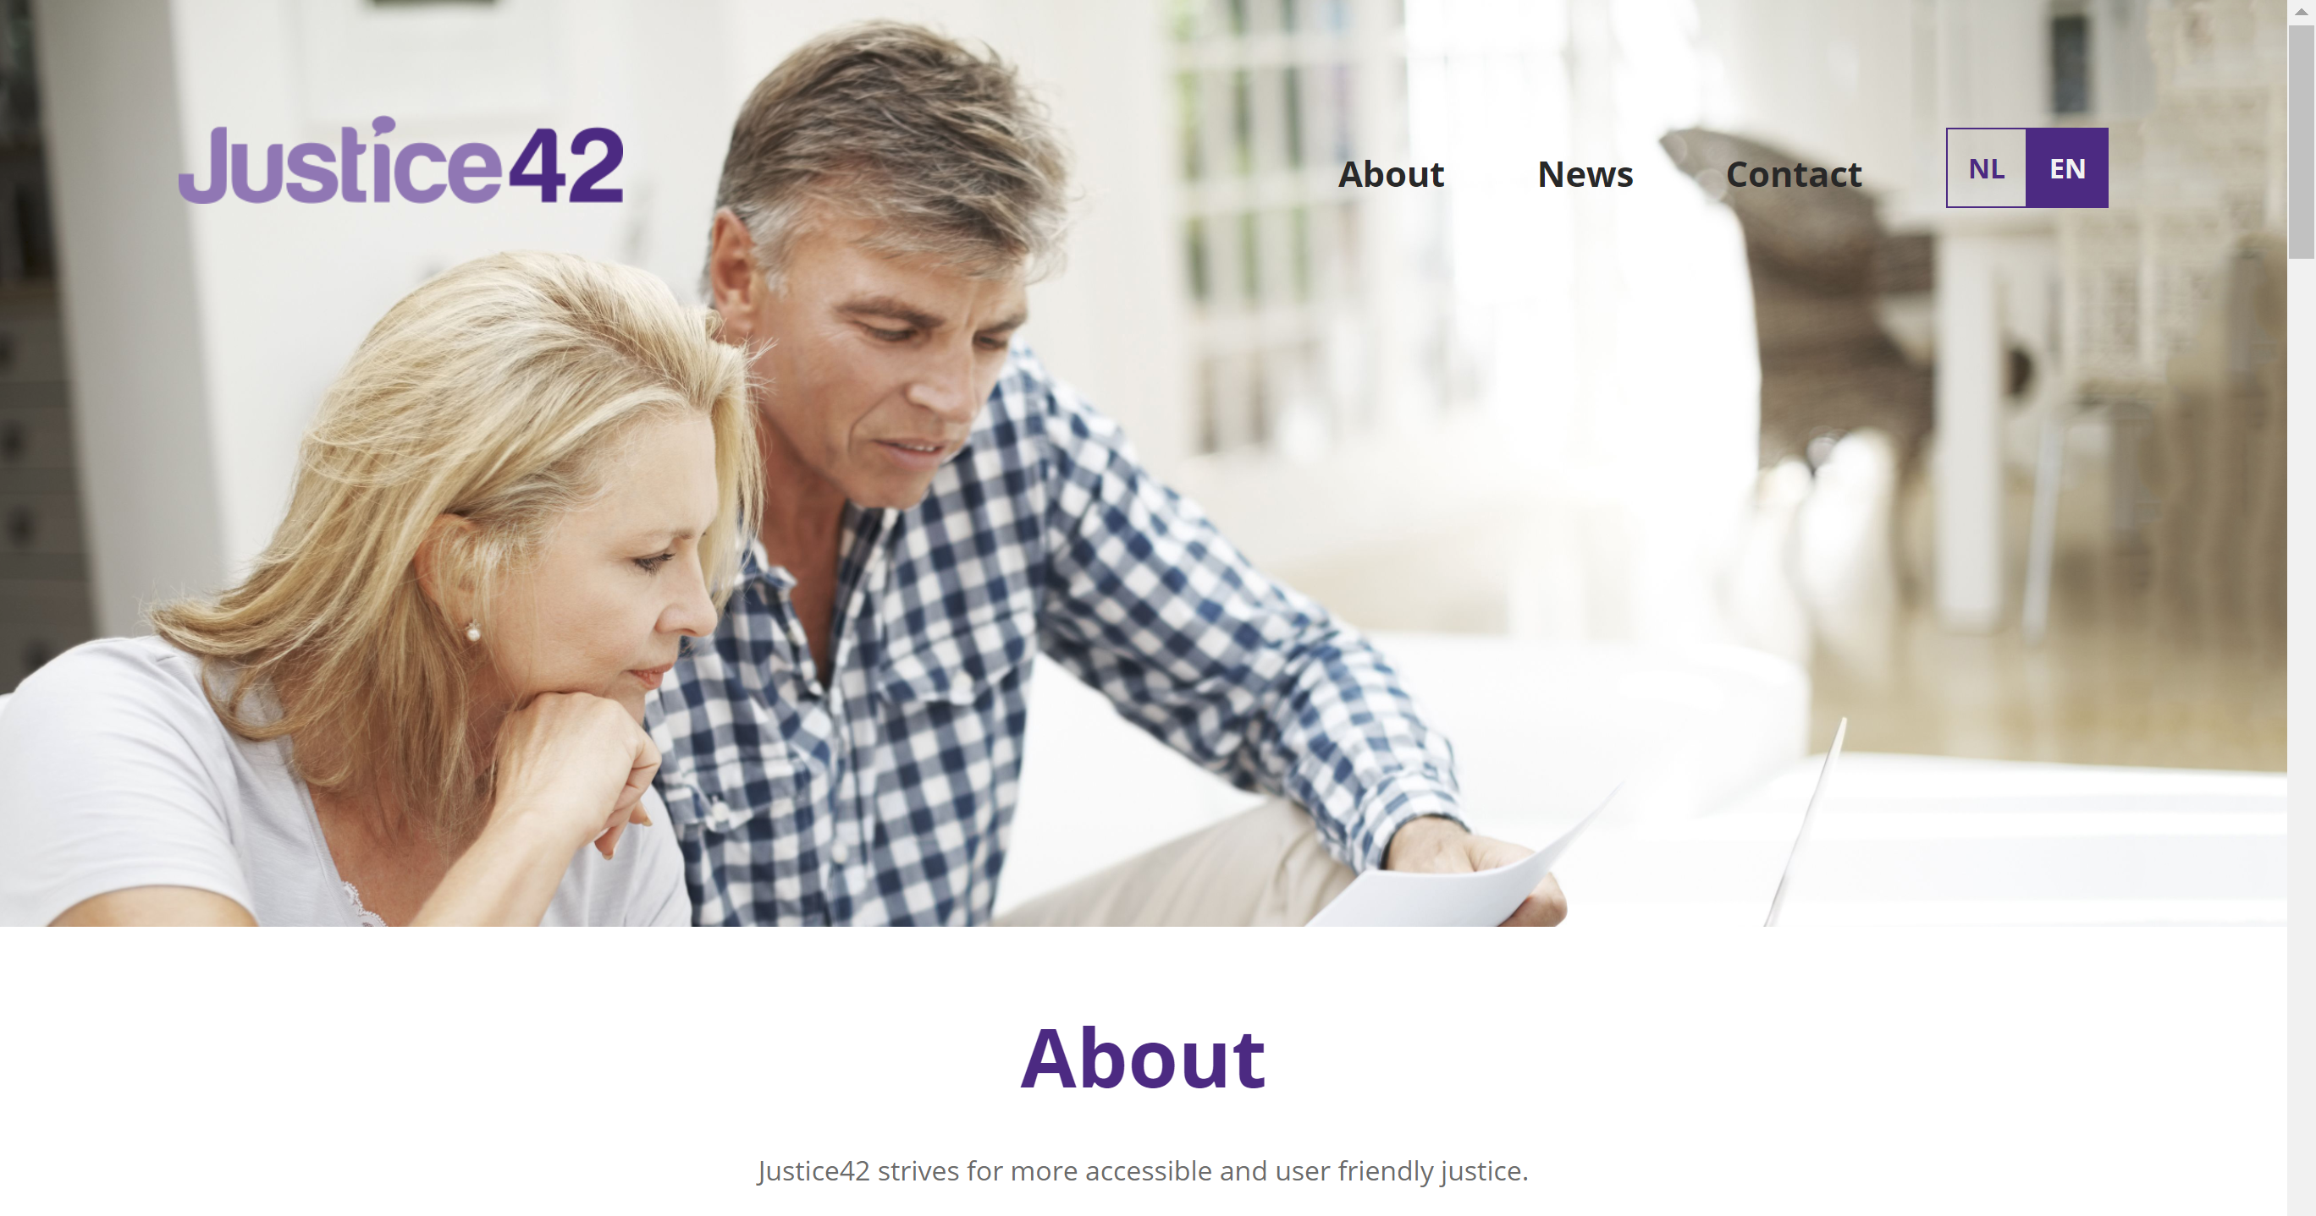
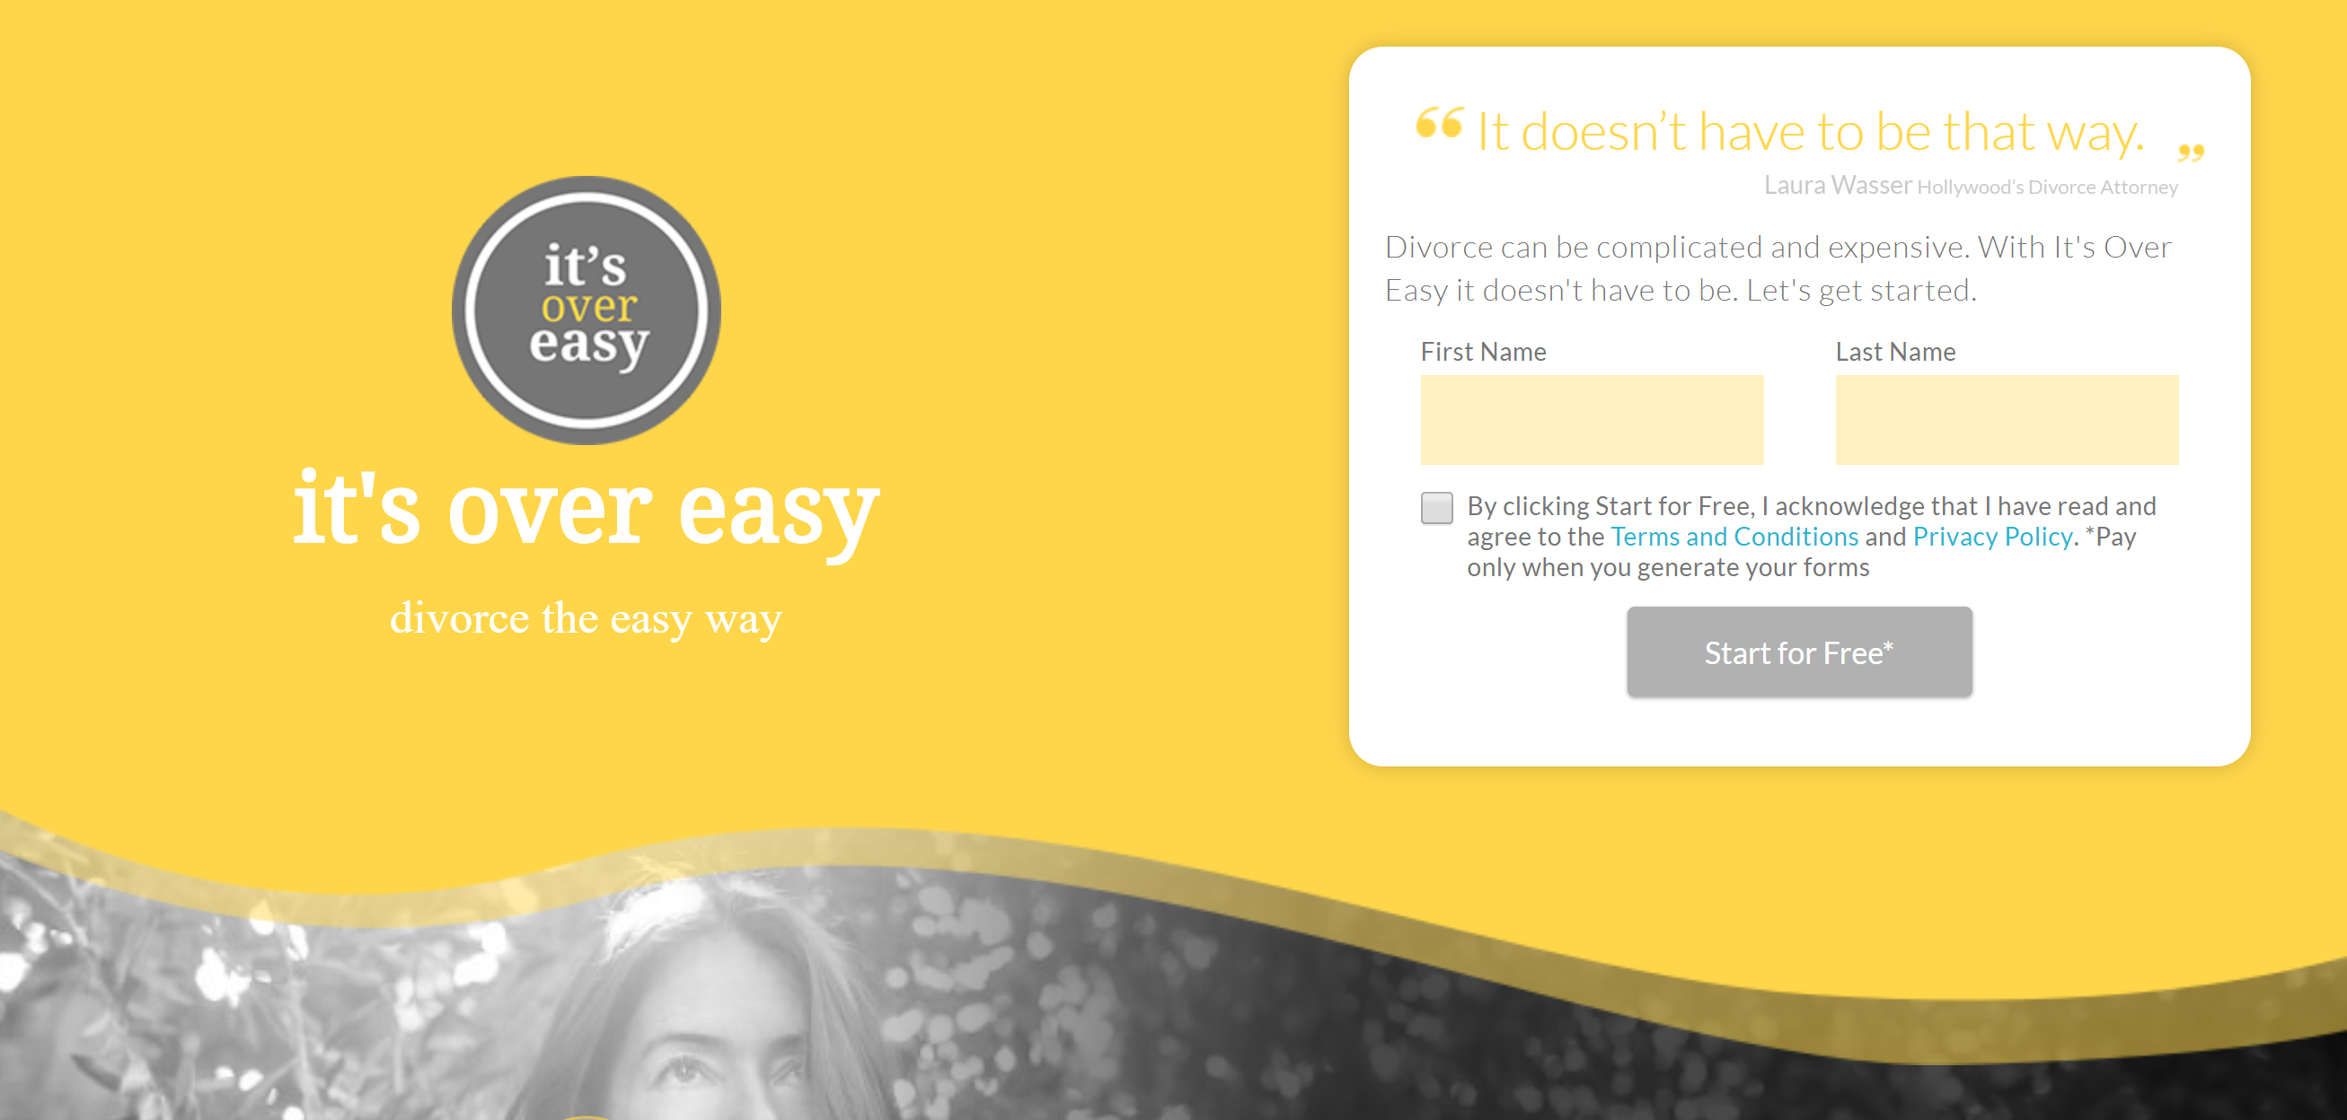
ODR Platforms for Family

