Slide 1
Online
Dispute
Resolution
Expanding Access to Justice

Slide 2
Reimagining civil justice

Slide 3
Notes:
Some of you might be wondering why we need to "Reimagine Civil Courts".
Think about this perspective
The image on the left shows an OR 100 years ago. Can you imagine a dr that practiced back them stepping into an OR today. They would probably think it was amazing but couldn’t even begin to do what needs to be done.

Slide 4
Notes:
An attorney from 100 years ago would be able to step into a courtroom and mostly be able to function without issues because the practice of law hasn't changed much over those 100 years.
The time is now to start rethinking how this should work.

Slide 5
Endless stacks of cases. Slow time to resolution. Budgets are tight. Citizens and staff are frustrated.
A growing number of self-represented litigants that don’t understand the court process.
Higher expectation from citizens driven by technology.

Slide 6
Some potential ODR case types
Landlord & tenant
Small claims
Custody / Parenting Plans
Debt collection
Construction / Repairs
Condo / Homeowners Association
Traffic
Civil contracts

Slide 7
Dispute-related workflow without ODR
Hearing
Court Decision
Dispute?
File & Serve
File into Court
Settlement
reached?
Settlement Agreement Filed into Case
Court Official Signs

Slide 8
Dispute-related workflow with ODR
Hearing
Court Decision
Dispute?
File & Serve
File into Court
Settlement
reached?
Settlement Agreement Filed into Case
Court Official Signs

Slide 9
Lifecycle of a Case*
Case Filed
Final Order
Answer Filed
Proposed Order
Hearing Set
Hearing(s) Held
Paper Filing
120 Days
&
*Based on NCSC Time Standards
Notes:
Your process may be different, but this is an example of a timeline of activity that happens on a small claims case.
Filings are coming into the Clerk’s office via paper or through an electronic means, like Guide & File and File & Serve.
Once the clerk accepts those documents, the case is filed.
The defendant is notified of the filing, files their answer or counterclaim, and a hearing is set for some time in the future.
The wonderful thing about

Slide 10
Lifecycle of a Case*
Case Filed
Final Order
Answer Filed
Proposed Order
Hearing(s) Held
50%
Paper Filing
60 Days
&
Time savings
*Based on NCSC Time Standards
Party-Party Negotiation
Mediation
Settlement?
Notes:
Your process may be different, but this is an example of a timeline of activity that happens on a small claims case.
Filings are coming into the Clerk’s office via paper or through an electronic means, like Guide & File and File & Serve.
Once the clerk accepts those documents, the case is filed.
The defendant is notified of the filing, files their answer or counterclaim, and a hearing is set for some time in the future.
The wonderful thing about

Slide 15
Ranged Offers

Slide 18
Case Study 2018 Clark County
Population
2,156,724
Ranking
12th largest county in U.S. by population
Courts
20 family courts
32 civil/criminal courts
More than 600 court employees

Slide 19
Overview of the Family Mediation Center
Staff
Equivalent of 11 full time mediators
Cases
~3,900 cases annually mediated
Time
Typically 21-28 days for first in-person mediation appointment
Plans
Parenting plans include, custody, vacation time, holidays, exchanges
Settlements
Average settlement rate of 71%
Notes:
10 full-time when fully staffed plus 2 part-time

Slide 20
Program implementation overview
Contested child custody parenting plans
Family mediation center allows negotiation phase for free and still charges for the mediation phase during the pilot
Pilot currently with 3 family courts with remaining to be added periodically
Short timeframe of 3 calendar days for each party to engage
Mandatory mediation ordered by the judges for all child custody cases

Slide 22
Plaintiff/Petitioner

Slide 23
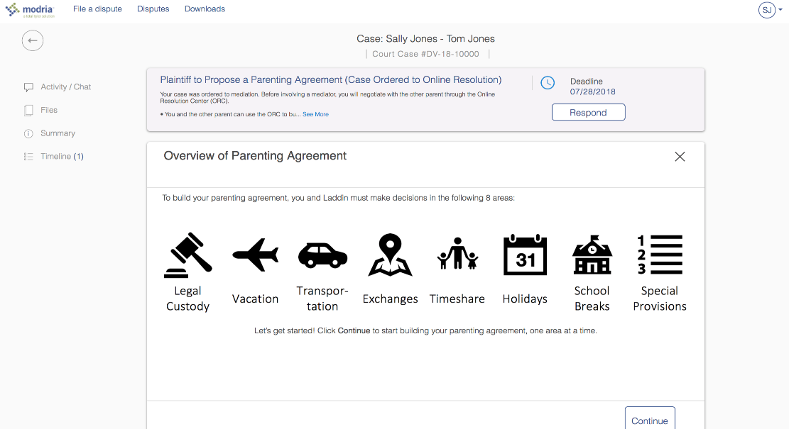
Plaintiff/Petitioner

Slide 24
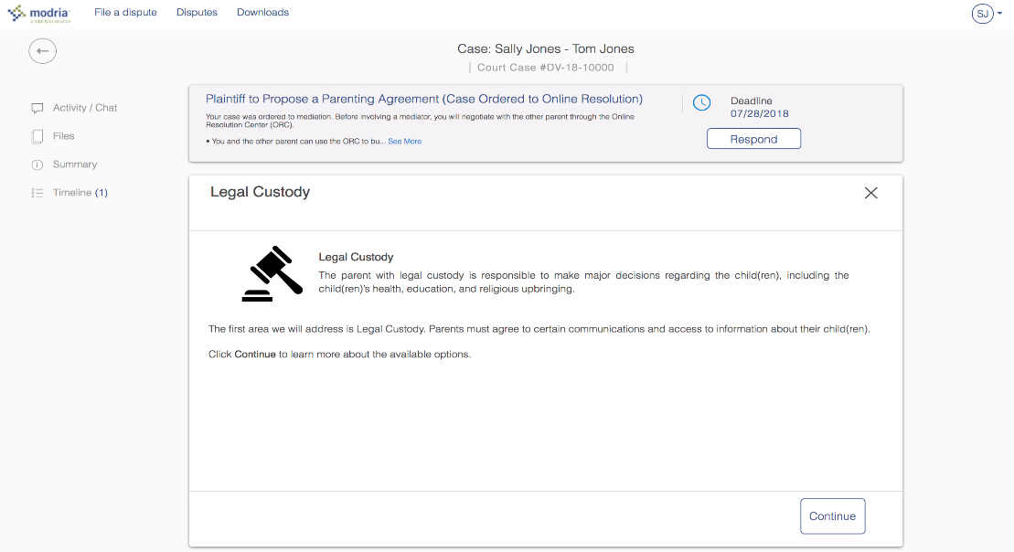
Plaintiff/Petitioner

Slide 25
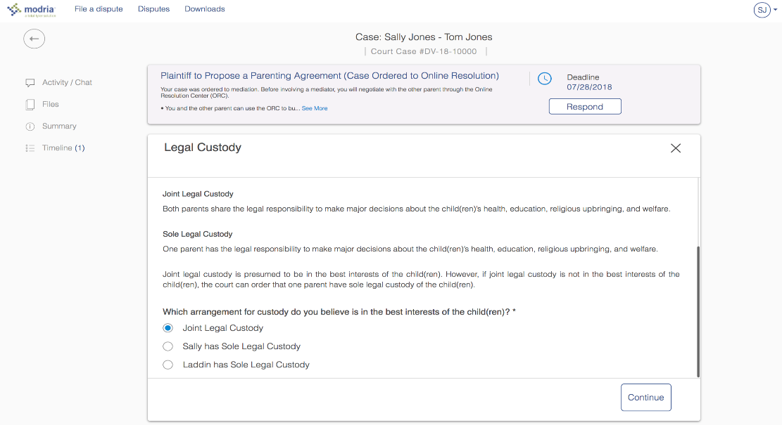
Plaintiff/Petitioner

Slide 26
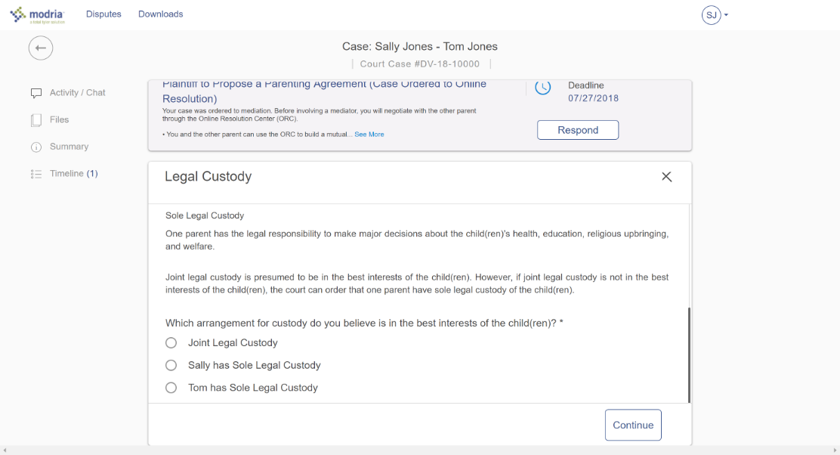
Plaintiff/Petitioner

Slide 27
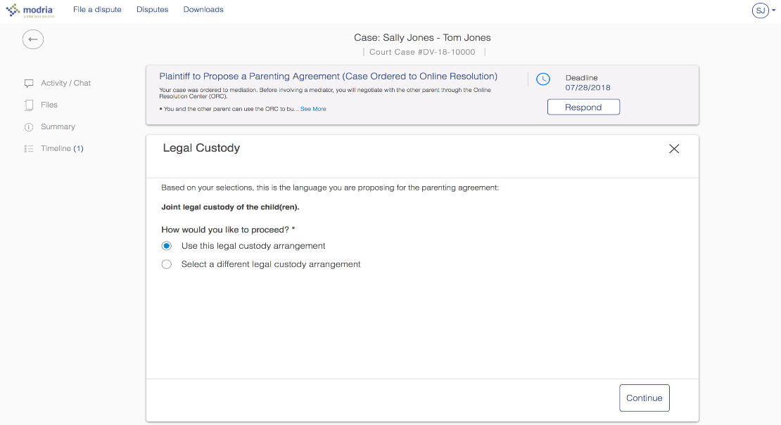
Plaintiff/Petitioner

Slide 28
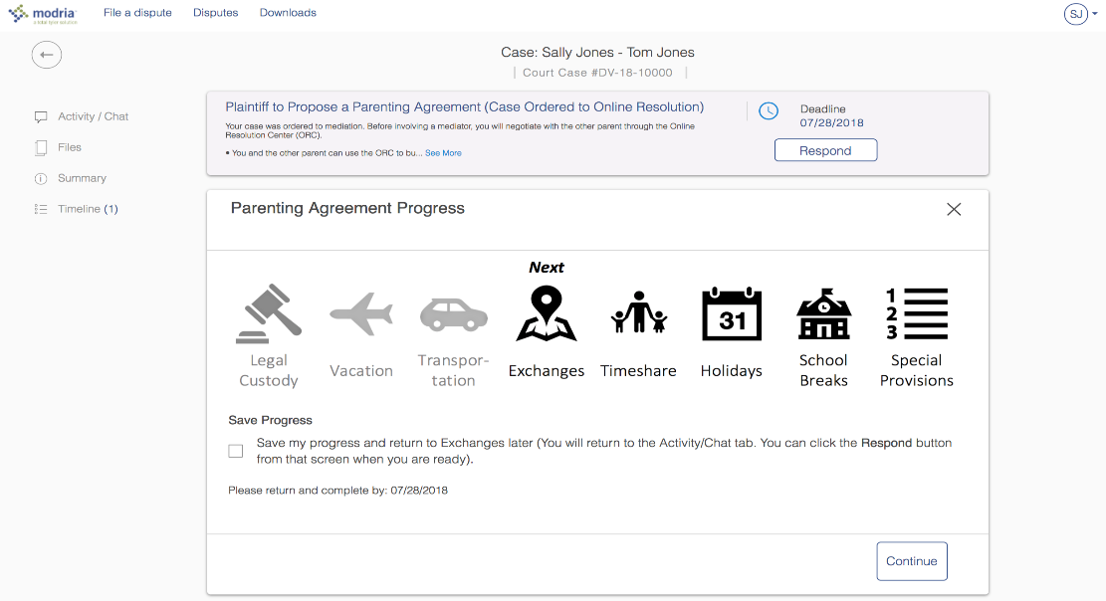
Plaintiff/Petitioner

Slide 29
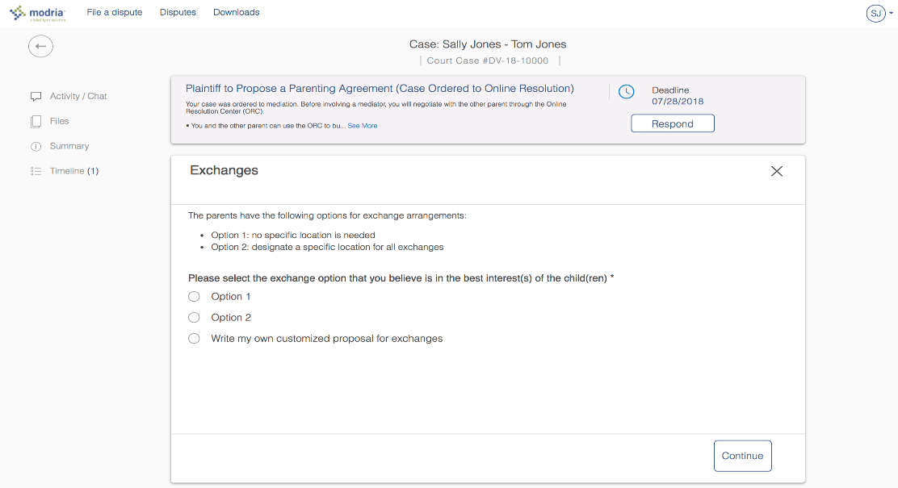
Plaintiff/Petitioner

Slide 30
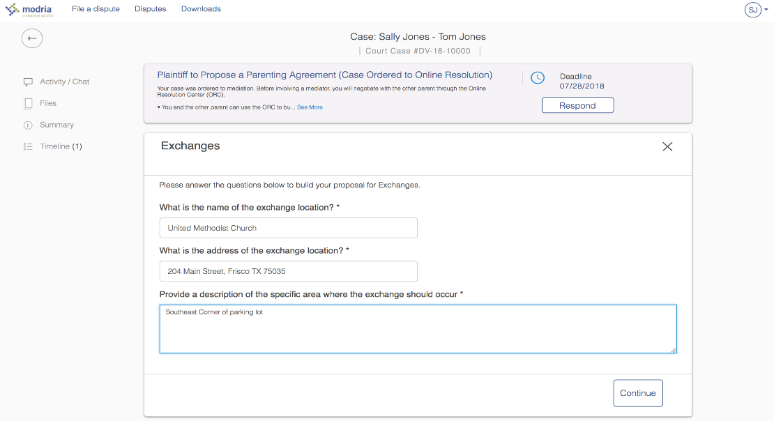
Plaintiff/Petitioner

Slide 31
Defendant/Respondent

Slide 32
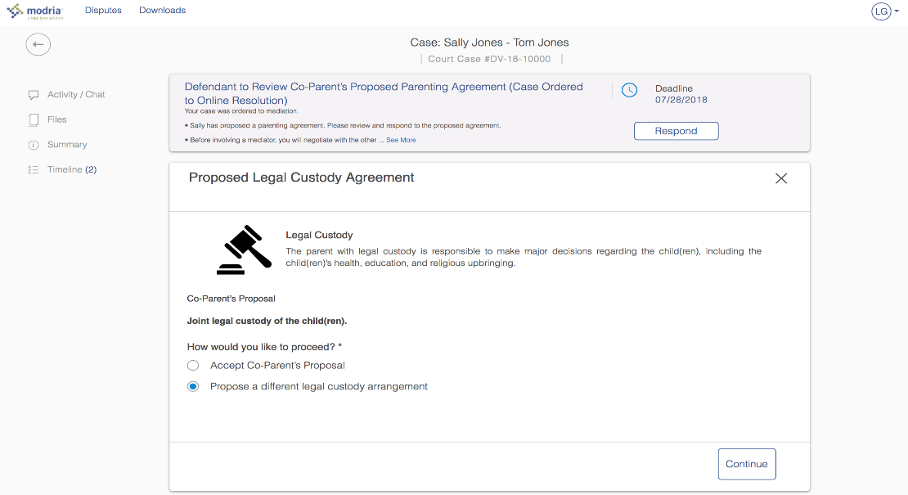
Defendant/Respondent

Slide 33
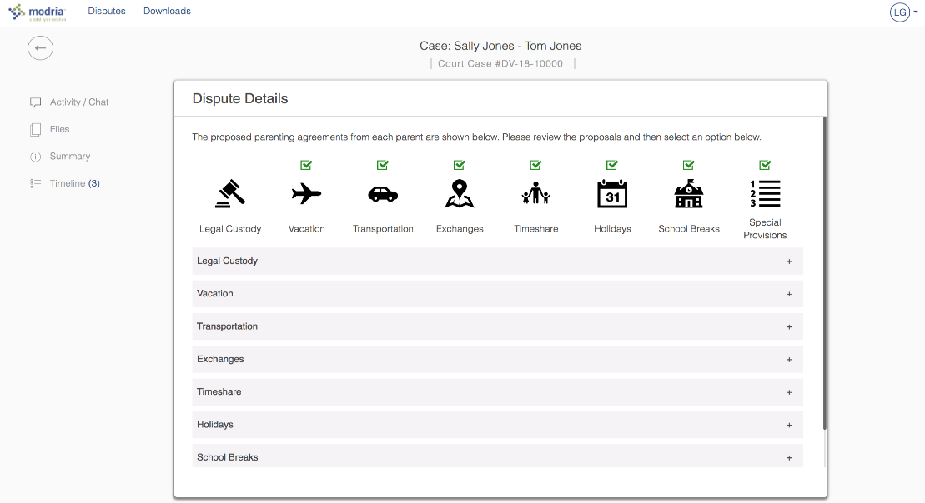
Defendant/Respondent

Slide 34
Mediator

Slide 35
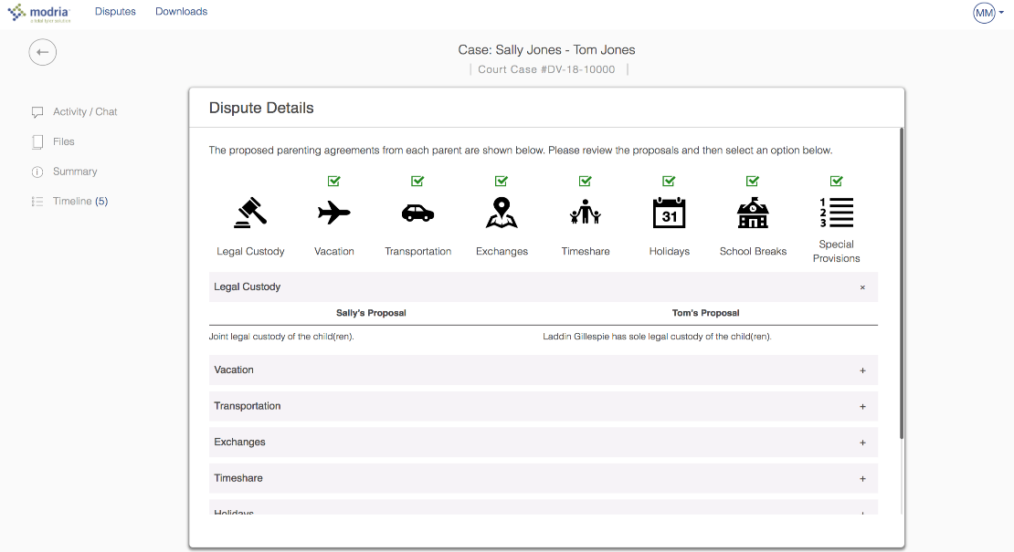
Mediator

Slide 36
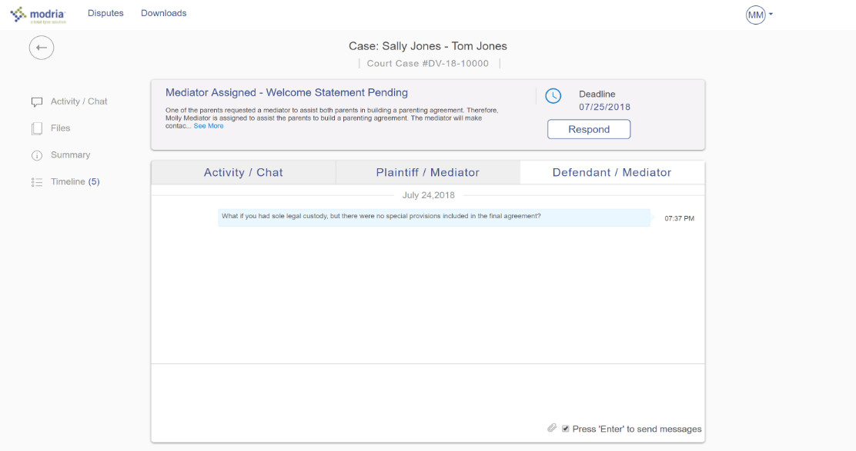
Mediator

Slide 37
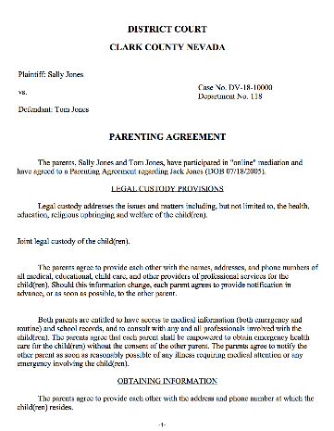
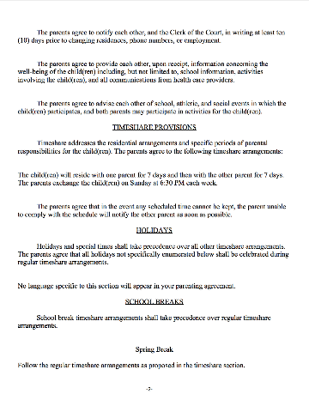
Customized outcome agreements based on selections
Agreements: Full agreements, partial agreements, or non-settlement agreements generated based on outcome
Signatures: Electronic signature component
Electronic filing: Integration with ECF 4.01 e-Filing systems

Slide 40
Analysis of Early Results
Notes:
Parties can select multiple reasons for lack of engagement
Feedback is helping refine the pilot offering (i.e. Mobile site updates and extended deadline)

Slide 41
Parenting plan participation results for one year
36% voluntary participation
Includes participation from both plaintiff and defendant
36%
Notes:
Now lets look at the impact on a year of usage for parenting plan disputes.

Slide 42
Outcomes of completed parenting plan disputes
Full Agreement – party to party
No Agreement
23%
2%
Completed online agreements
Mediator efficiencies expected
ODR is expanding access to justice
75%
Partial Agreement
*Based on cases where both parties participated

Slide 43
Average timeline to resolution
Week
Court Trial Date
1
4
6
7
2
5
8
3
In-Person Mediation Appointment
Modria
Notes:
In court – assumed about 60 days for trial scheduling
In person mediation – assumed 30 days on average over the last year
ODR – averaged 6 days
2 days shortest

Slide 44
Parties that successfully negotiated a full parenting agreement averaged only 6 days and the fastest was 2 days

Slide 45
Participation results based on final agreement
84% of agreements reached outside of court hours
Includes agreements reached with and without a mediator
84%
Notes:
In my opinion this number is one of the best measurements to show the need to additional access to justice. The citizens we are serving are clearly showing their need for things that can happened outside of curt business hours.
Courts don't have budget or desire to be open 24X7X365 but the litigants are proving the need for this.

Slide 46
ODR mediator skills
Multitasking
Crafting language carefully
When and how to caucus
Constant communication / high touch
Balancing power differentials
Leveraging outside information and resources

Slide 47
Online Active Listening
Using text vs. non-verbals
Utilizing affirming language
Providing quick responses
Re-stating and re-framing
Avoiding language that can be misinterpreted
Constant communication / memorializing progress
Leveraging caucusing to prove key points are heard

Slide 48
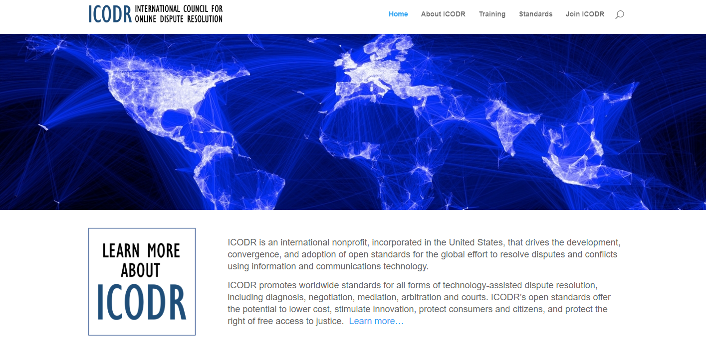
Getting Involved
Notes:
Court disputes (low value civil cases: e.g. divorce, tenant)
Public disputes (e.g. Property Tax Appeals)
Insurance (e.g. AAA NYNF Process)
Product liability (e.g. Pharmaceuticals)
Consumer (e.g. Ombuds offices, UK CAA)
eCommerce disputes (payments, marketplaces, merchants)

Slide 50
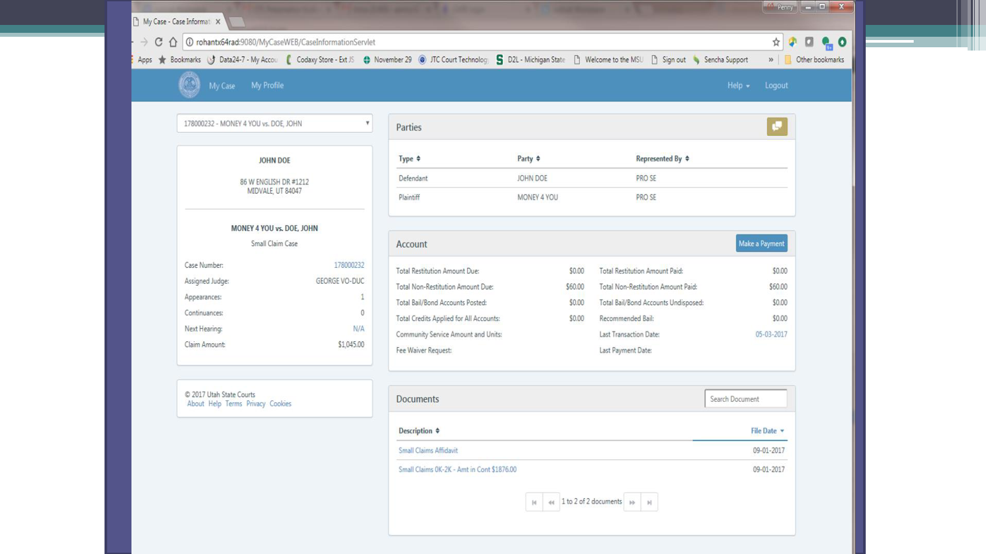

Slide 51
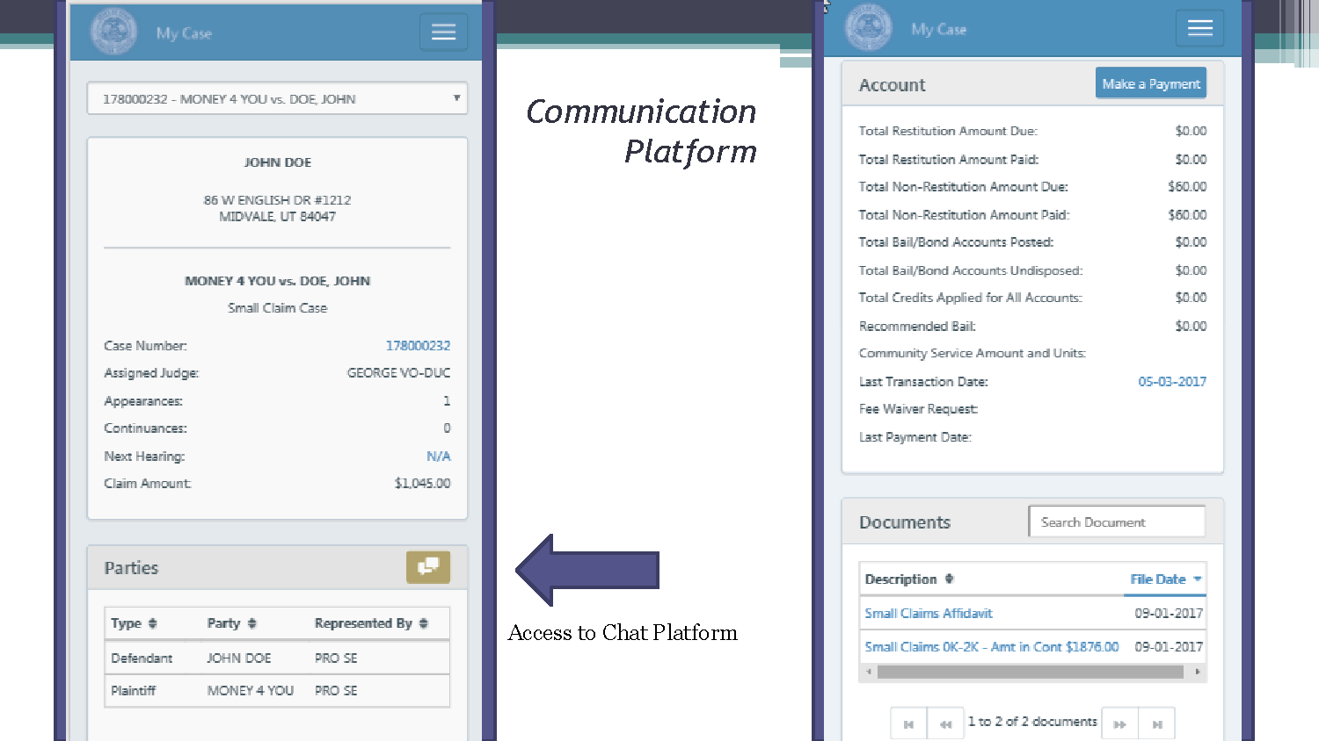

Slide 55
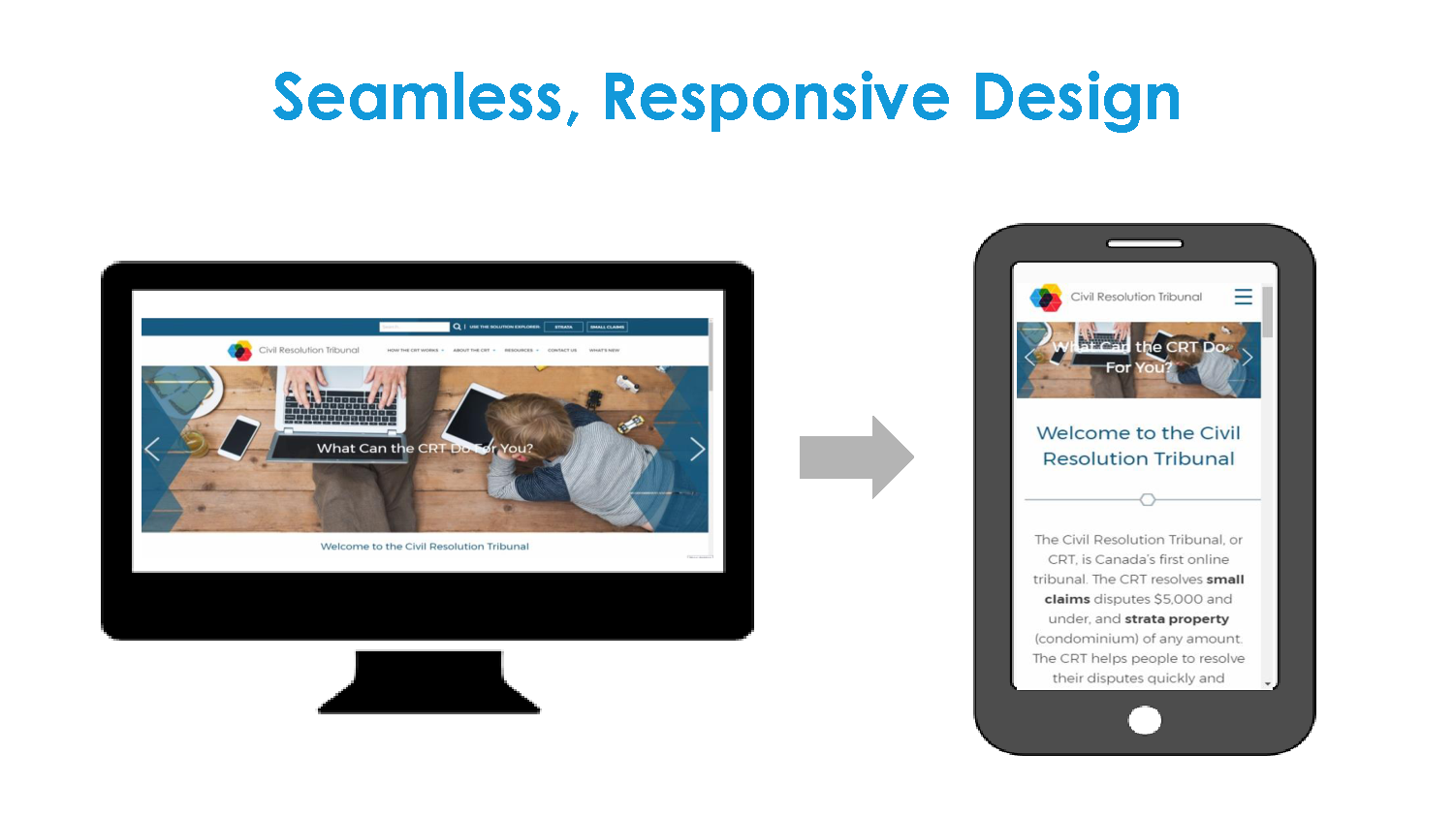

Slide 56
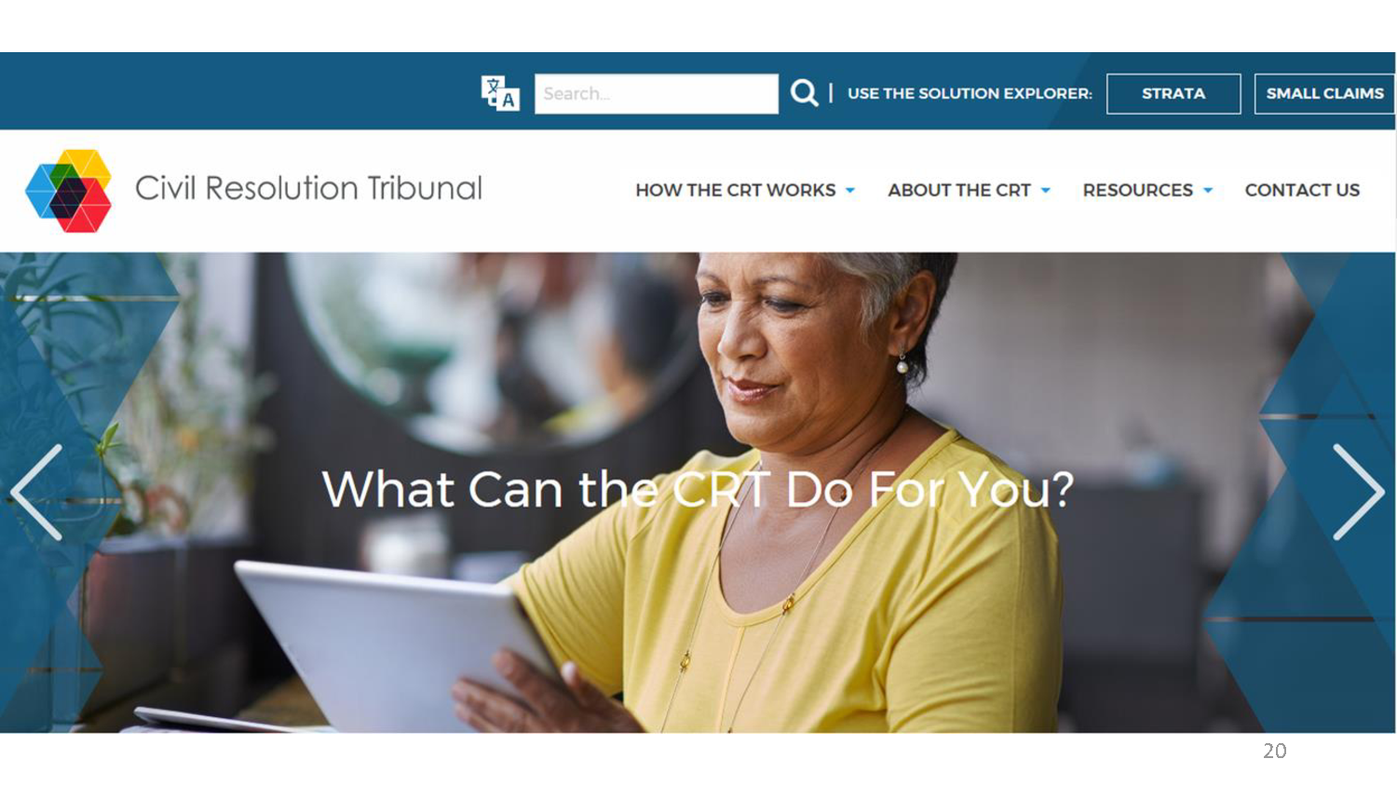

Slide 57
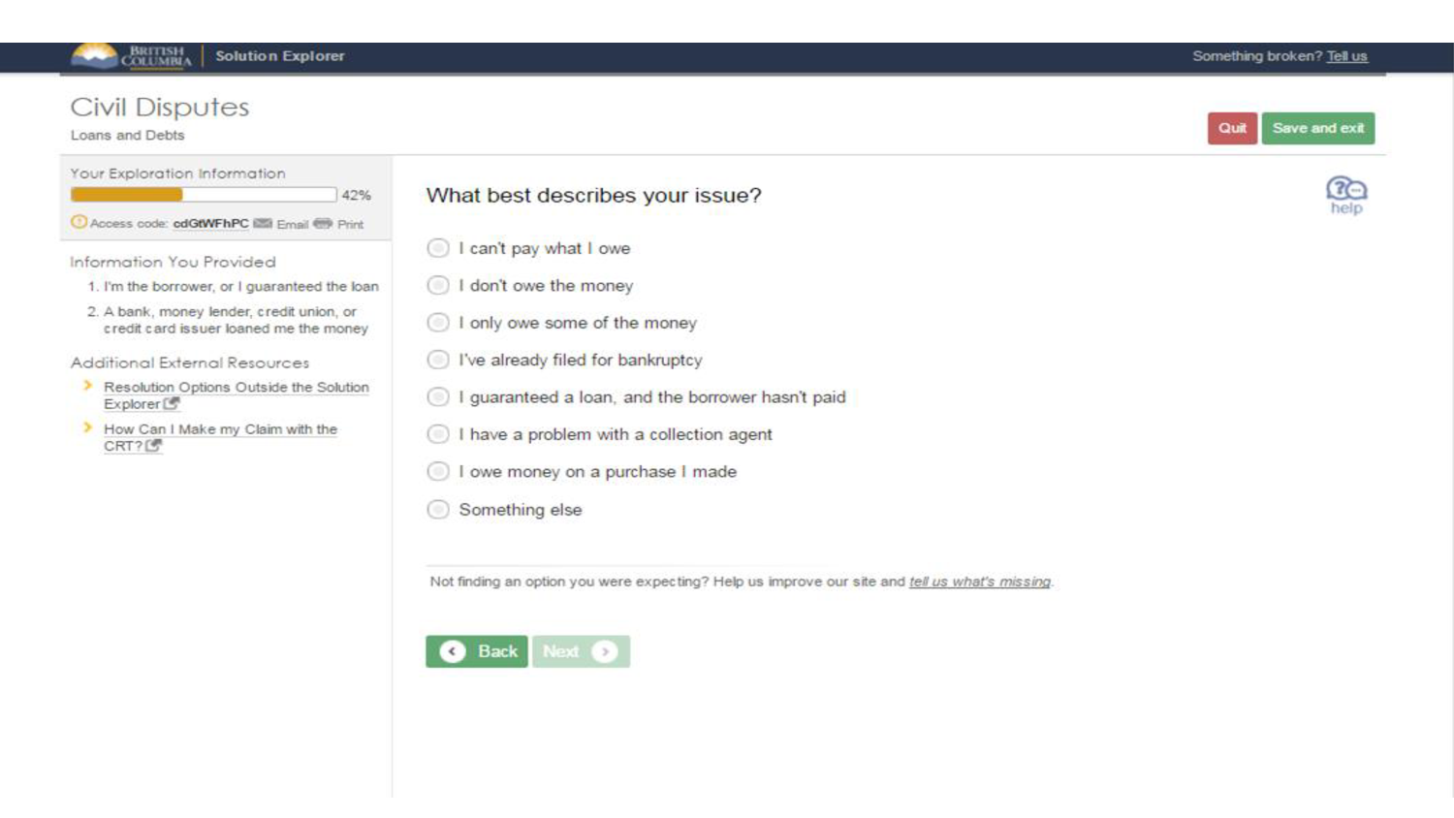

Slide 58
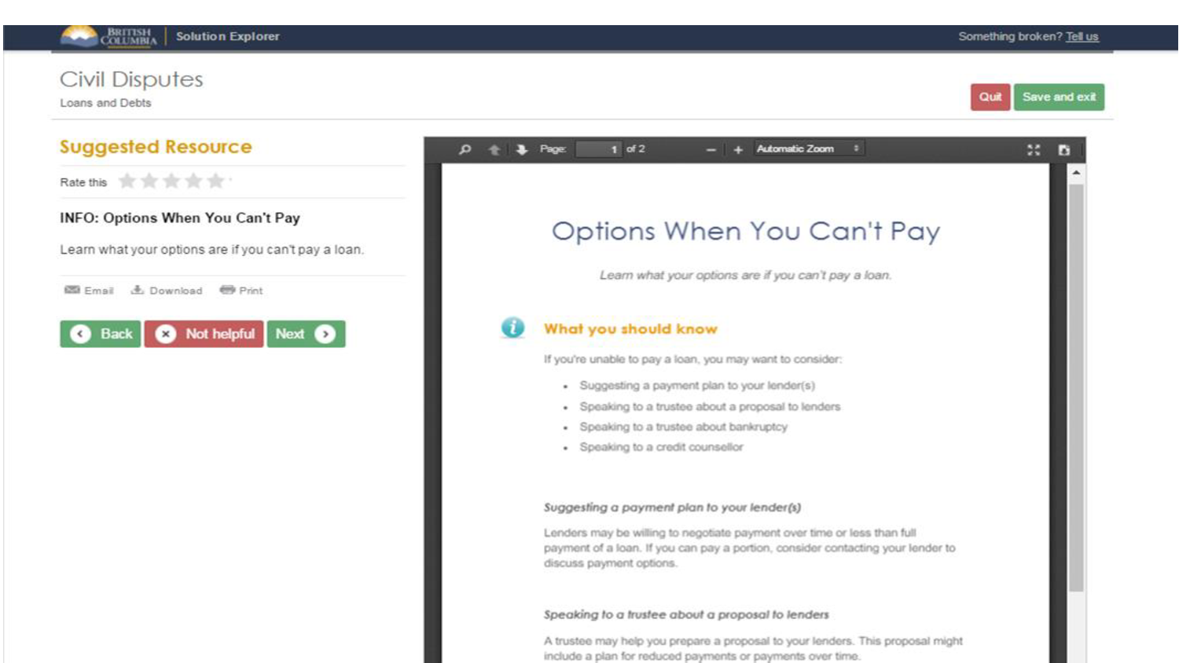

Slide 59
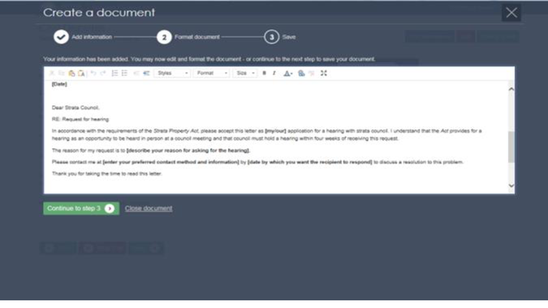

Slide 60
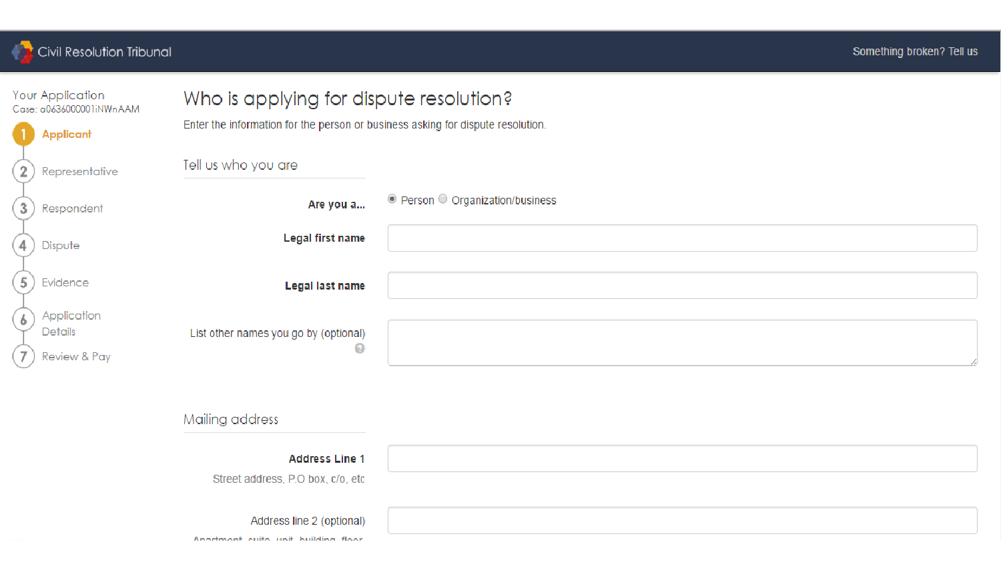

Slide 61
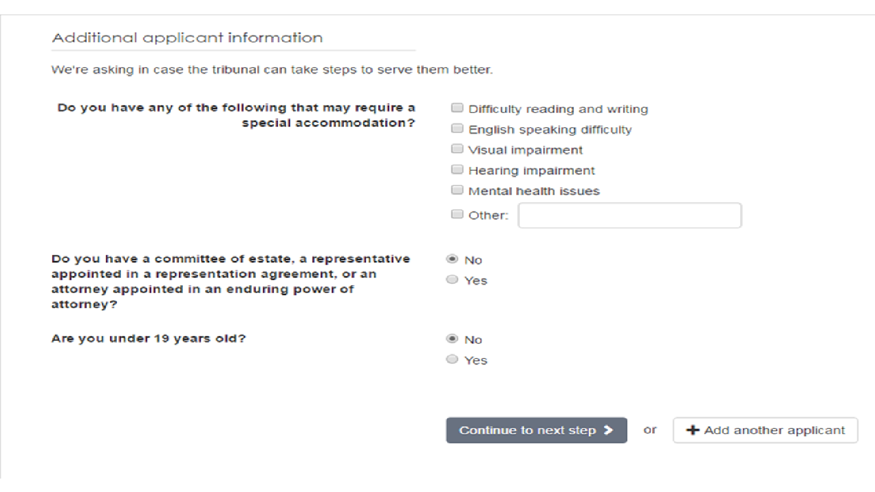

Slide 65
