Slide 1
Prepare for the Future:
Artificial Intelligence and its Impact on the Future of Justice

Slide 2
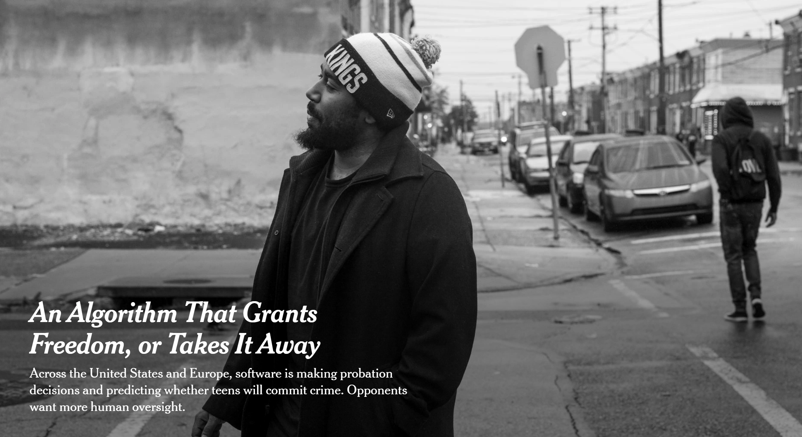

Slide 3
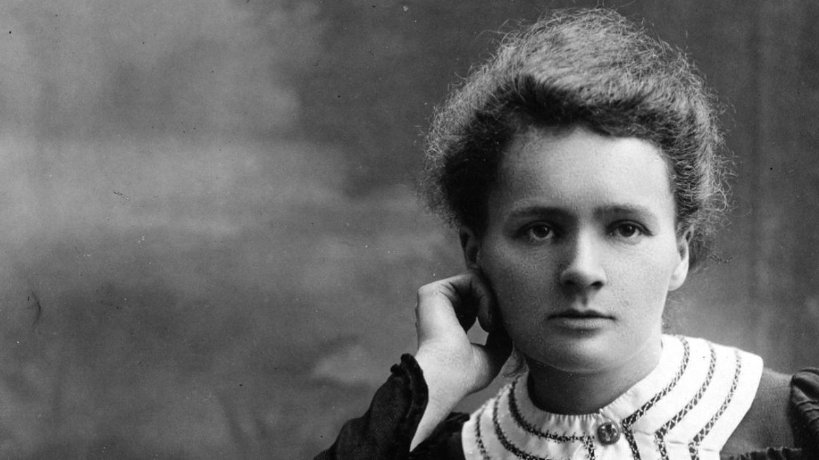
Marie Curie
Notes:
Marie Curie was the first woman to be awarded a Nobel Prize, the first person to get the Nobel prize twice. And the only person to win the Nobel Prize in two different scientific fields --Physics and Chemistry. Along with her husband Pierre, she discovered the element Radium and did pioneeingr research on radioactivity. The effects of radiation were not well understood then. Exposure to radationimpacted her health and cost her her life.

Slide 4
Notes:
Once radium moved from the lab to production it was available to manufacturers to use in different ways.

Slide 5
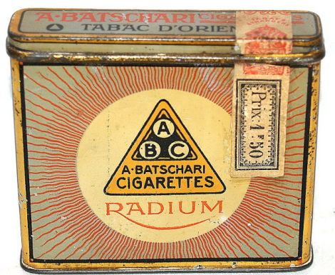
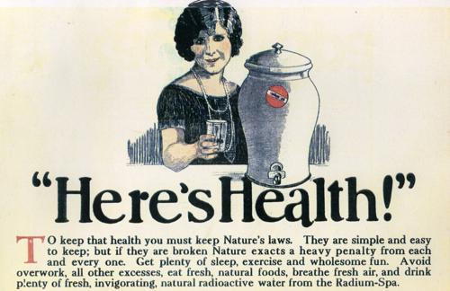
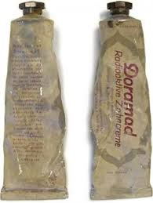
Notes:
And they did. It was used in cosmetics, cigarettes, and toothpaste.Sometimes the name was just slapped on even if the product did not have radium.

Slide 6
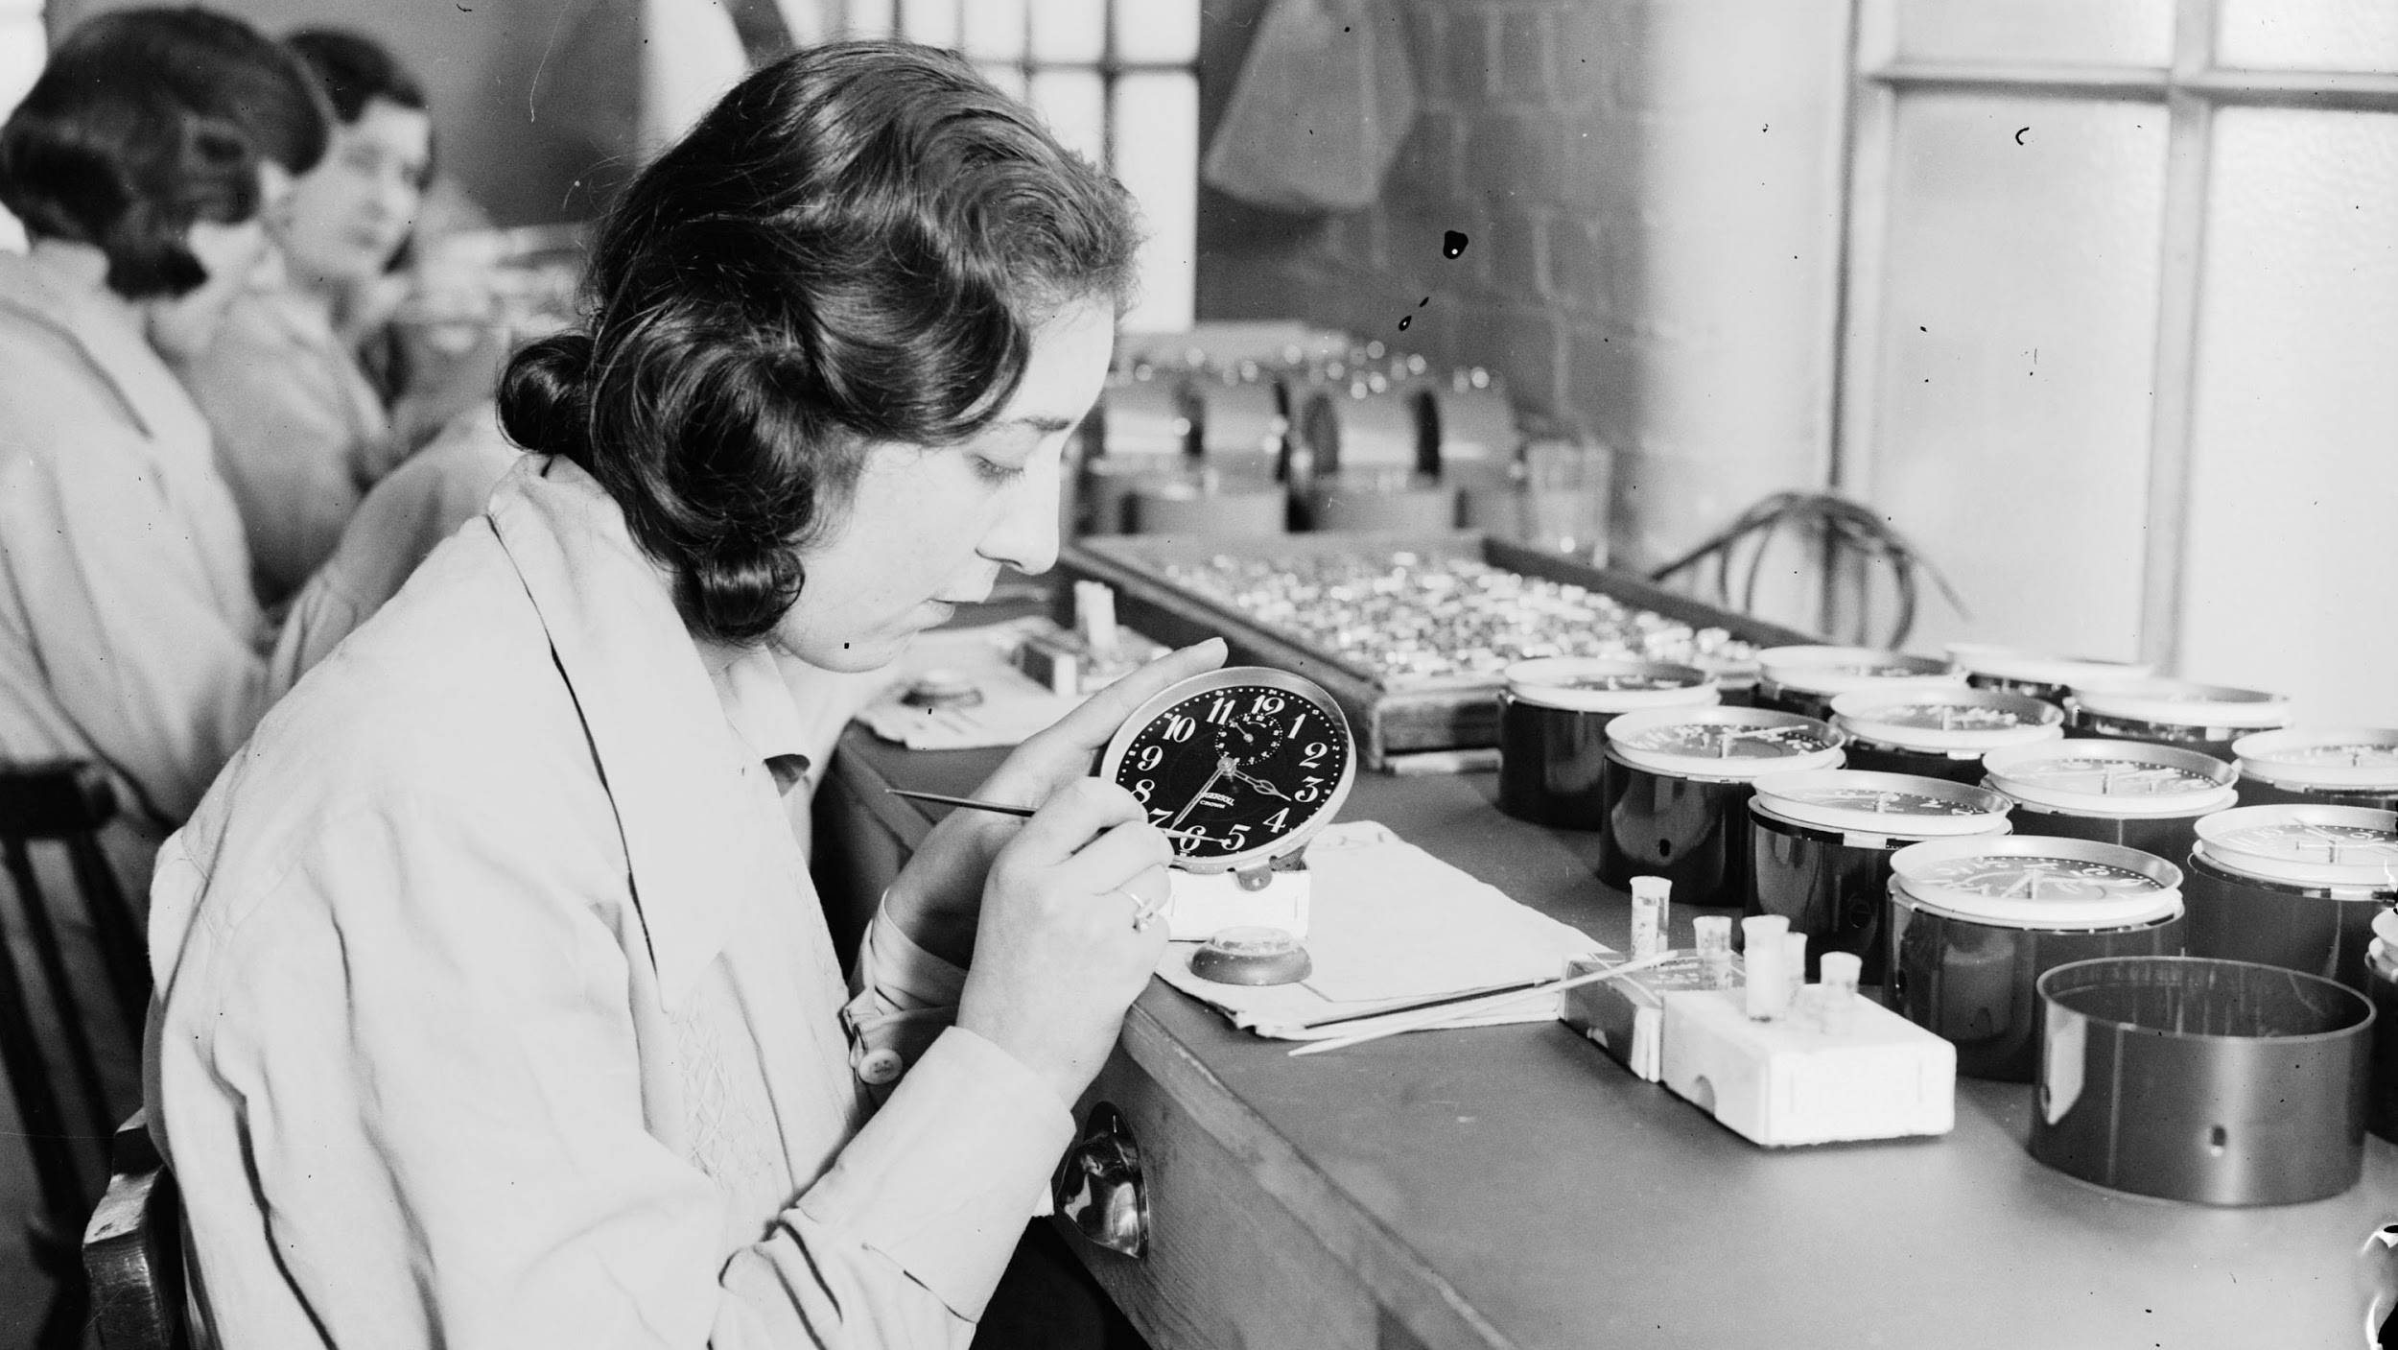
Source: Wikipedia - “Radium Girls”
Notes:
It was used on clocks and watches to make the numerals and hands glow in the dark. The workers who hand painted the dials were told it was safe and they were given no protection. Their health suffered and many died at an early age. It took time and work to understand the effects of radioactivity, to learn how to protect against it. Today radium is used in limited industrial and medical use.

Slide 7
Notes:
New advancements in science and technology follow the trajectory of discovery, excitement, hype. Then slowly we understand its impact and how and where to use it.

Slide 8
A I
Notes:
AI may be on the same trajectory. AI is an tmbrella term that’s used for several technologies including machine learning, natural language processing (NLP), facial recognition. These technologies are evolving at a rapid rate and we are just beginning to understand their potential and dangers. And we are beginning to ask the difficult question -- which tasks that are currently done by humans CAN or SHOULD be done by machines?

Slide 9
Notes:
WHAT ARE WE TALKING ABOUT?
HOW DOES IT WORK?
Simple description for purposes here
‘Learn’ is in quotations because it is not learning they way humans do
‘predict’, and not ‘recommend’ to remind us this is usually statistics and correlation,
NOT reasoning or causation
TALKING ABOUT AI TOOLS THAT MAKE DECISIONS AFFECTING PEOPLE’S LIVES,
NOT TOOLS CONTROLLING MACHINES, IoT, ETC.

Slide 10
Notes:
WHAT ARE WE TALKING ABOUT?
HOW DOES IT WORK?
Simple description for purposes here
‘Learn’ is in quotations because it is not learning they way humans do
‘predict’, and not ‘recommend’ to remind us this is usually statistics and correlation,
NOT reasoning or causation
TALKING ABOUT AI TOOLS THAT MAKE DECISIONS AFFECTING PEOPLE’S LIVES,
NOT TOOLS CONTROLLING MACHINES, IoT, ETC.

Slide 11
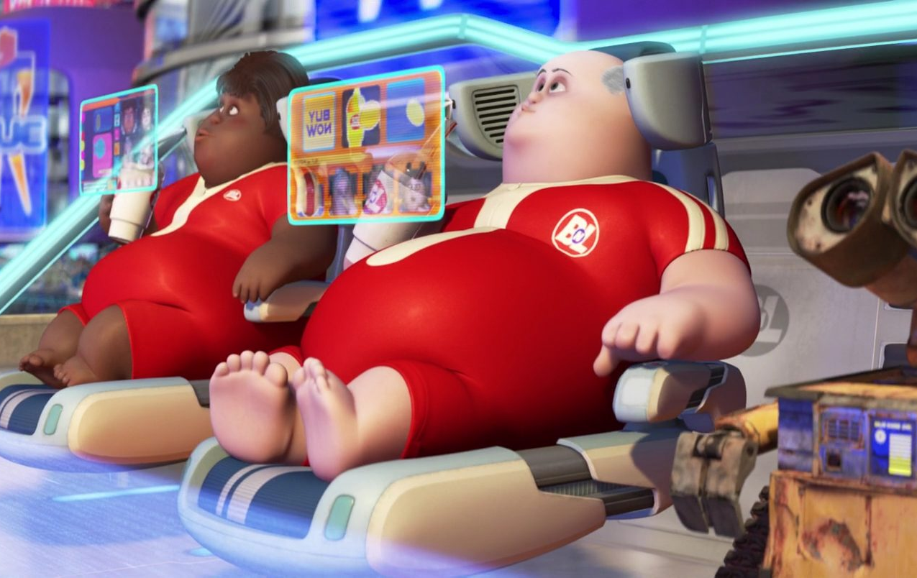
Notes:
WHAT ARE WE TALKING ABOUT?
HOW DOES IT WORK?
Simple description for purposes here
‘Learn’ is in quotations because it is not learning they way humans do
‘predict’, and not ‘recommend’ to remind us this is usually statistics and correlation,
NOT reasoning or causation
TALKING ABOUT AI TOOLS THAT MAKE DECISIONS AFFECTING PEOPLE’S LIVES,
NOT TOOLS CONTROLLING MACHINES, IoT, ETC.

Slide 12
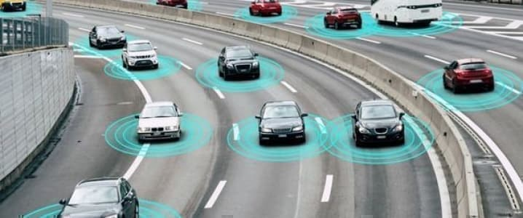
Notes:
WHAT ARE WE TALKING ABOUT?
HOW DOES IT WORK?
Simple description for purposes here
‘Learn’ is in quotations because it is not learning they way humans do
‘predict’, and not ‘recommend’ to remind us this is usually statistics and correlation,
NOT reasoning or causation
TALKING ABOUT AI TOOLS THAT MAKE DECISIONS AFFECTING PEOPLE’S LIVES,
NOT TOOLS CONTROLLING MACHINES, IoT, ETC.

Slide 13
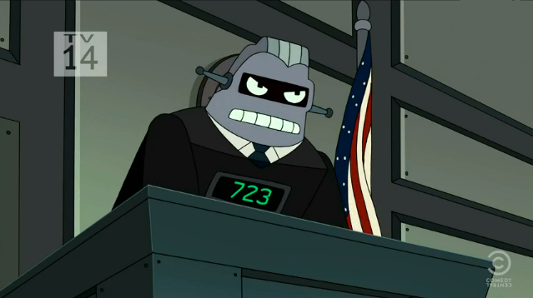
Notes:
WHAT ARE WE TALKING ABOUT?
HOW DOES IT WORK?
Simple description for purposes here
‘Learn’ is in quotations because it is not learning they way humans do
‘predict’, and not ‘recommend’ to remind us this is usually statistics and correlation,
NOT reasoning or causation
TALKING ABOUT AI TOOLS THAT MAKE DECISIONS AFFECTING PEOPLE’S LIVES,
NOT TOOLS CONTROLLING MACHINES, IoT, ETC.

Slide 14
Notes:
WHAT ARE WE TALKING ABOUT?
HOW DOES IT WORK?
Simple description for purposes here
‘Learn’ is in quotations because it is not learning they way humans do
‘predict’, and not ‘recommend’ to remind us this is usually statistics and correlation,
NOT reasoning or causation
TALKING ABOUT AI TOOLS THAT MAKE DECISIONS AFFECTING PEOPLE’S LIVES,
NOT TOOLS CONTROLLING MACHINES, IoT, ETC.

Slide 15
“There’s nothing artiﬁcial about AI. It’s inspired by people,
it’s created by people, and—most importantly— it impacts people. ”
— Fei-Fei Li
Source: https://www.wired.com/story/fei-fei-li-artiﬁcial-intelligence-humanity/
Notes:
SOURCE OF QUOTE: “Artificial Intelligence: Do stupid things faster with more energy!”, at: https://towardsdatascience.com/artificial-intelligence-do-stupid-things-faster-with-more-energy-379aa6bac220

Slide 16
How does AI work?
AI methods ‘learn’ by observation, essentially pattern recognition, and generate a decision-making tool that predicts an outcome based on input values
Notes:
WHAT ARE WE TALKING ABOUT?
HOW DOES IT WORK?
Simple description for purposes here
‘Learn’ is in quotations because it is not learning they way humans do
‘predict’, and not ‘recommend’ to remind us this is usually statistics and correlation,
NOT reasoning or causation
TALKING ABOUT AI TOOLS THAT MAKE DECISIONS AFFECTING PEOPLE’S LIVES,
NOT TOOLS CONTROLLING MACHINES, IoT, ETC.

Slide 17
Sample Data
Correlation
Computer
Expected Result
Learning
Prediction
New Data
Result
Computer
Model

Slide 18
Notes:
WHAT ARE WE TALKING ABOUT?
HOW DOES IT WORK?
Simple description for purposes here
‘Learn’ is in quotations because it is not learning they way humans do
‘predict’, and not ‘recommend’ to remind us this is usually statistics and correlation,
NOT reasoning or causation
TALKING ABOUT AI TOOLS THAT MAKE DECISIONS AFFECTING PEOPLE’S LIVES,
NOT TOOLS CONTROLLING MACHINES, IoT, ETC.

Slide 19
Characteristics of AI tools
“Think of [AI] as a proliferation of magic lamp. Unlike traditional programming, they allow you to solve a problem even if you can’t think up the solution’s steps yourself. That’s because they let you express your wishes with examples and objectives instead of explicit instructions. But do you remember the moral of every be-careful-what-you-wish-for story? ”
- Cassie Kozyrkov, Chief Decision Scientist, Google
Notes:
SOURCE OF QUOTE: “Artificial Intelligence: Do stupid things faster with more energy!”, at: https://towardsdatascience.com/artificial-intelligence-do-stupid-things-faster-with-more-energy-379aa6bac220

Slide 20
“It’s not the genie that’s dangerous,
it’s the unskilled wisher.” - Cassie Kozyrkov, Chief Decision Scientist, Google
Cassie Kozyrkov, Chief Decision Scientist, Google

Slide 21
Diabetic blindness in India
Source: The New York Times

Slide 22
70 million are diabetic and at risk of
diabetic blindness in India
Only 11 eye doctors for every
1 million people
Source: The New York Times

Slide 23
Automate eye screening using AI
Source: The New York Times

Slide 24
Researchers using AI to detect illness and disease
Detect cancer, stroke, heart disease by automated analysis of X-rays, M.R.I. and CT scans
How could it work for justice?

Slide 25
AI and ODR
The Fourth Party
AI vs. if/then rules or decision trees
Digital mediators and arbitrators?
Transparency vs. confidentiality

Slide 26
Benefits
Challenges
Reduce cost of service
Provide faster service
Provide better service
Serve more people
Data & Privacy
Safety
Regulations
Ethics
Notes:
These new technologies have a great potential but also pose challenges that are more than the technology itself.

Slide 27
AI and Justice: 5 Questions
Technically feasible?
Morally acceptable?
Commercially viable?
Culturally sustainable?
Jurisprudentially coherent?
Notes:
In his latest book, Richard Susskind says that question is actually 5 guestions

Slide 28
Opportunity Areas for AI in ODR
Diagnosis: automated assistance to disputants
Translations, voice-based assistance for improving accessibility, chatbots, categorize their legal issue(s), navigate and connect with providers.
Guided Interviews: Assist self-represented litigants (SRL) assemble documents and fill out court forms.
Intake and Filing: Automate and streamline intake and filing processes. AI could use bed to structure and clean data, extraction, redaction, etc.
Research: Provide case research tools to SRLs probability of outcomes, success rate, etc.
Notes:
These new technologies have a great potential but also pose challenges that are more than the technology itself. With that, I will hand over the mic to Alan.

Slide 29
Opportunity Areas for AI in ODR (2)
Facilitation: helping to achieve resolutions
Case classification and pathing
Structuring negotiations
Decision Support via automated predictive analysis
Evidence evaluation
Analyzing and summarizing related cases
Comparison with past cases and outcomes
Providing outcome recommendations
Tracking KPIs and outcomes over time
Notes:
These new technologies have a great potential but also pose challenges that are more than the technology itself. With that, I will hand over the mic to Alan.

Slide 30
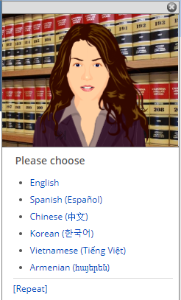
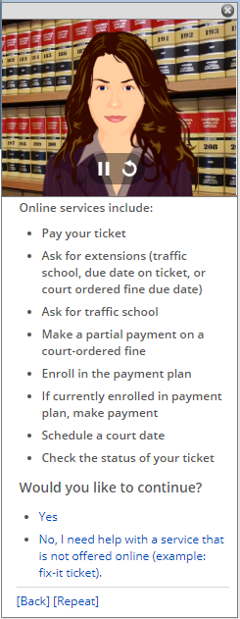
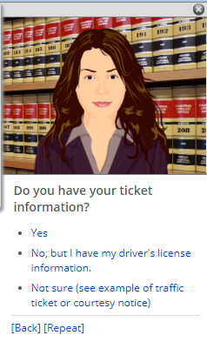
Meet Gina...
Virtual Assistant for Traffic

Slide 31
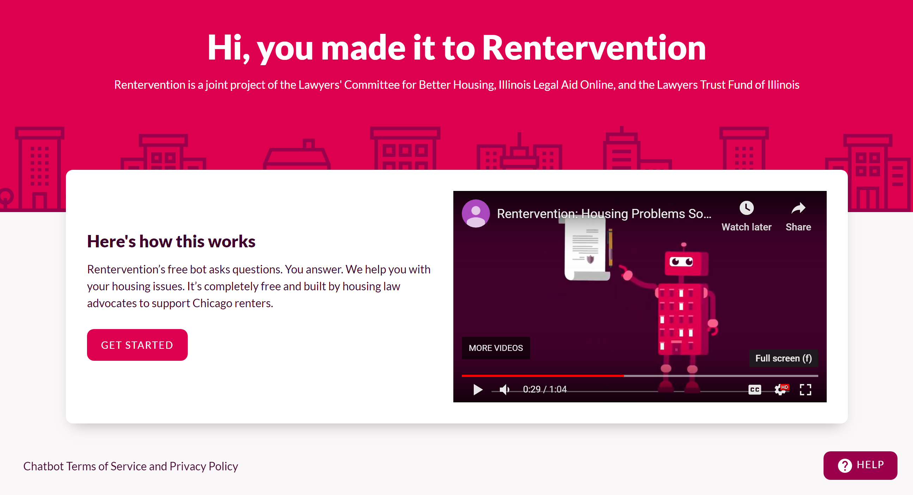

Slide 32
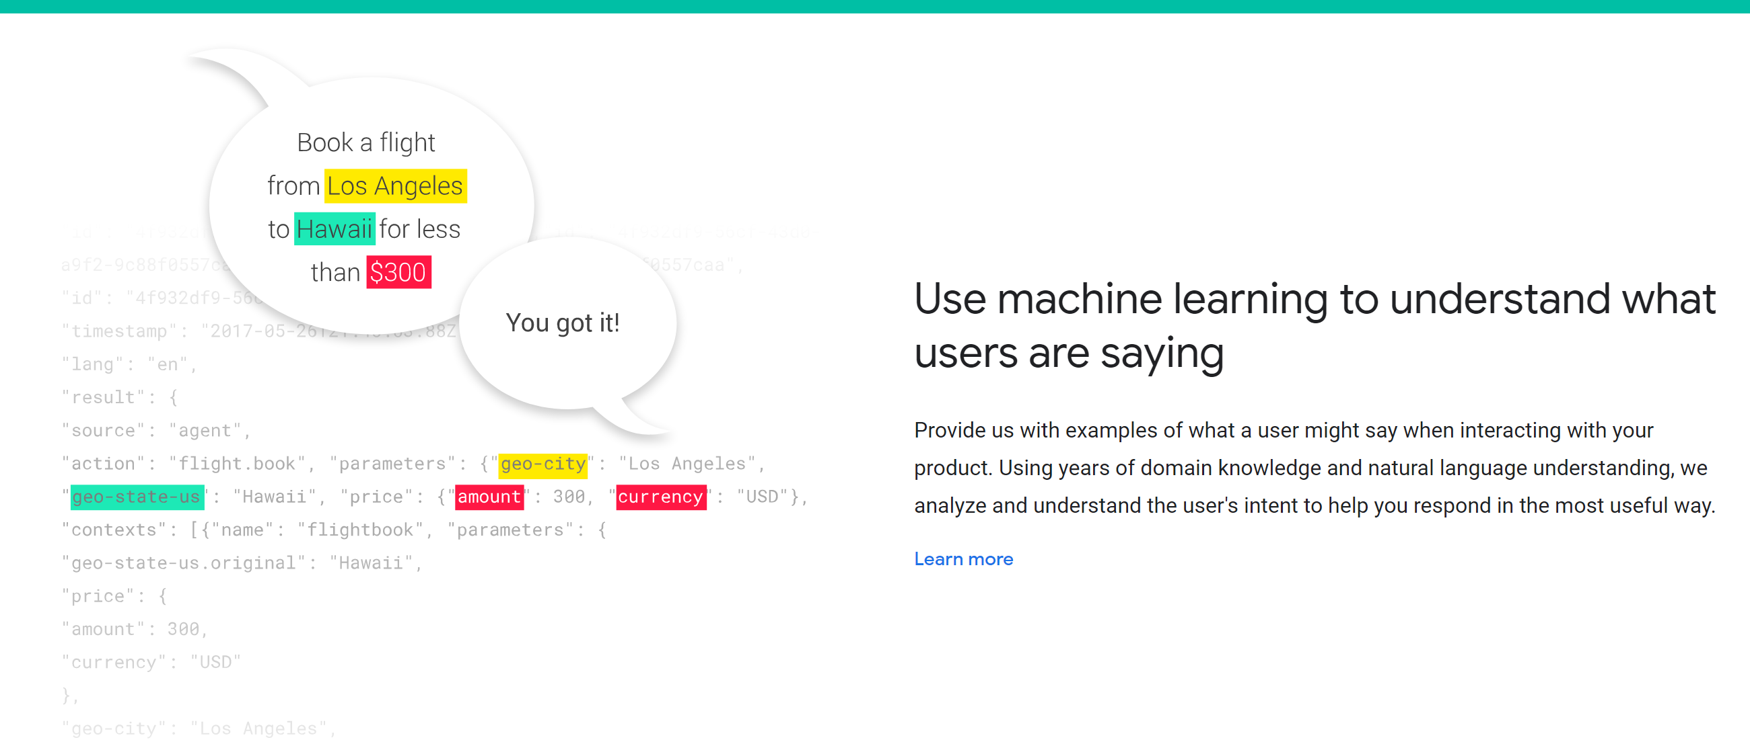

Slide 33
“An algorithm is an opinion embedded in mathematics” Cathy O’Neil, author of Weapons of Math Destruction
“Algorithms are neither good nor bad,
but they are certainly not neutral” Kranzberg’s First Law of Technology
Technology and Culture, Vol. 27, No. 3 (July 1986), pp. 544-560
Notes:
WHAT TO REMEMBER ABOUT AI TOOLS
To help you understand what they do, and what they don’t do
An algorithm is an “opinion embedded in mathematics” -- Cathy O’Neil, author of Weapons of Math Destruction
CORRELATION, NOT CAUSATION
Where is the knowledge we have lost in information? -- T.S. Eliot
Not coming up with theories of laws of nature, just patterns
Cassie Kozyrkov, head of Decision Intelligence for Google:
You can use AI to find “patterns in data instead of having to meditate your way to a solution. Do you realize how powerful this is? It means that even if you can’t come up with instructions, you might be able to automate your task anyway.”
“It’s a set of tools for writing software a different way, letting you program with examples (data) instead of explicit instructions.”

Slide 35
Characteristics of AI tools
An algorithm based on human decisions reflects human biases and weaknesses:
We tend to imbue technology with the ideals of the people who have created it.
Implicitly, the technologies reinforce the beliefs and intentions of those who make and sell them.
The true impact of a technology is, more often than not, defined by those who use it. - Anab Jain
Notes:
Who the developers and users are is as important as the hardware, software, and data
Computing, software, and data have changed,
BUT humans who develop and use tools have not changed
Will provide some specific examples
SOURCE: Tackling the Ethical Challenges of Slippery Technology, Anab Jain, Jun 11. 2018,
At: https://blog.usejournal.com/tackling-the-ethical-challenges-of-slippery-technology-94500e723d34

Slide 36
European ethical Charter for the use of AI in judicial systems and their environment
Council of Europe Commission for the Efficiency of Justice (CEPEJ)
Quality group
Ethical charter
Adopted December 2018
5 principles

Slide 37
Principle 1: Respect for fundamental rights
Privacy
Equal treatment
Fair trial
Ensure that design and Implementation of AI tools and services are Compatible with fundamental rights…
Fair trial
Transparent
Equality of arms
Reasoned decision

Slide 38
Principle 2: Non-discrimination
Prevent discrimination between individuals or groups of individuals
e.g.: Risk assessments in custody, sentencing and parole (COMPAS and Northpointe)

Slide 39
Principle 3: Quality and Security
…processing of judicial decisions and data, use certified sources and intangible data with models conceived in a multidisciplinary manner, in a secure technological environment…

Slide 40
Principle 4: Transparency, impartiality and Fairness
Make data processing methods
accessible and understandable
Authorize external audits

Slide 41
Principle 5: AI under user control
Preclude a prescriptive approach
⇢ The computer does not decide on its own
Ensure that users are informed actors
⇢ Users know what the AI does
Users are in control of their choices
⇢Users can decide what to do with the AI’s result

Slide 42
Operationalizing ethical guidelines

