Slide 1
Online Dispute Resolution
in the Age of AI
Colin Rule
SCU Law
June 25, 2026

Slide 2
Agenda / Overview
Introduction to ODR
Advantages / Disadvantages
Where we’ve come from
Where we’re going
Simulation: you be the online mediator
Current providers
Discuss Systems Design Project/Paper

Slide 3

Acronyms
Dispute Resolution
  ADR, AAA, ABA, ACR, CPR, etc.
Technology
  ODR, UI, HTML, PHP, etc.
International Organizations
  WIPO, ICANN, UNECE, BBB, etc.
If you don’t know what something is,
  please don’t hesitate to ask!

Slide 4

What is ODR?
Online Dispute Resolution (ODR) is the use of information and communications technology to help disputants find resolution to their disputes.
4

Slide 5
What is ODR?
Online Dispute Resolution (ODR) is the use of information and communications technology to help parties manage, transform, and resolve their conflicts.
5

Slide 6
What is ODR?
Online Dispute Resolution (ODR) is “a public-facing digital space in which parties can convene to resolve their dispute or case.”
- National Center for State Courts
6

Slide 7
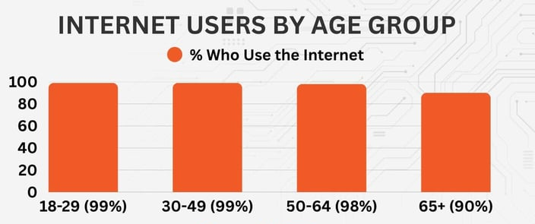
The Changing Environment for ADR
Society is Networking
Artificial Intelligence
Mobile devices
Social networks
If you’re not online, you’re at risk
of increasing irrelevance
https://www.statista.com/statistics/266587/percentage-of-internet-users-by-age-groups-in-the-us/
The Evolution of ADR
The line between ODR/ADR is blurry
Mediators are doing ODR now
Tech is changing every industry
The law is not immune
The pace of change is accelerating
MODRIA INC. PROPRIETARY & CONFIDENTIAL

Slide 8
Resolution Matrix
NON-BINDING
BINDING
DIRECT
NEGOTIATION
PRIVATE
JUDGING
HIGH
FACILITATIVE MEDIATION
ARBITRATION
PROCESS
CONTROL
EVALUATIVE MEDIATION
FINAL OFFER
ARBITRATION
LOW
MED/ARB
HIGH
LOW
OUTCOME CONTROL

Slide 9
Online communication types
ASYNCHRONOUS
emails
discussion boards
chats
instant messaging
audio conferencing
video conferencing
SYNCHRONOUS

Slide 10
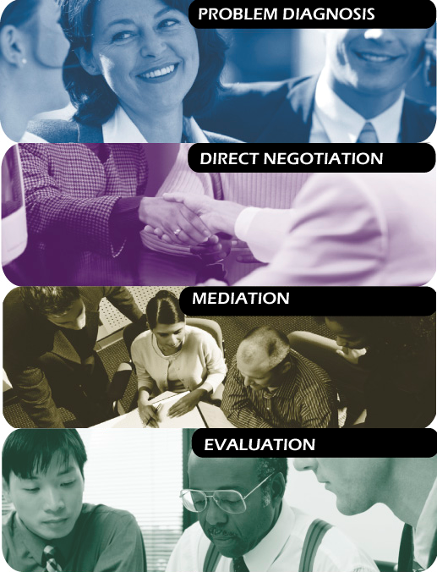
Common (but not all) ODR Types
Problem Diagnosis
An automated process that provides buyers and sellers key information and sets reasonable expectations
Direct Negotiation
A tool that enables disputants to communicate directly through a web forum in an attempt to reach agreement
Mediation
A process in which an impartial third party joins the discussion between the disputants to help them find resolution
Evaluation
The endpoint for ODR, where a neutral hears both sides of the dispute and then renders a decision that is binding on both sides

Slide 11
ODR Advantages
Asynchonous interaction
  - “cooling” distance
  - you don’t have to react immediately
Pre-communication re-framing
Concurrent caucusing
Archived communication
  - re-usable language
  - text-based interaction
Automated procedures (the “fourth side”)

Slide 12
ODR Disadvantages
“ODR” is a bad acronym (too late)
Online, you lose important information
  - body language
  - non-verbal cues
It’s easy for people to drop out or stonewall
People are more strategic online
  - more likely to lie
  - less trusting of information
Privacy and confidentiality

Slide 13
Online Mediator Scenario
Pretend you are an online mediator for OnlineMediators.com. You receive a case assignment and when you log in to the thread to get started to see the following chain of messages. What would your first posting be in this situation?
Complainant
Hello. My name is Sarah Chen. I was given the login to this web page by the case administrator at OnlineMediators.com. I work as an emergency room nurse at Mercy Hospital – in fact, I got this condo because it’s near the hospital. I often have to work nights and sleep during the day, but I can’t get any sleep because of the noise from Mike’s condo just below my unit. It’s happening almost every day.

Slide 14
Online Mediator Scenario (2)
Respondent
My name is Mike Thompson. I just received an email that I've been asked to participate in this online mediation -- I was surprised. I clicked the link in the email and it brought me here. I've never been in a mediation before. Yes, I do live below Sarah, but I teach guitar lessons during the day. Plus my apartment is my only practice space, and I have to practice. I’m usually done by 9:30pm each night.
Complainant
Mike, it’s not OK for everyone in the building to have to listen to your guitar all day. You play quite loud. As I explained to you on the stairwell, please don’t make me file a formal complaint to the condo board that you’re violating the terms of your lease.
Respondent
If the mediator does even a cursory investigation they will realize I am well within my rights to play guitar in my condo during they daytime, and I’m confident they will decide in my favor.

