Slide 1

Online Dispute
Resolution in the Age of AI
Online Dispute
Resolution in the Age of AI
Colin Rule
SCU Law
6/25/26

Slide 2
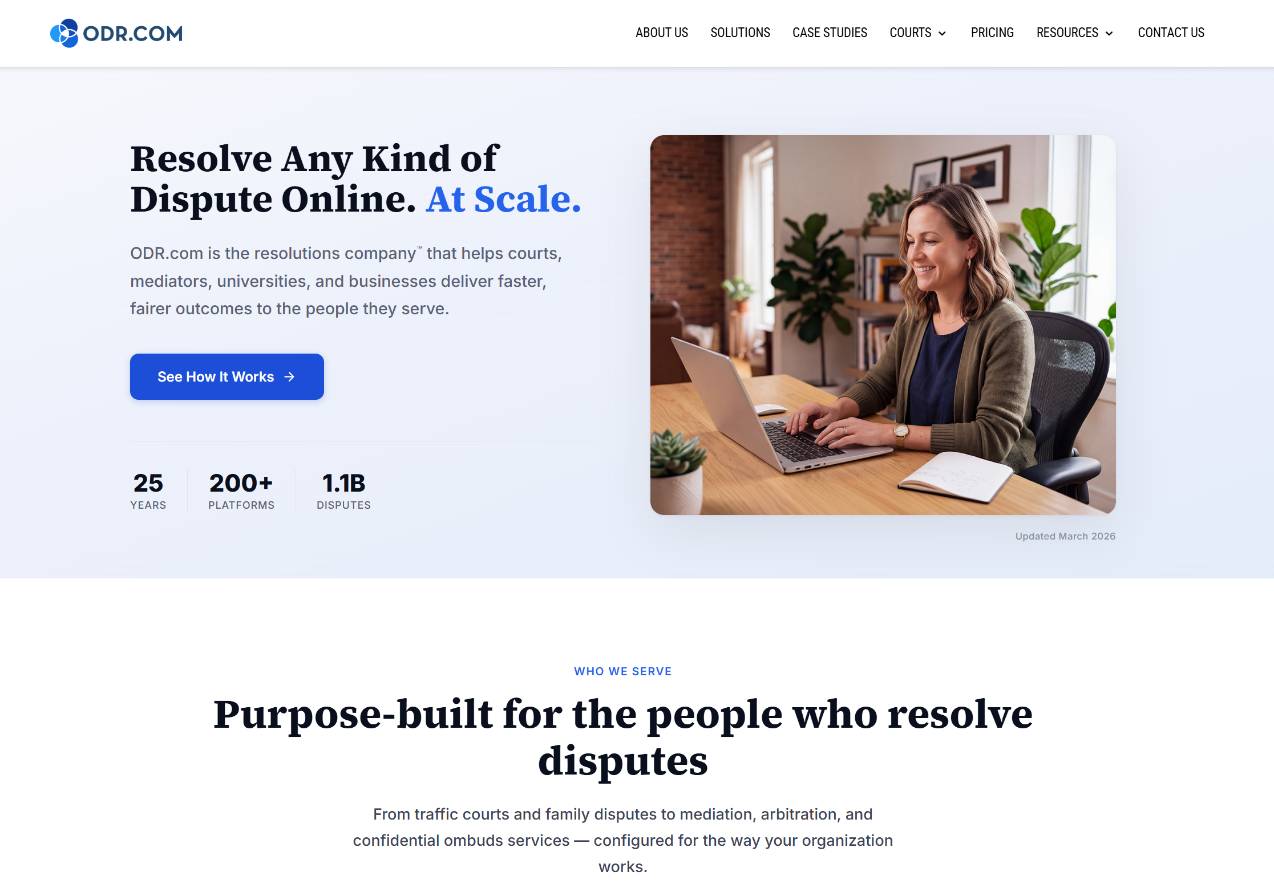

Slide 3
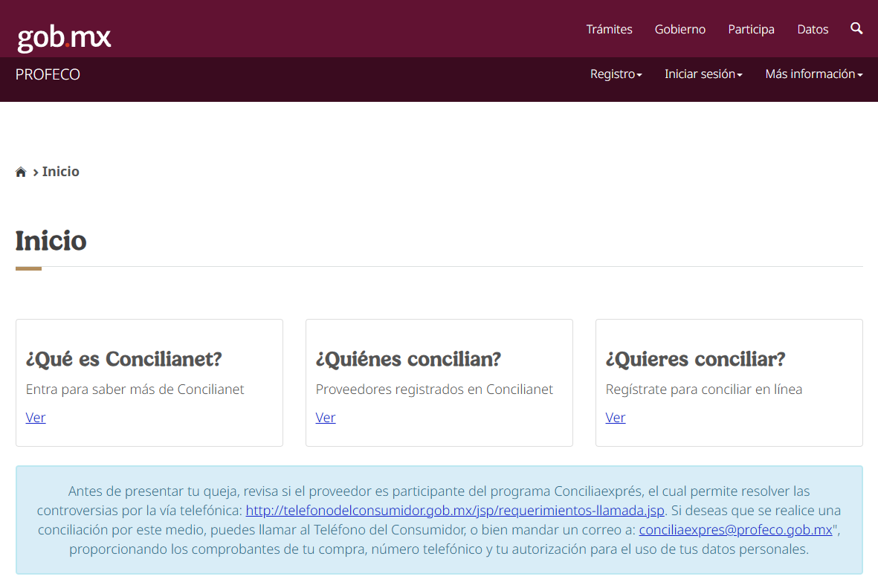

Slide 4
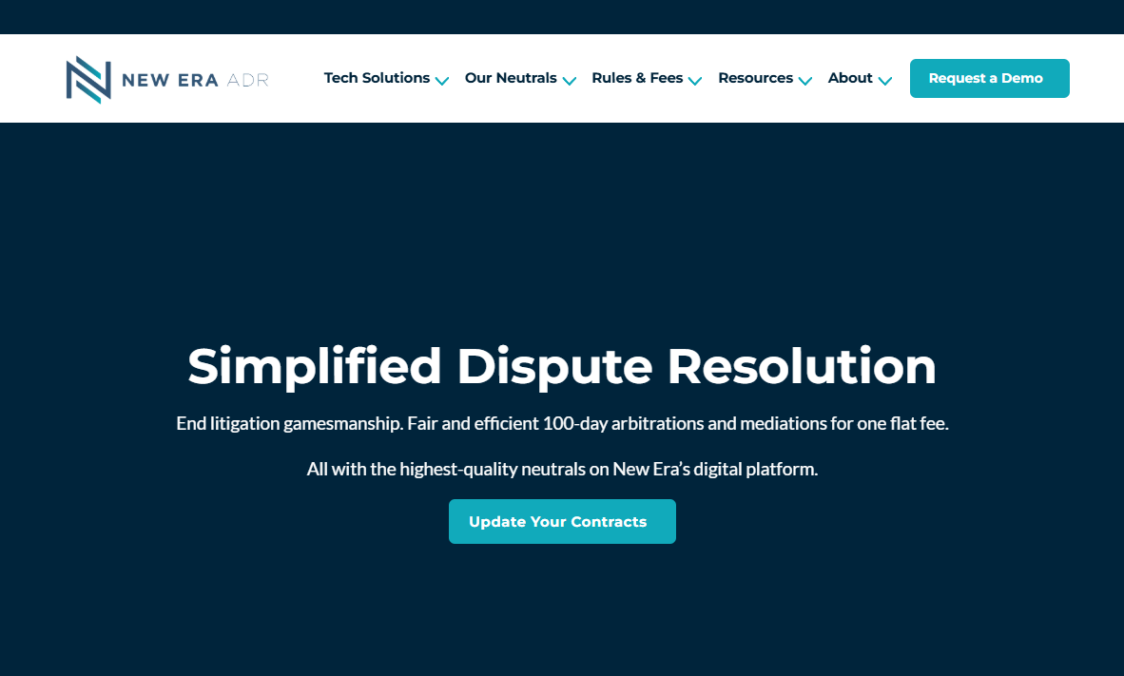

Slide 5
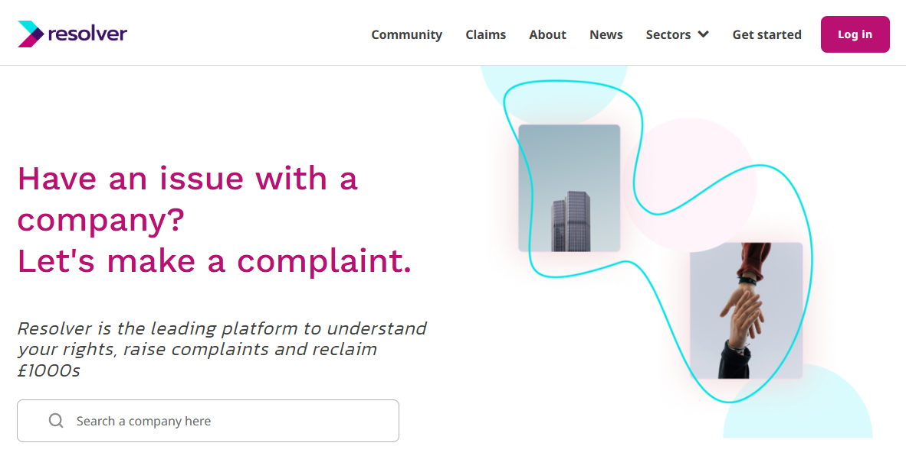

Slide 6
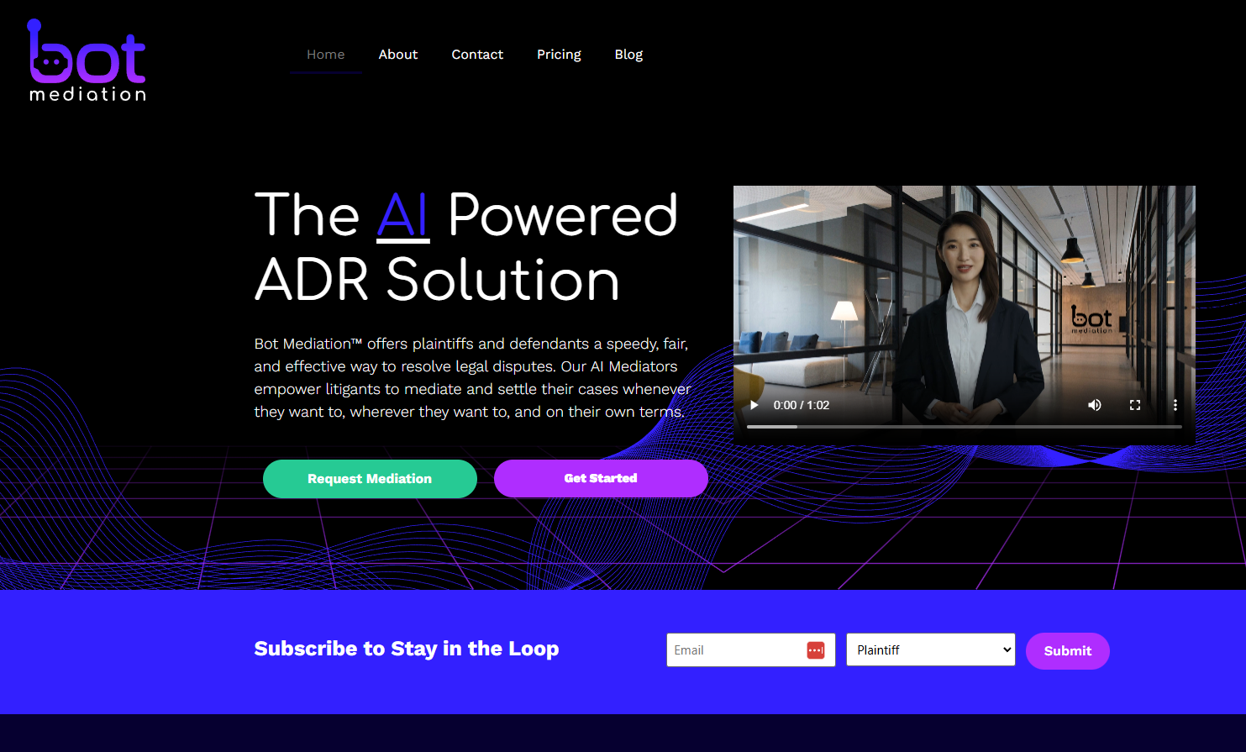

Slide 7
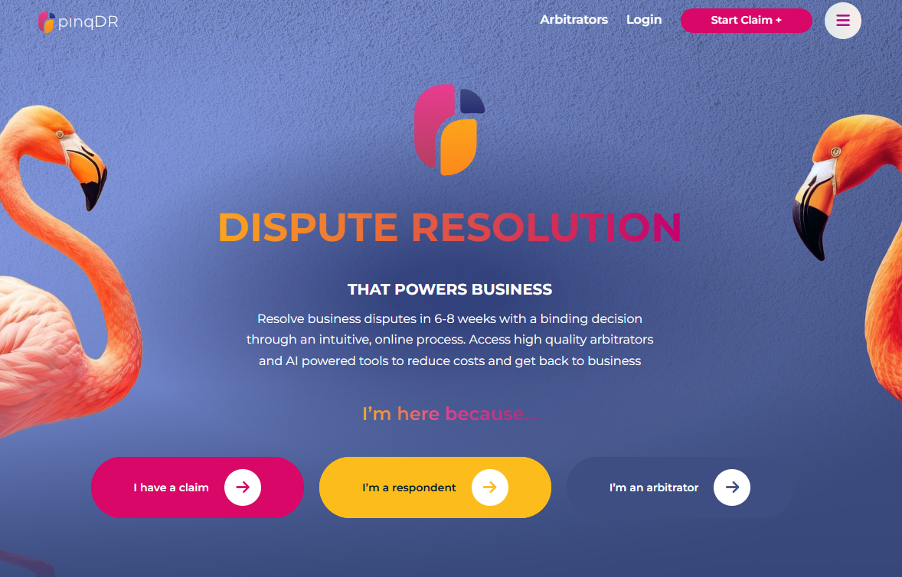

Slide 8
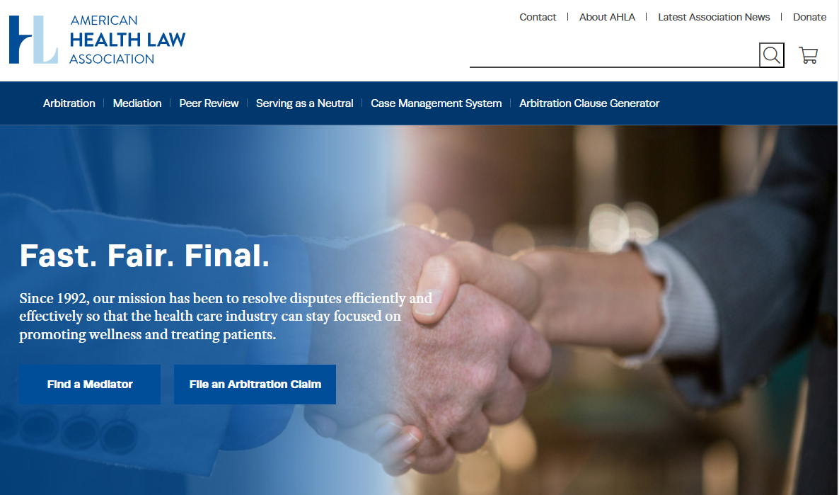

Slide 9
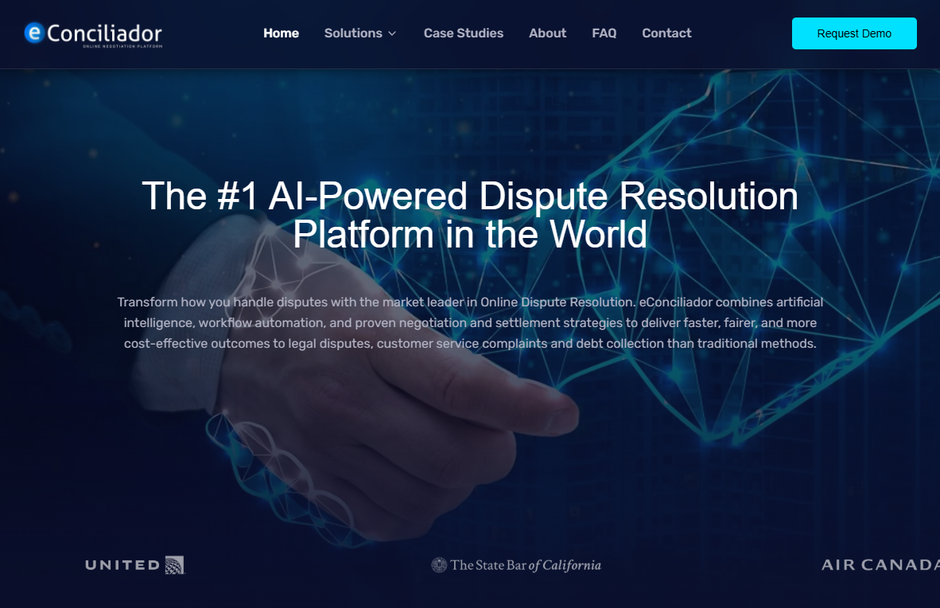


Slide 10
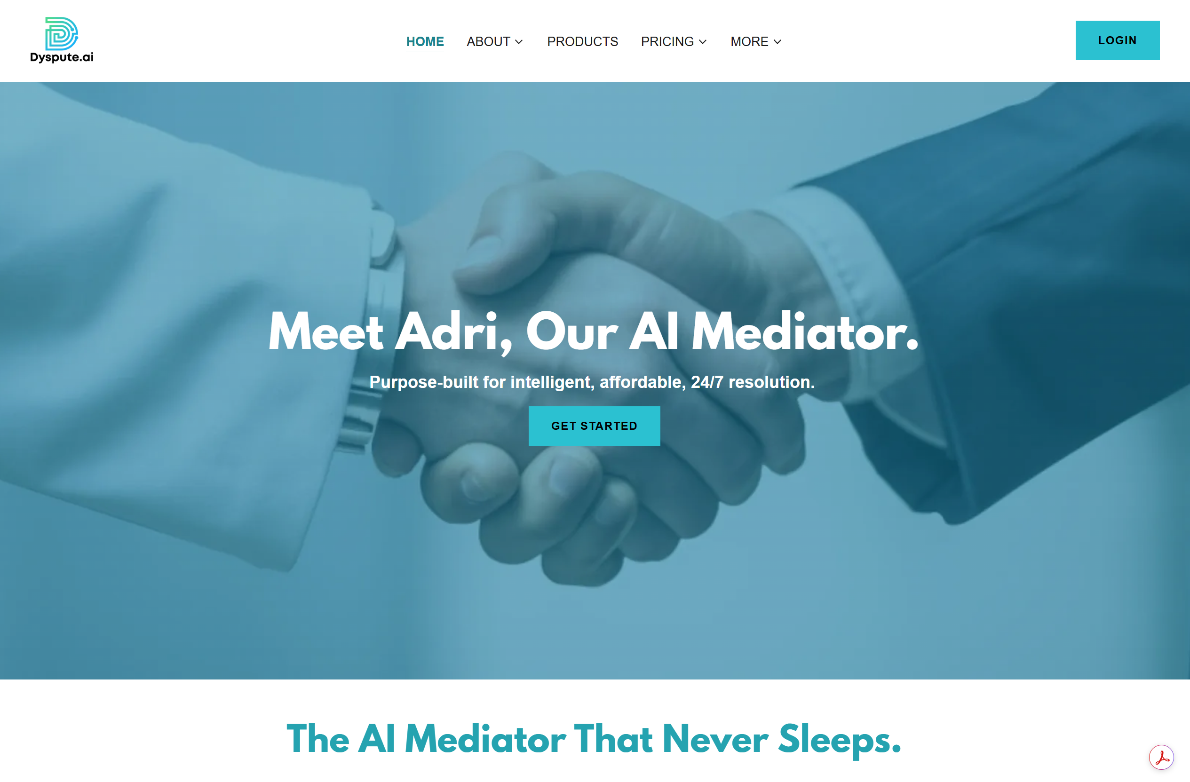

Slide 11
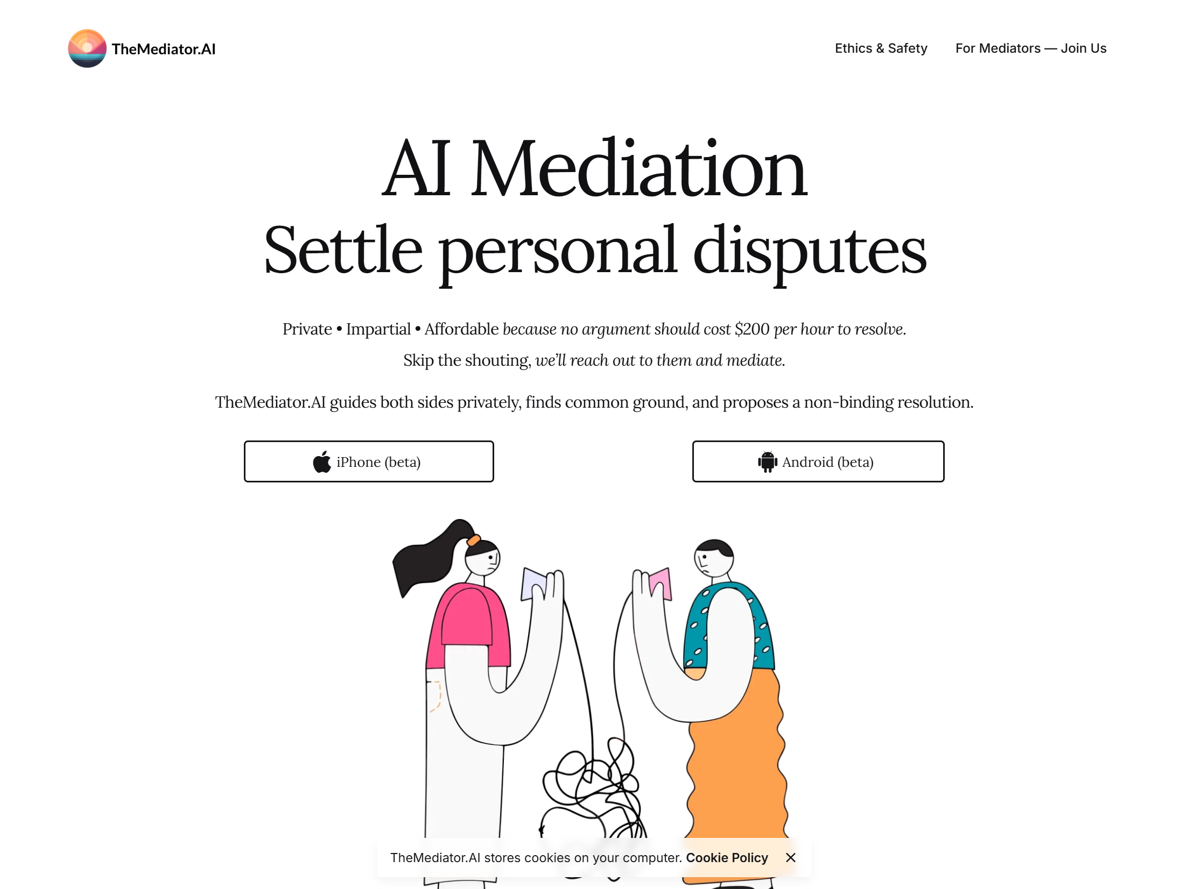

Slide 12
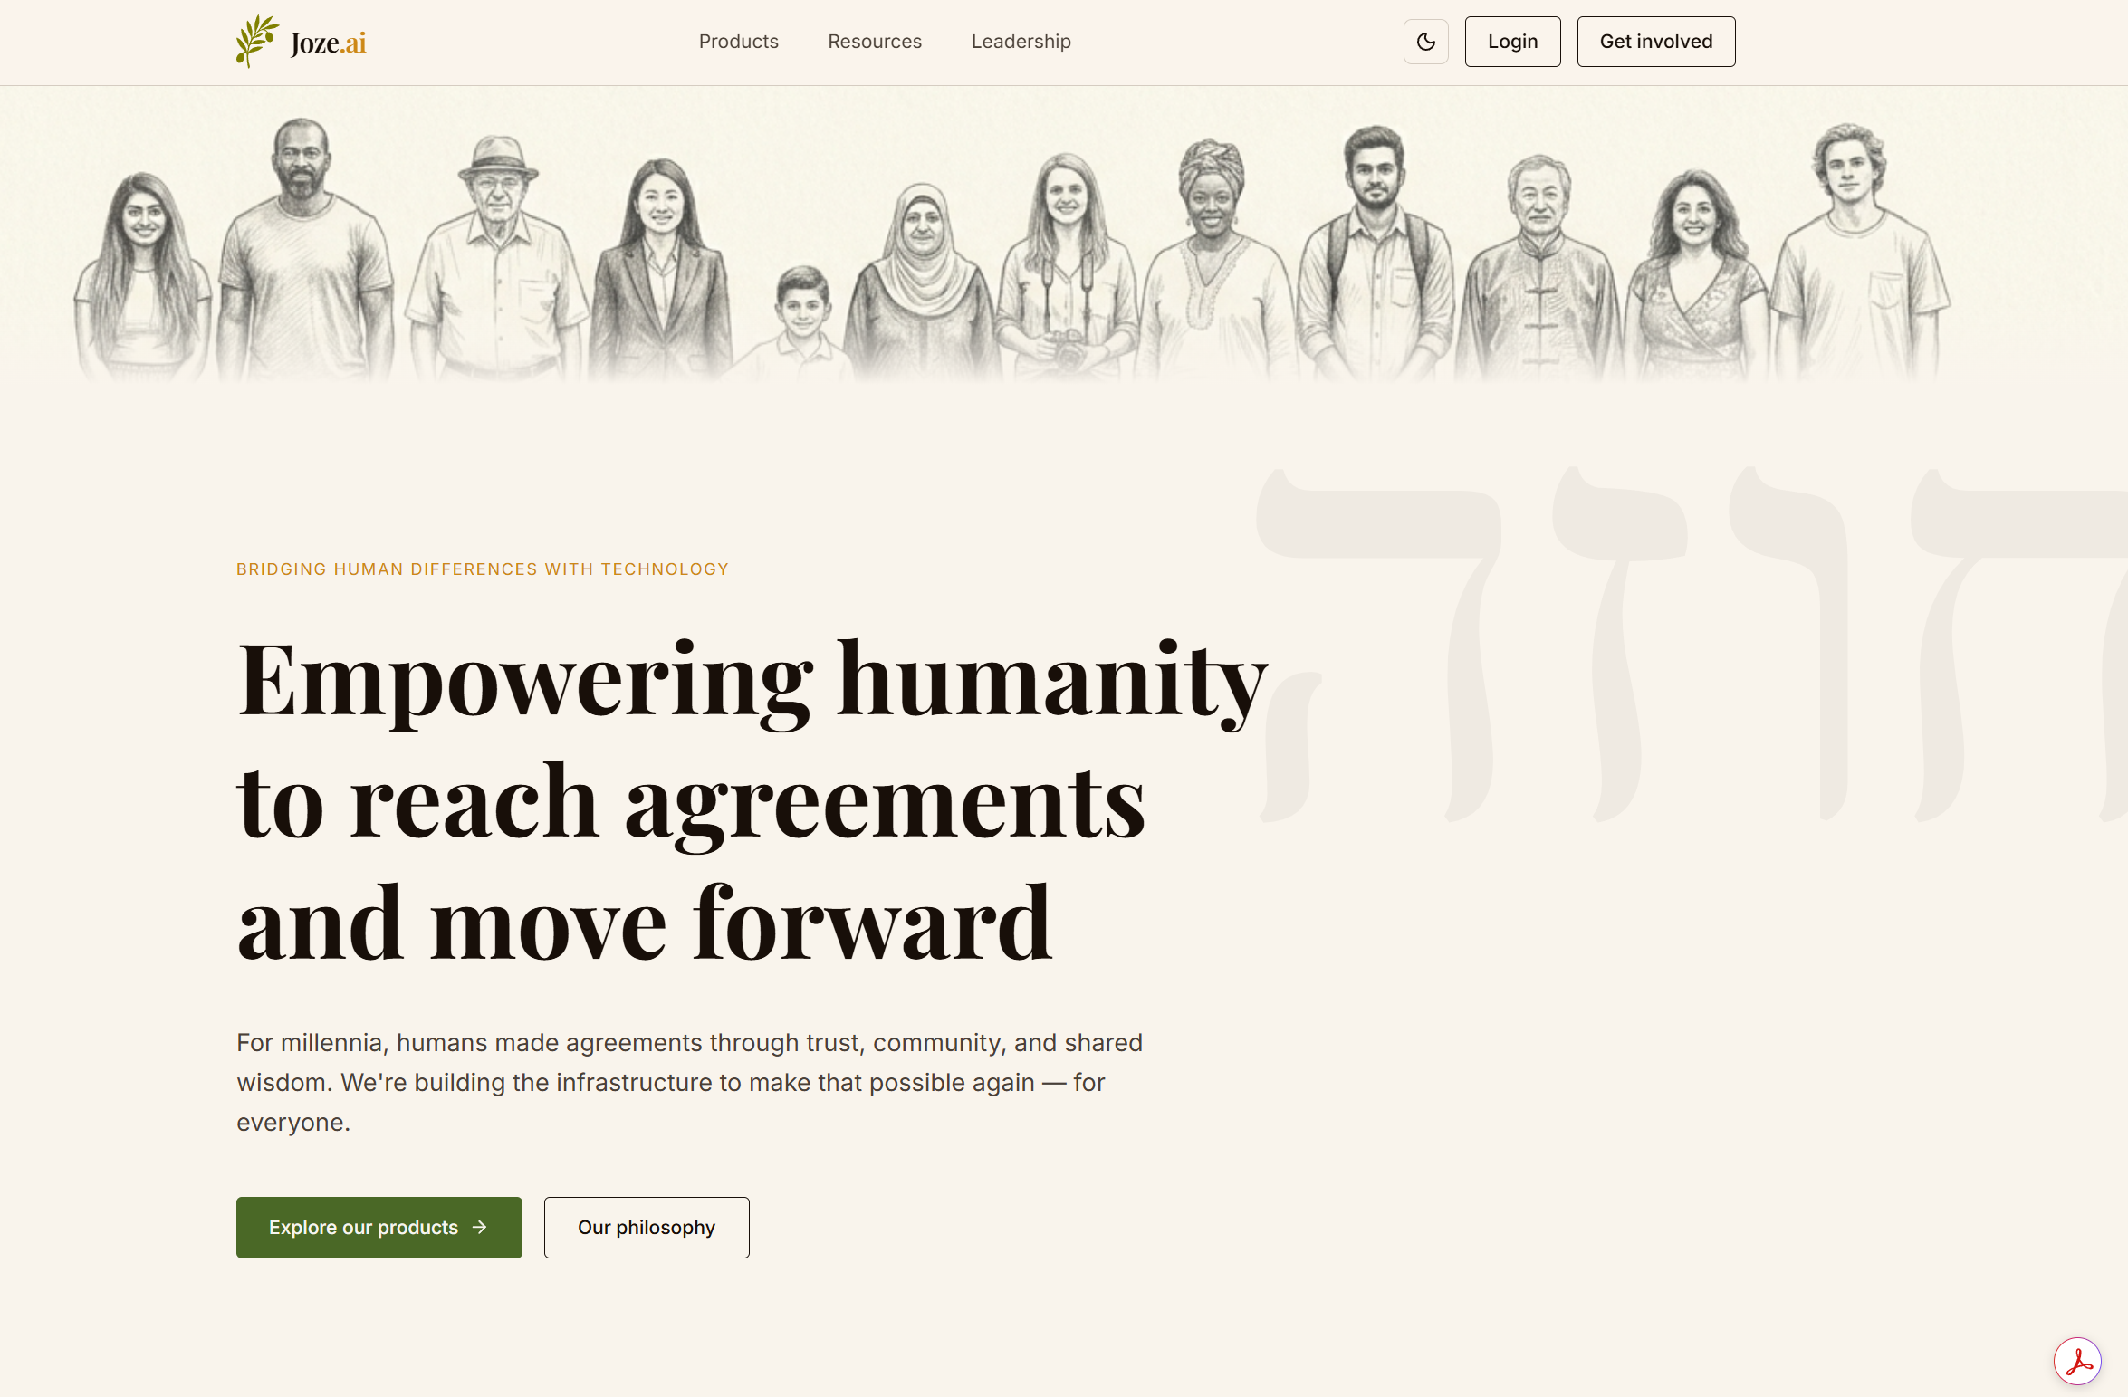

Slide 13
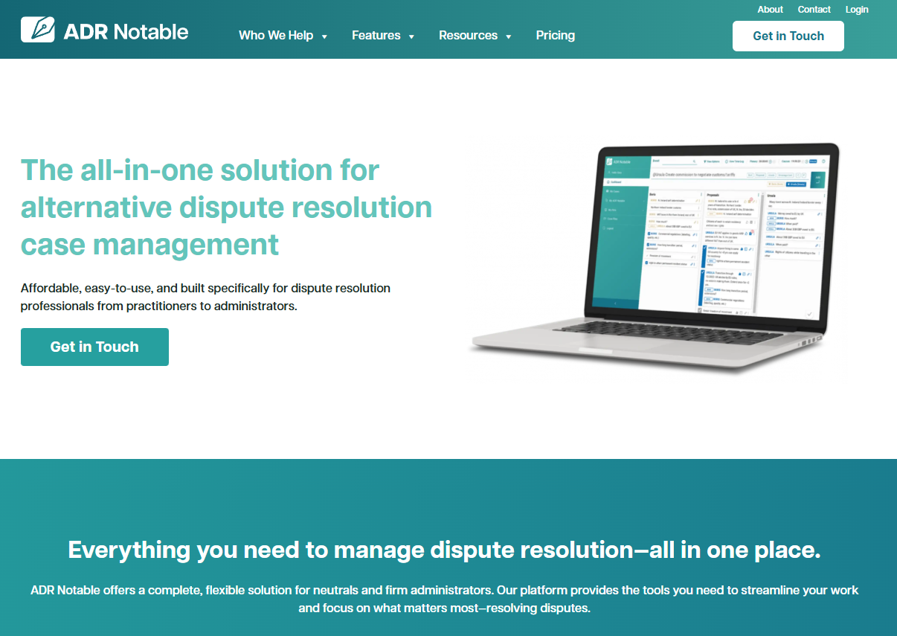

Slide 14
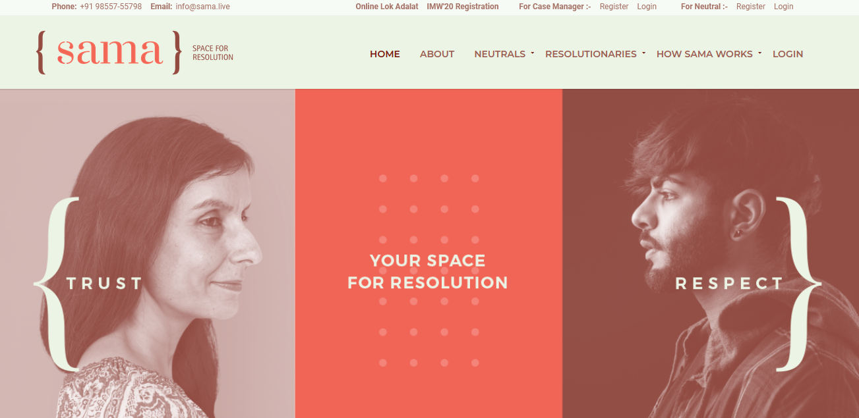

Slide 15
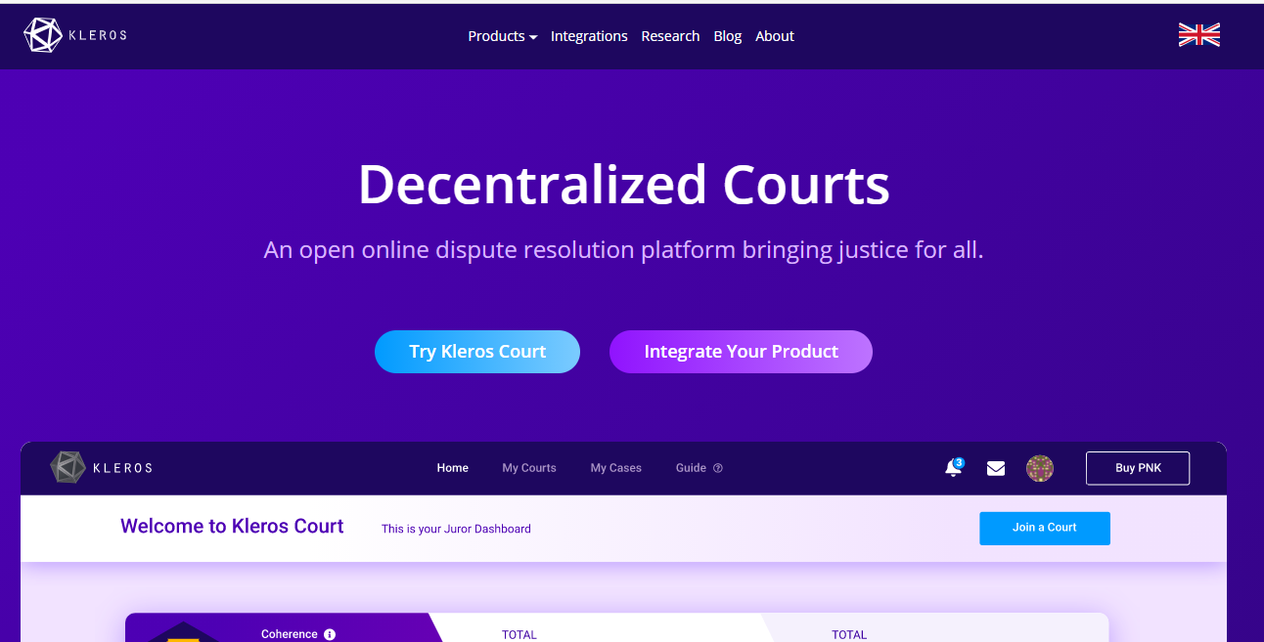

Slide 16
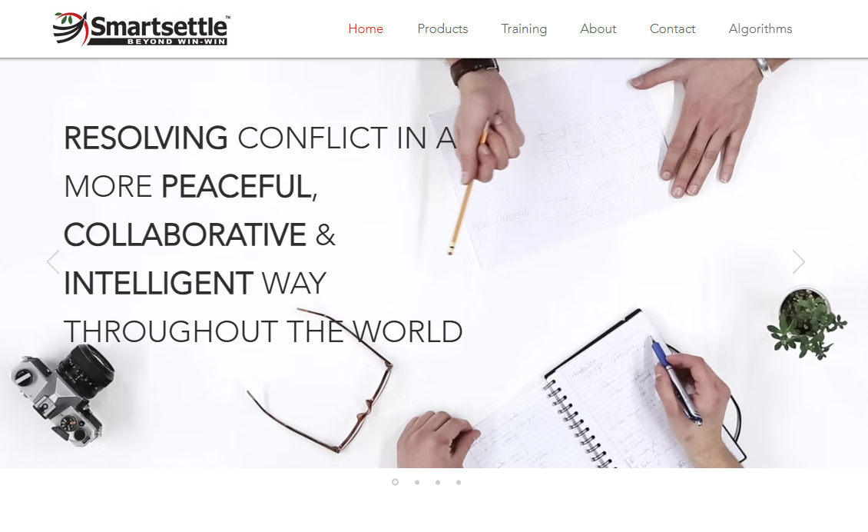

Slide 17
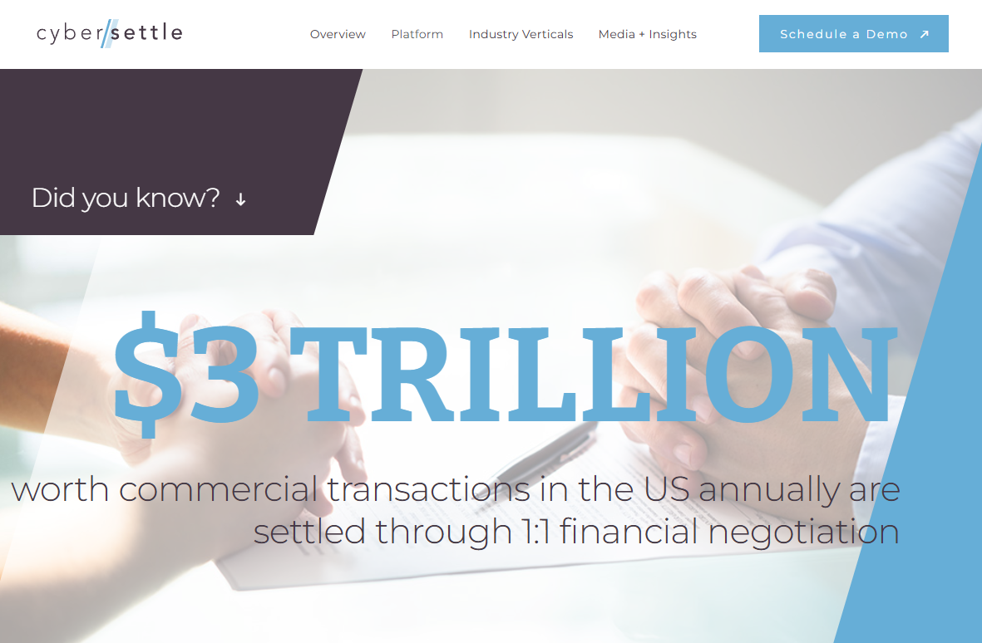

Slide 18
clickNsettle.com
Notes:
Good afternoon and once again thank you all for coming today. My name is Bob Mack, and I am Executive Vice President of Business Development for clickNsettle.com.
Yes that’s right, we have now arrived at the “marketing” part of today’s seminar. And since dinner and cocktails start as soon as I am finished, I promise to keep this brief.

Slide 19
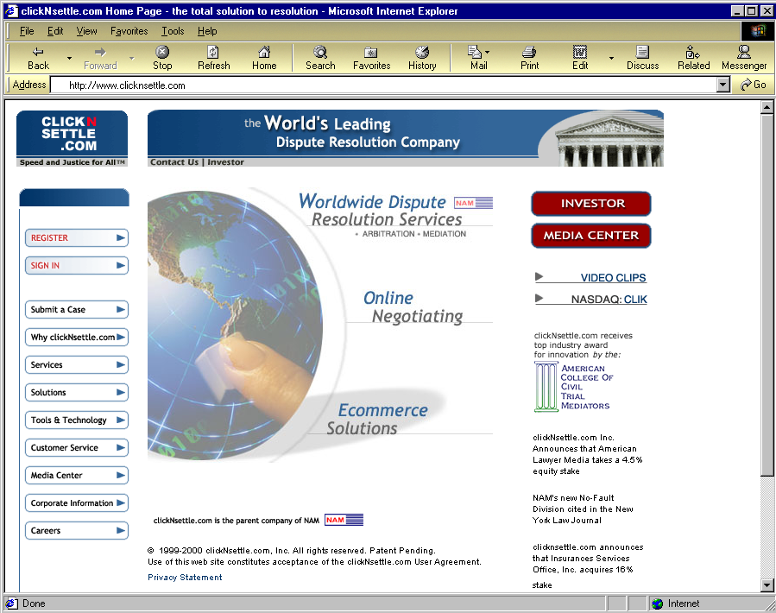
This is the clickNsettle.com Home Page

Slide 20
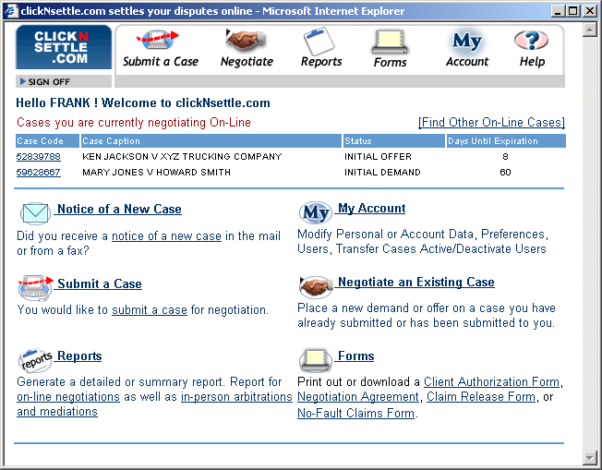
Select Submit a Case

Slide 21
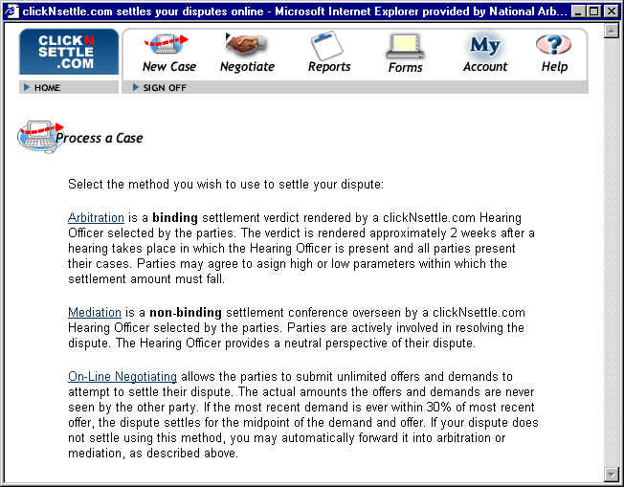
Select On-Line Negotiating

Slide 22
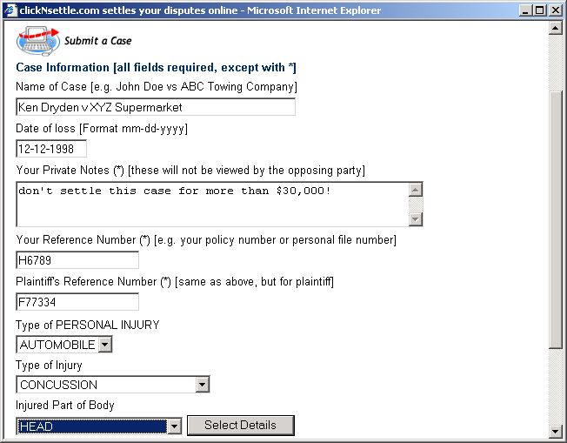
Fill out form

Slide 23
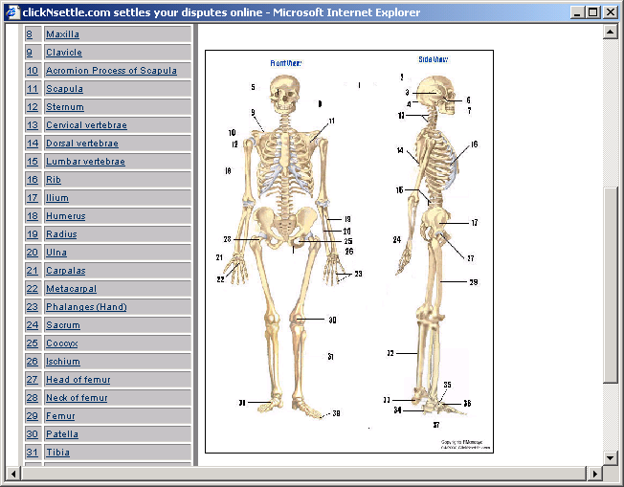
Select Injury Details

Slide 24
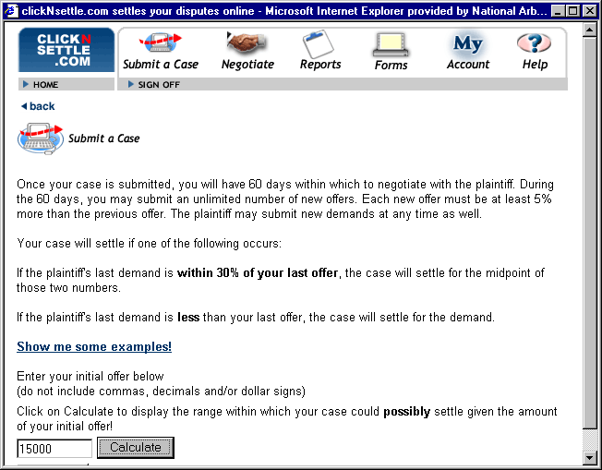
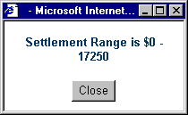
Enter initial offer

Slide 25
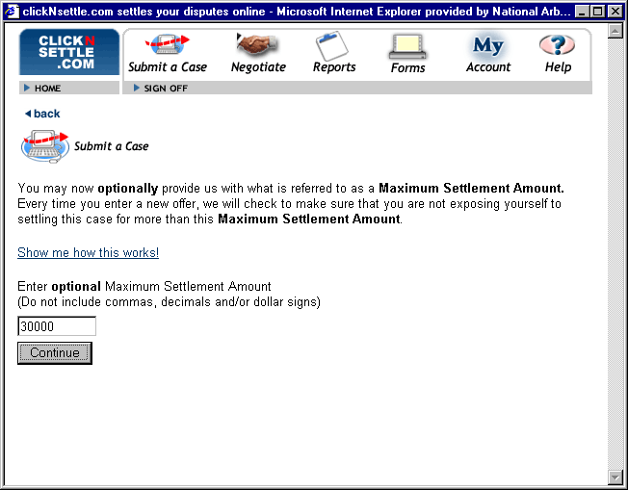
Enter optional maximum settlement amount.

Slide 26

Once the case is submitted, clickNsettle.com contacts the other party. The other party may then begin negotiating. Each party may submit an unlimited number of new offers or demand for up to 60 days.
Each new offer must increase a minimum of 5%. Each new demand must decrease by a minimum of 5%.
Either party may terminate negotiations at any time.
If the last demand is within 30% if the last offer, the case settles for the midpoint of the offer and demand.
If the last demand is less than the last offer, the case settles for the demand.

Slide 27
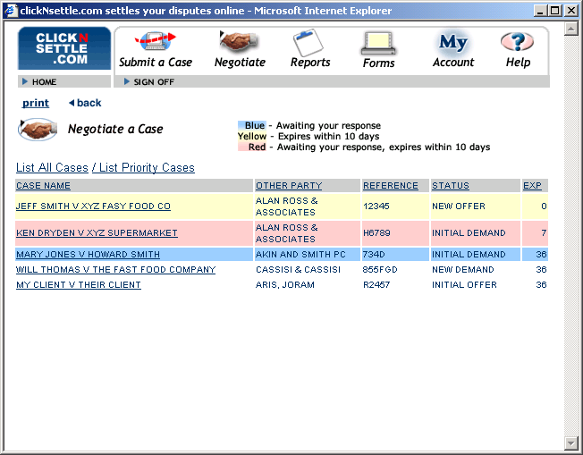
NEW DEMAND
Click on Negotiate to list active cases, color-coded to indicate priority level. Click on 2nd case.

Slide 28
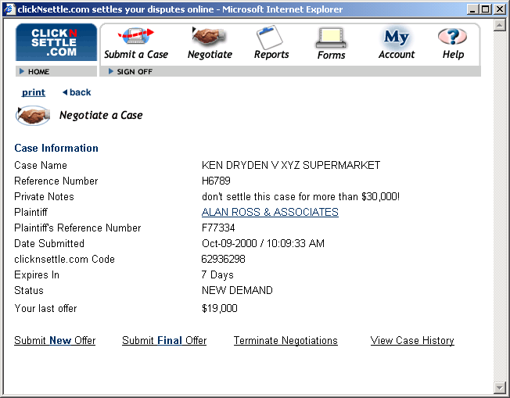
Clicking on case brings up negotiating screen.

Slide 29
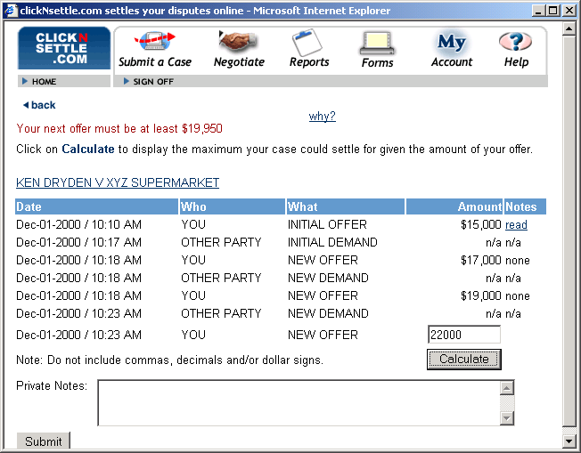
Typical Negotiating scenario, enter a new offer of $22,000

Slide 30
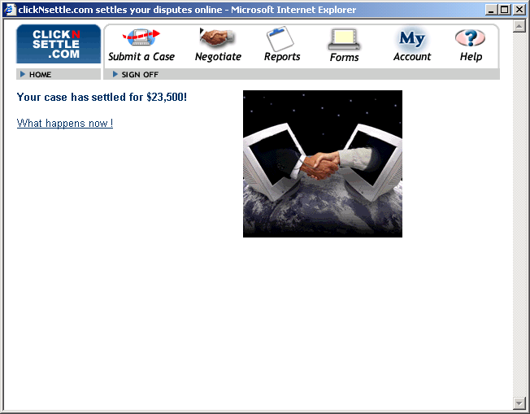

Last demand was $25,000, new offer of $22,000 settles case for $23,500!

