Slide 1


ODR and the Rise of the Fourth Party
Colin Rule
SCU Law
June 27, 2026

Slide 2
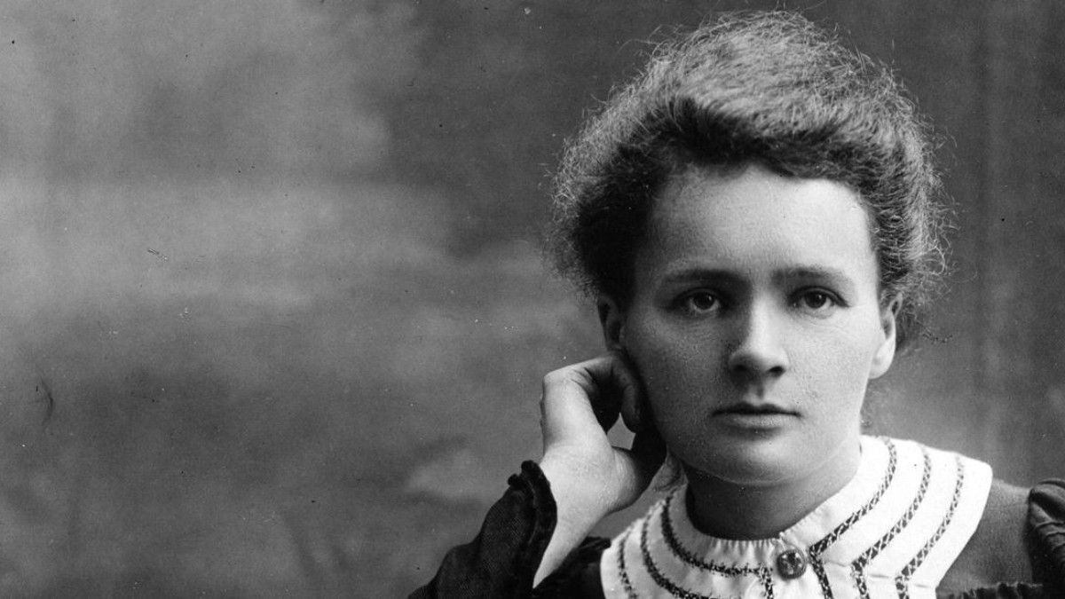
Marie Curie
Notes:
Marie Curie was the first woman to be awarded a Nobel Prize, the first person to get the Nobel prize twice. And the only person to win the Nobel Prize in two different scientific fields --Physics and Chemistry. Along with her husband Pierre, she discovered the element Radium and did pioneeingr research on radioactivity. The effects of radiation were not well understood then. Exposure to radationimpacted her health and cost her her life.

Slide 3
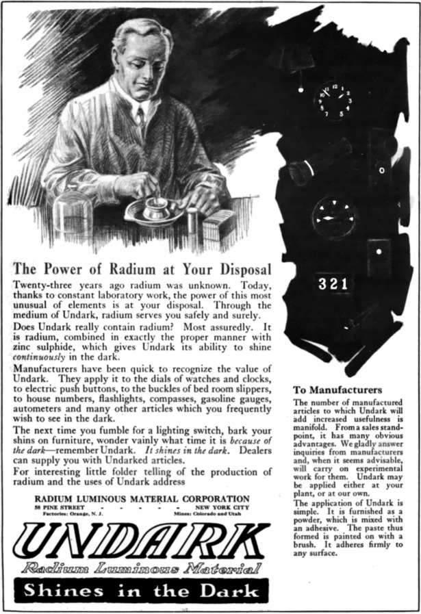
Notes:
Once radium moved from the lab to production it was available to manufacturers to use in different ways.

Slide 4
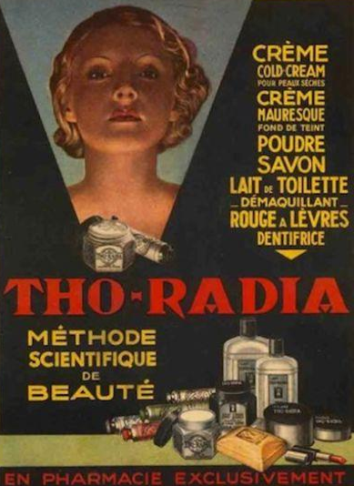


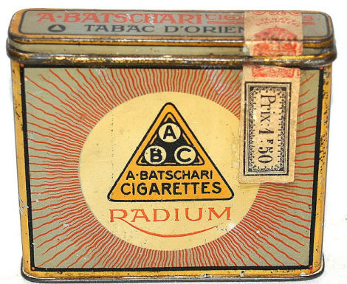
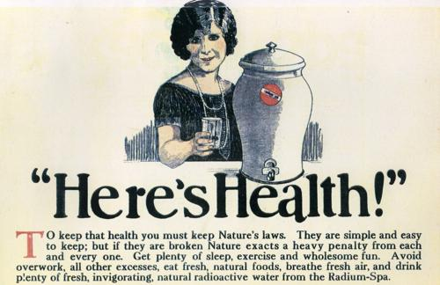
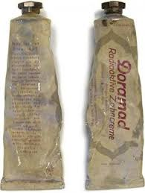
Notes:
And they did. It was used in cosmetics, cigarettes, and toothpaste.Sometimes the name was just slapped on even if the product did not have radium.

Slide 5
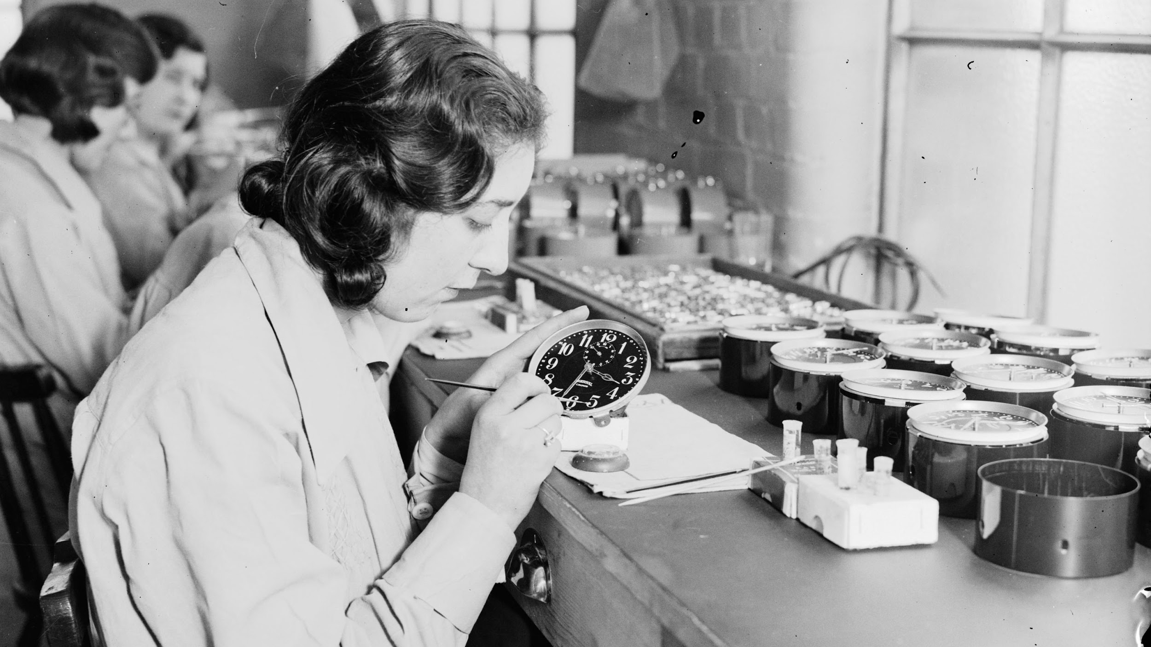
Source: Wikipedia - “Radium Girls”
Notes:
It was used on clocks and watches to make the numerals and hands glow in the dark. The workers who hand painted the dials were told it was safe and they were given no protection. Their health suffered and many died at an early age. It took time and work to understand the effects of radioactivity, to learn how to protect against it. Today radium is used in limited industrial and medical use.

Slide 6
Notes:
New advancements in science and technology follow the trajectory of discovery, excitement, hype. Then slowly we understand its impact and how and where to use it.

Slide 7
A I
Notes:
AI may be on the same trajectory. AI is an tmbrella term that’s used for several technologies including machine learning, natural language processing (NLP), facial recognition. These technologies are evolving at a rapid rate and we are just beginning to understand their potential and dangers. And we are beginning to ask the difficult question -- which tasks that are currently done by humans CAN or SHOULD be done by machines?

Slide 8
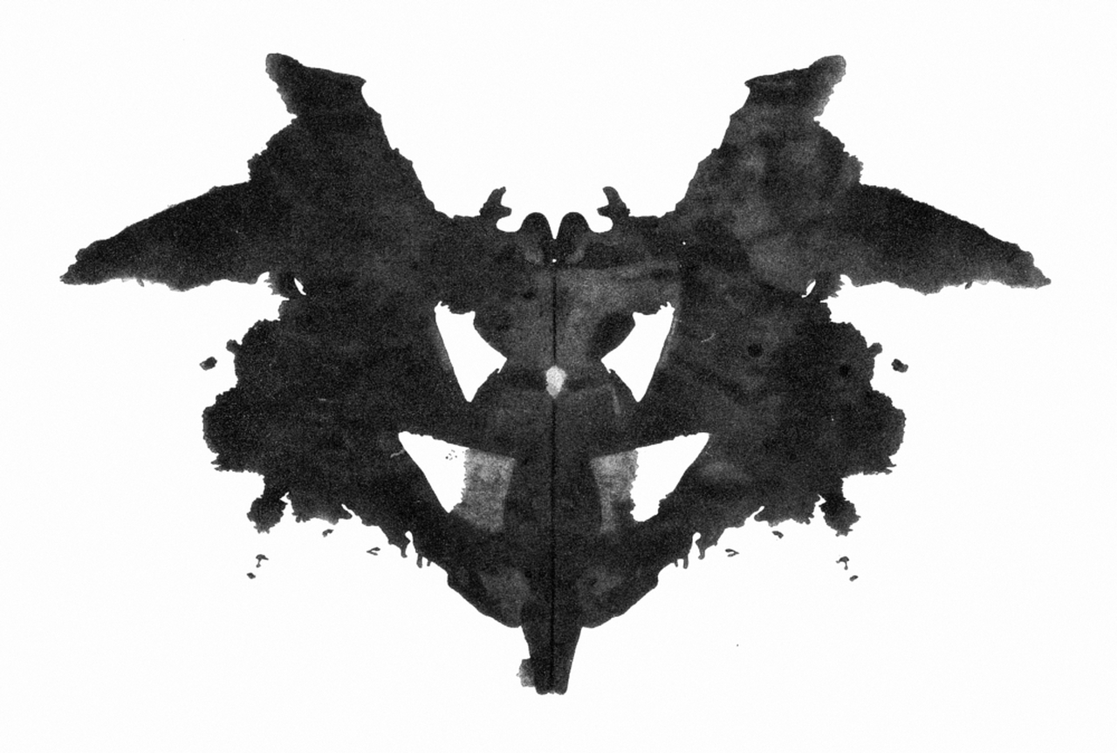
Notes:
WHAT ARE WE TALKING ABOUT?
HOW DOES IT WORK?
Simple description for purposes here
‘Learn’ is in quotations because it is not learning they way humans do
‘predict’, and not ‘recommend’ to remind us this is usually statistics and correlation,
NOT reasoning or causation
TALKING ABOUT AI TOOLS THAT MAKE DECISIONS AFFECTING PEOPLE’S LIVES,
NOT TOOLS CONTROLLING MACHINES, IoT, ETC.

Slide 9

Notes:
WHAT ARE WE TALKING ABOUT?
HOW DOES IT WORK?
Simple description for purposes here
‘Learn’ is in quotations because it is not learning they way humans do
‘predict’, and not ‘recommend’ to remind us this is usually statistics and correlation,
NOT reasoning or causation
TALKING ABOUT AI TOOLS THAT MAKE DECISIONS AFFECTING PEOPLE’S LIVES,
NOT TOOLS CONTROLLING MACHINES, IoT, ETC.

Slide 10
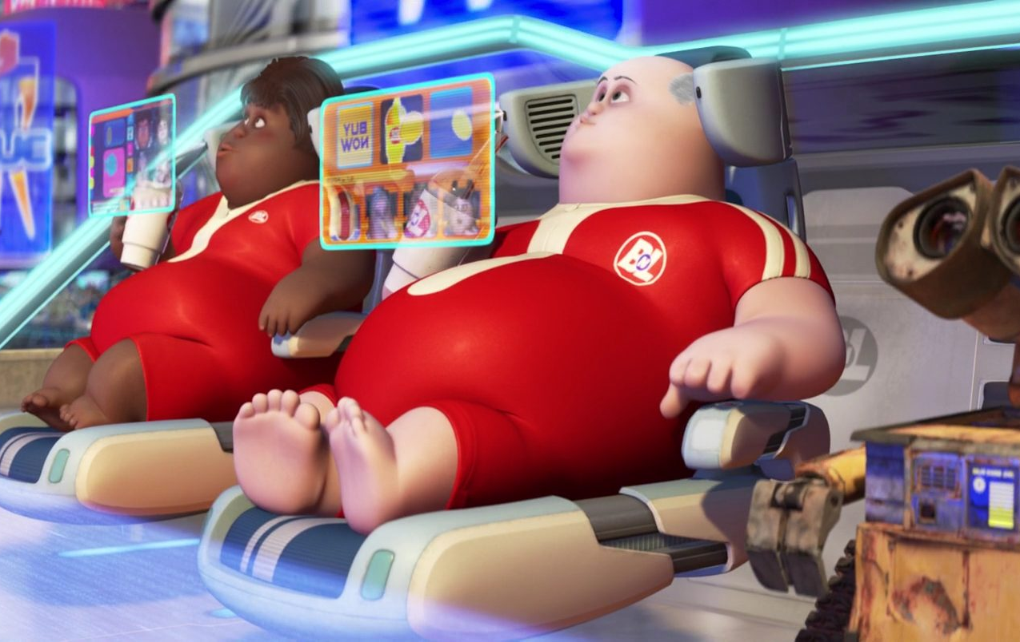
Notes:
WHAT ARE WE TALKING ABOUT?
HOW DOES IT WORK?
Simple description for purposes here
‘Learn’ is in quotations because it is not learning they way humans do
‘predict’, and not ‘recommend’ to remind us this is usually statistics and correlation,
NOT reasoning or causation
TALKING ABOUT AI TOOLS THAT MAKE DECISIONS AFFECTING PEOPLE’S LIVES,
NOT TOOLS CONTROLLING MACHINES, IoT, ETC.

Slide 11
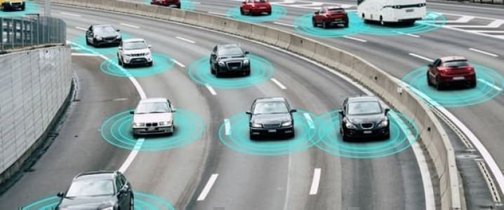
Notes:
WHAT ARE WE TALKING ABOUT?
HOW DOES IT WORK?
Simple description for purposes here
‘Learn’ is in quotations because it is not learning they way humans do
‘predict’, and not ‘recommend’ to remind us this is usually statistics and correlation,
NOT reasoning or causation
TALKING ABOUT AI TOOLS THAT MAKE DECISIONS AFFECTING PEOPLE’S LIVES,
NOT TOOLS CONTROLLING MACHINES, IoT, ETC.

Slide 12
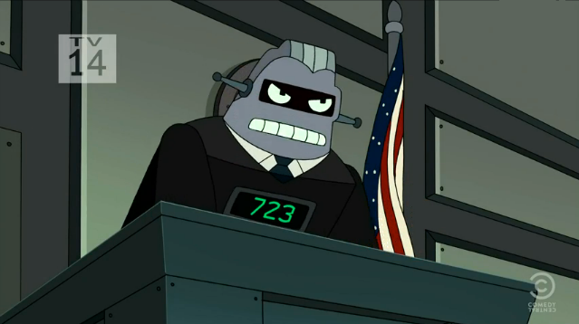
Notes:
WHAT ARE WE TALKING ABOUT?
HOW DOES IT WORK?
Simple description for purposes here
‘Learn’ is in quotations because it is not learning they way humans do
‘predict’, and not ‘recommend’ to remind us this is usually statistics and correlation,
NOT reasoning or causation
TALKING ABOUT AI TOOLS THAT MAKE DECISIONS AFFECTING PEOPLE’S LIVES,
NOT TOOLS CONTROLLING MACHINES, IoT, ETC.

Slide 13
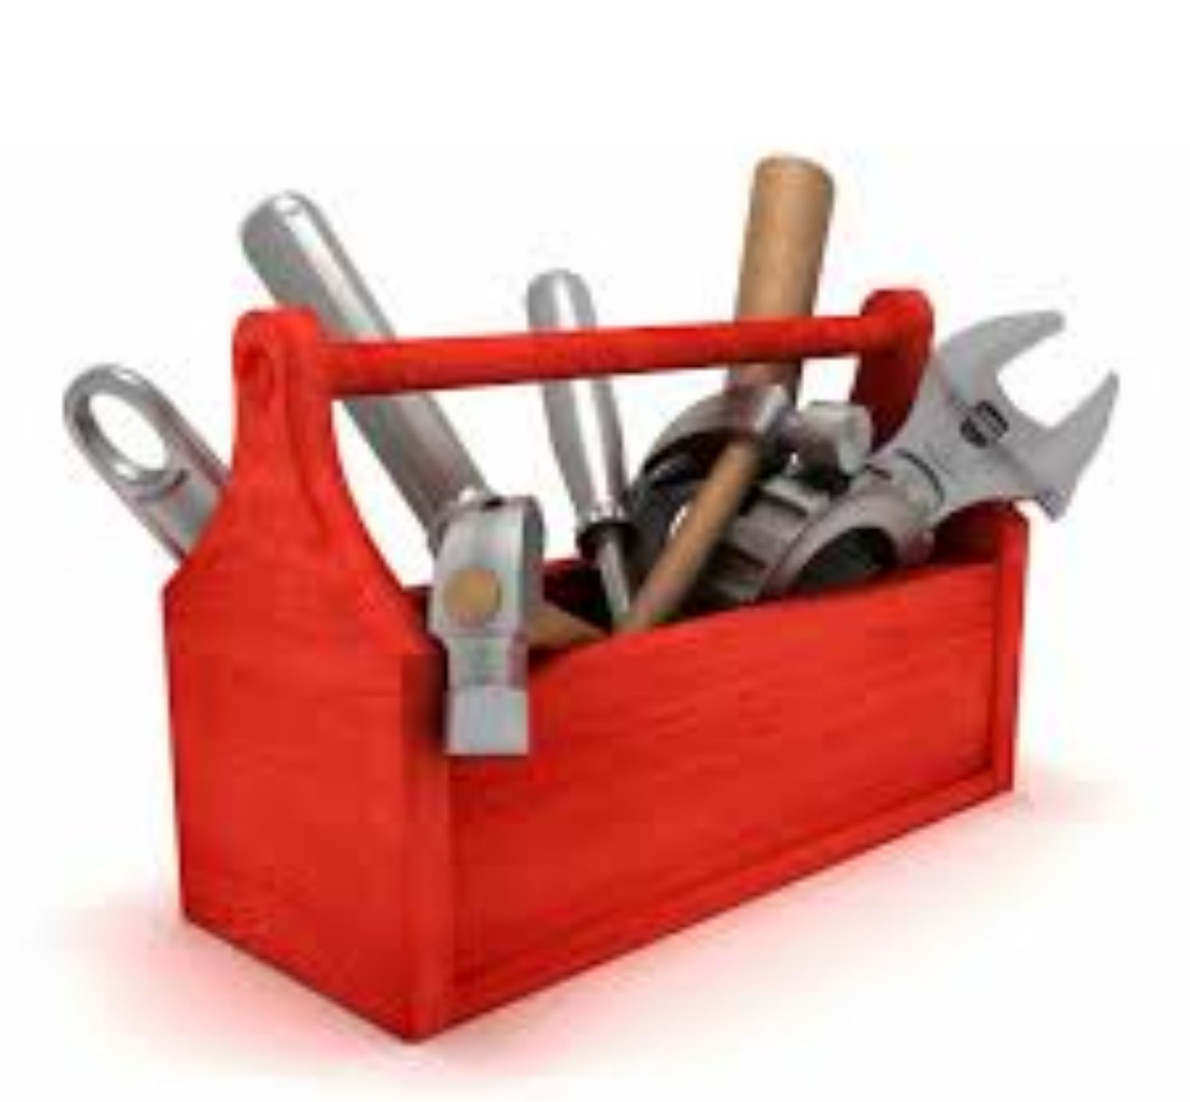
Notes:
WHAT ARE WE TALKING ABOUT?
HOW DOES IT WORK?
Simple description for purposes here
‘Learn’ is in quotations because it is not learning they way humans do
‘predict’, and not ‘recommend’ to remind us this is usually statistics and correlation,
NOT reasoning or causation
TALKING ABOUT AI TOOLS THAT MAKE DECISIONS AFFECTING PEOPLE’S LIVES,
NOT TOOLS CONTROLLING MACHINES, IoT, ETC.

Slide 14
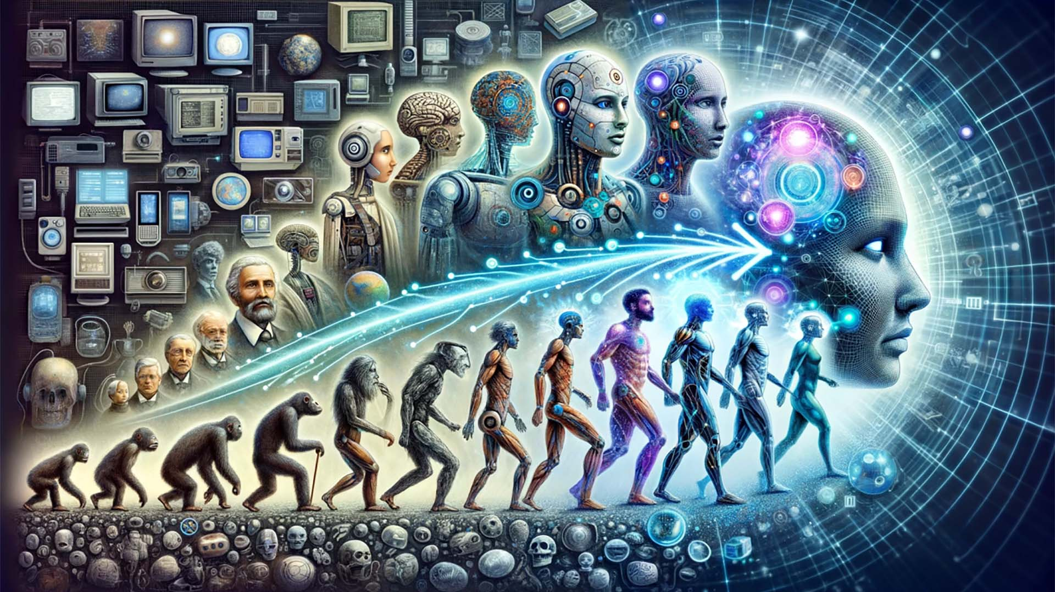


AI Evolution Snapshot
AI accelerating
Culture changing
AI bias/complacency
Growing resistance
Green pledge
Mediate.com R&D
  MediatorDojo
  NegotiatorDojo
  Mediatorlab
  ChatODR

Slide 15
How does AI work?
AI methods ‘learn’ by observation, essentially pattern recognition, and generate a decision-making tool that predicts an outcome based on input values
Notes:
WHAT ARE WE TALKING ABOUT?
HOW DOES IT WORK?
Simple description for purposes here
‘Learn’ is in quotations because it is not learning they way humans do
‘predict’, and not ‘recommend’ to remind us this is usually statistics and correlation,
NOT reasoning or causation
TALKING ABOUT AI TOOLS THAT MAKE DECISIONS AFFECTING PEOPLE’S LIVES,
NOT TOOLS CONTROLLING MACHINES, IoT, ETC.

Slide 16

Sample Data
Correlation
Computer
Expected Result
Learning
Prediction
New Data
Result
Computer
Model

Slide 17
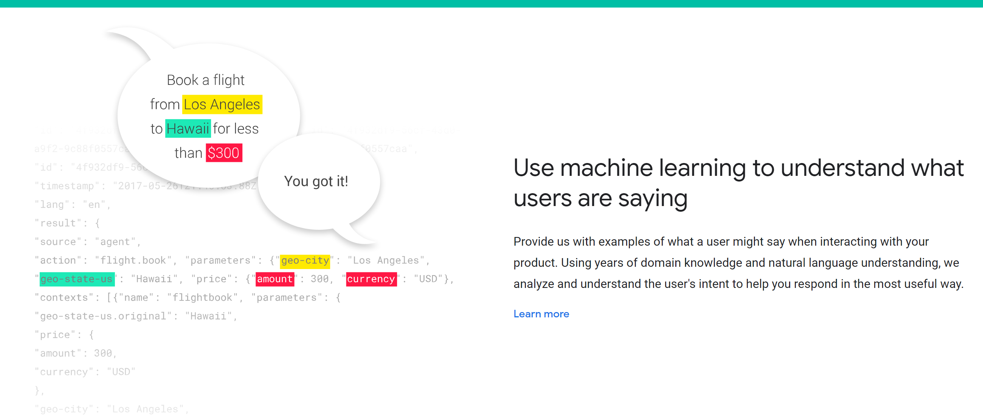
Generative AI
A large neural network machine learning algorithm that predicts the next word in a series using the rules it has gleaned from analyzing billions of data segments drawn from the internet
Large Learning Models (LLMs) do not require training on structured data sets – they take enormous amounts of unstructured data and find patterns

Slide 18

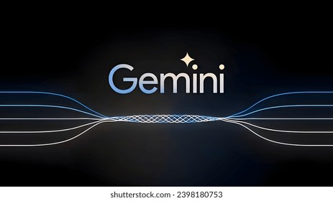
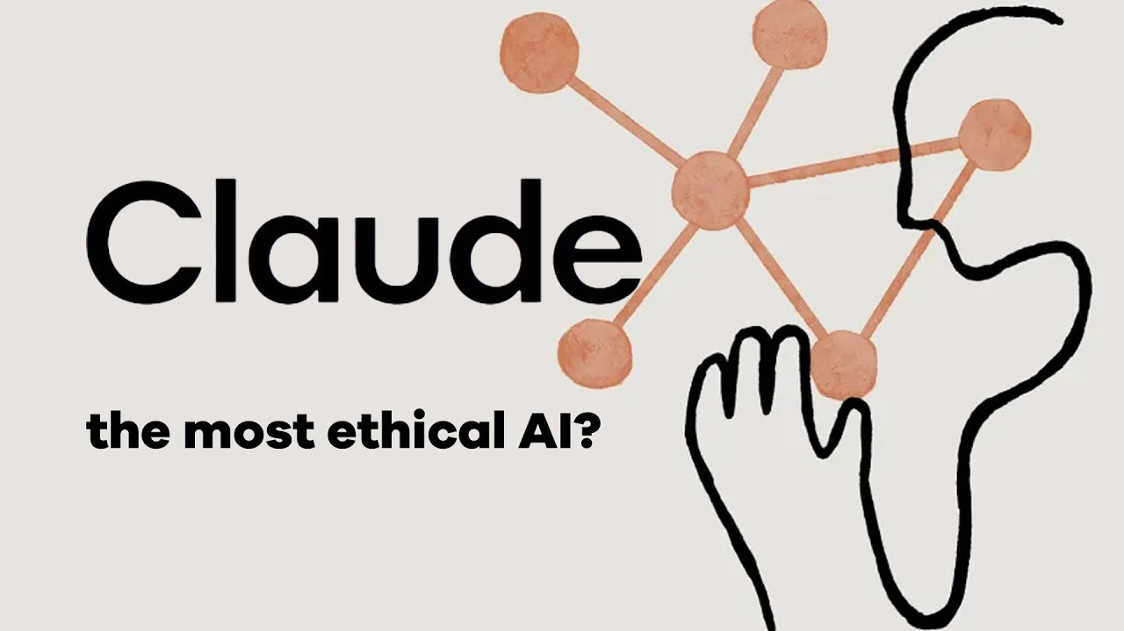

Slide 19
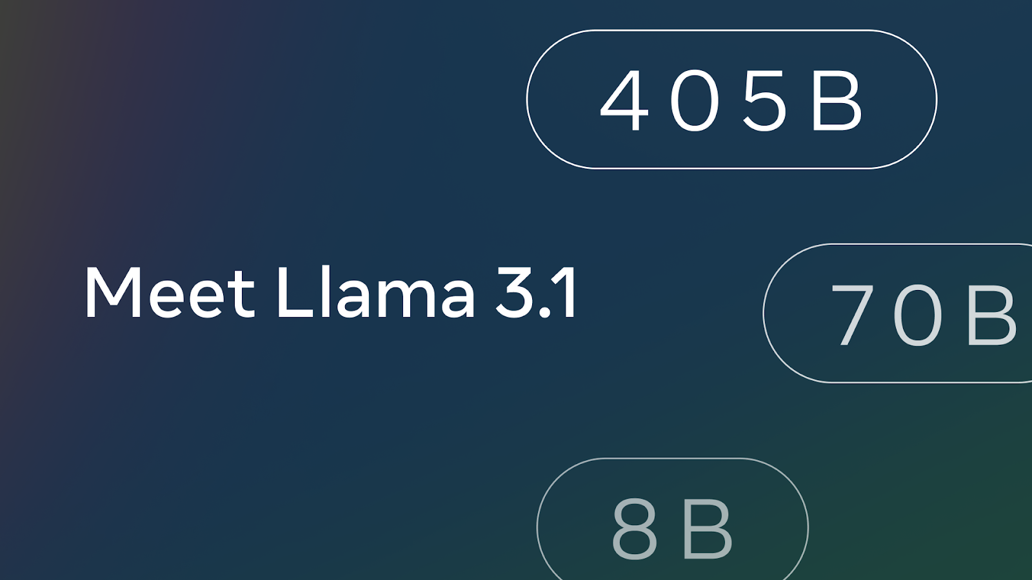







Slide 20
What is RAG?
Retrieval augmented generation, or RAG, is an architectural approach that can improve the efficacy of large language model (LLM) applications by leveraging custom data. This is done by retrieving data/documents relevant to a question or task and providing them as context for the LLM.

Slide 21
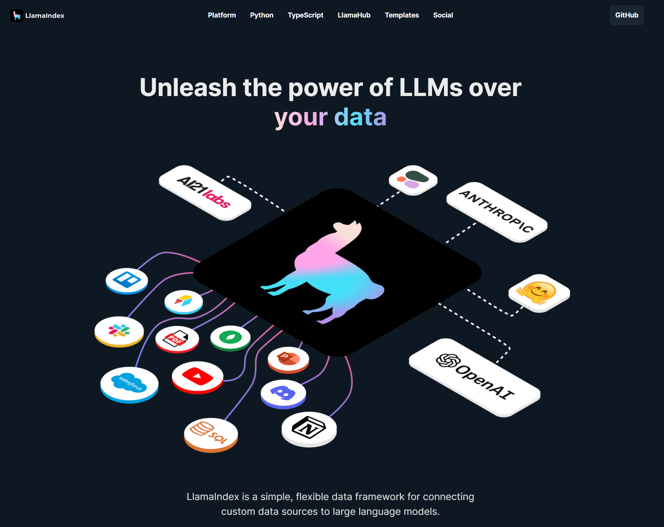
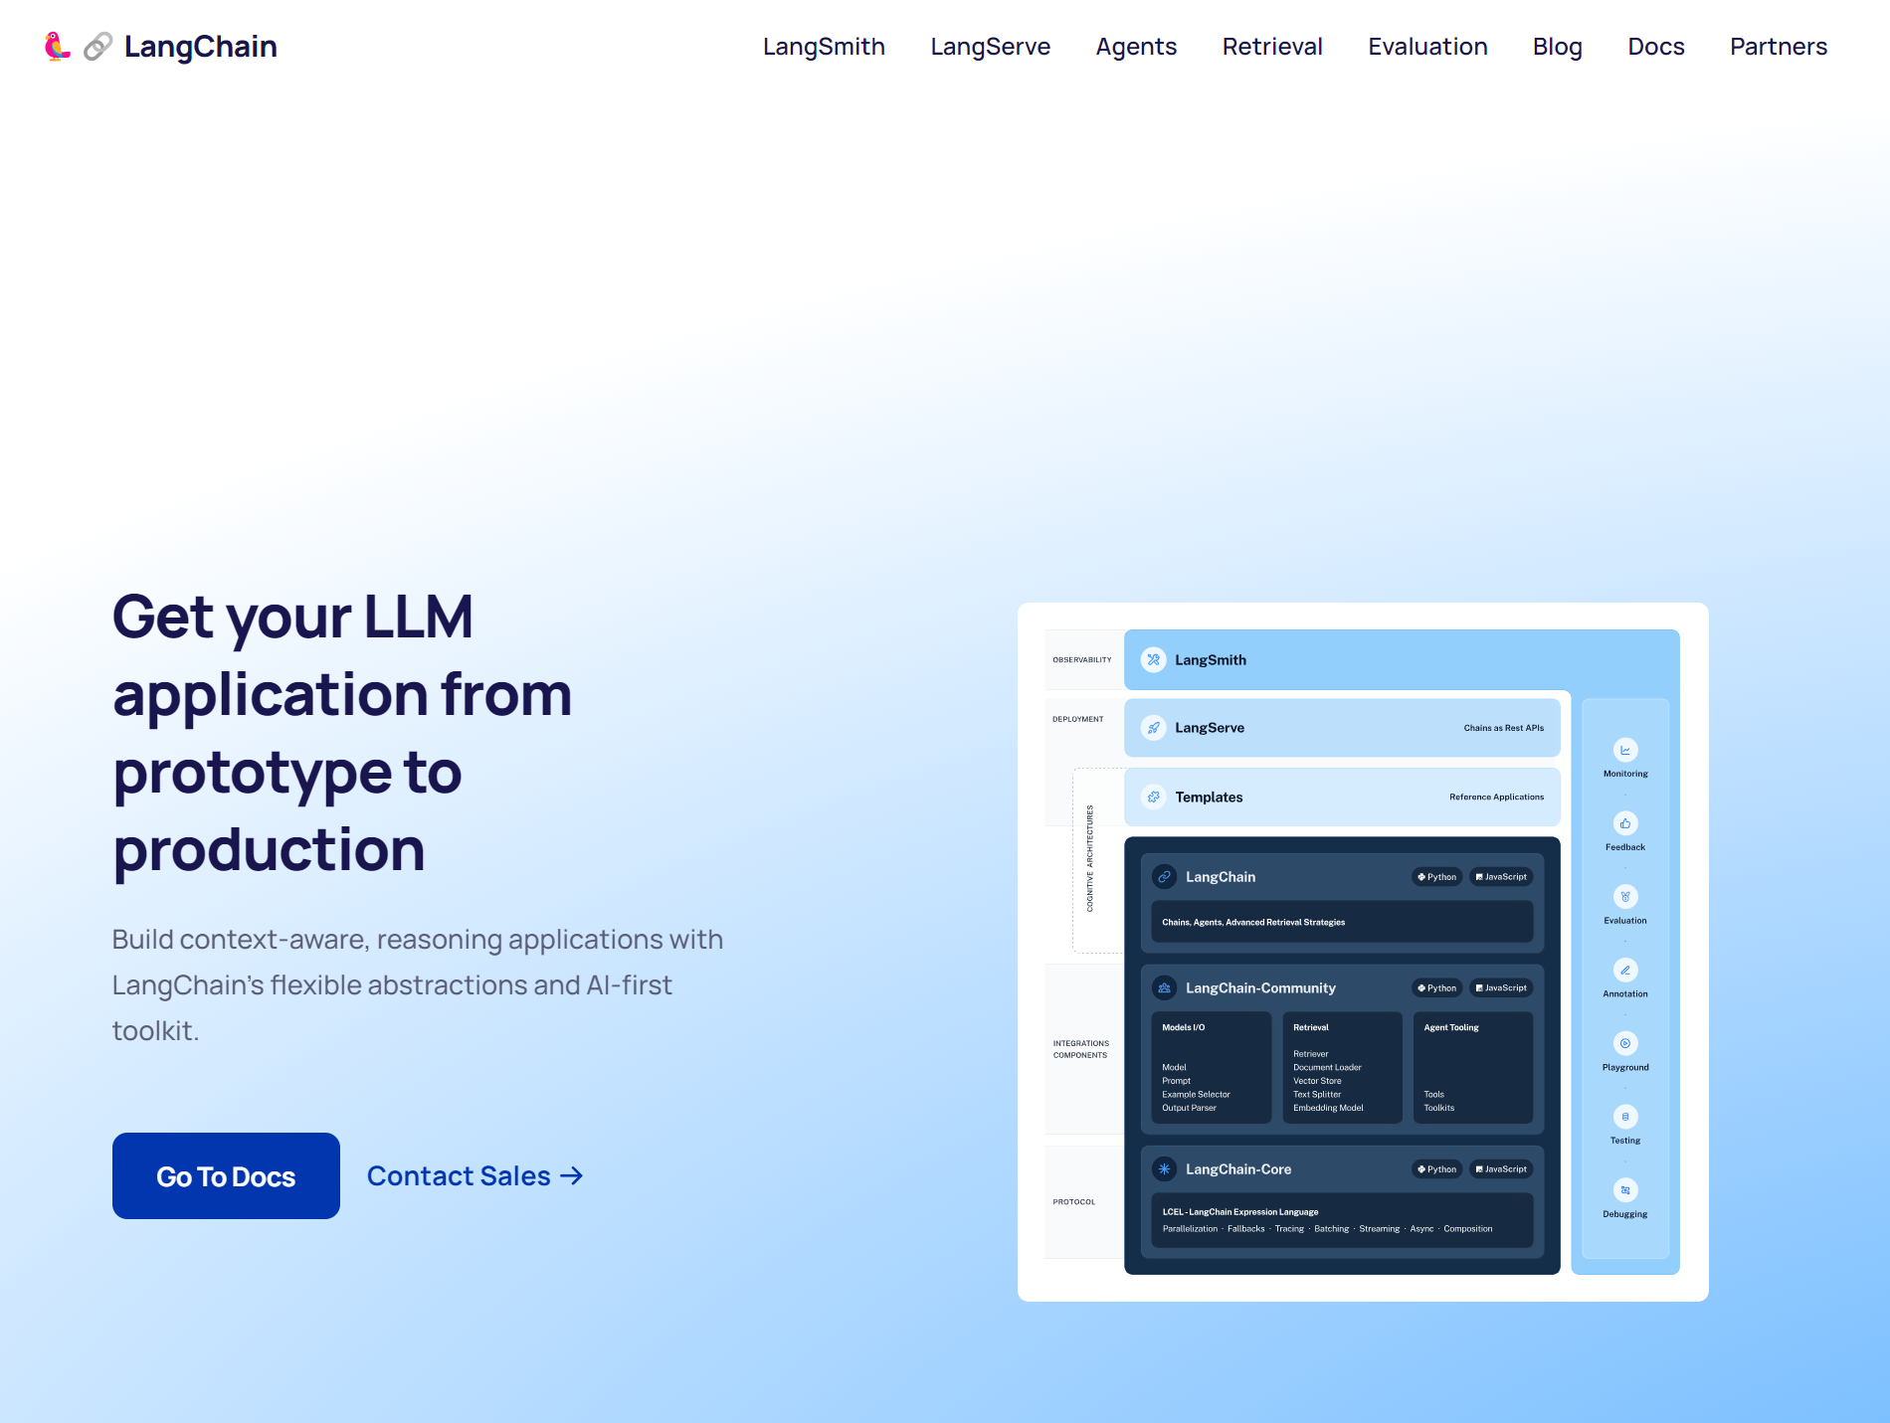

Slide 22
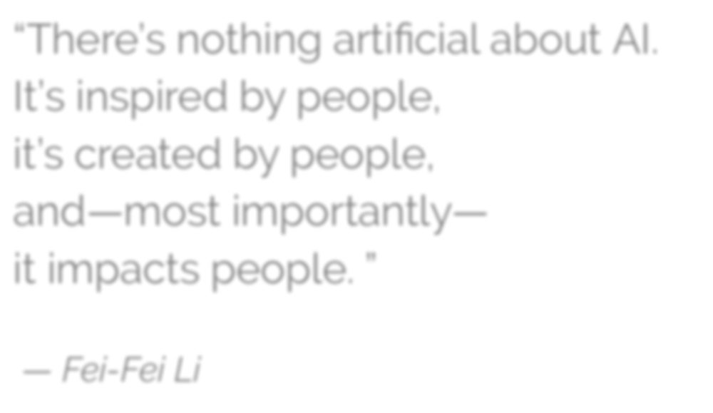
“There’s nothing artiﬁcial about AI. It’s inspired by people,
it’s created by people, and—most importantly— it impacts people. ”
— Fei-Fei Li
Source: https://www.wired.com/story/fei-fei-li-artiﬁcial-intelligence-humanity/
Notes:
SOURCE OF QUOTE: “Artificial Intelligence: Do stupid things faster with more energy!”, at: https://towardsdatascience.com/artificial-intelligence-do-stupid-things-faster-with-more-energy-379aa6bac220

Slide 23

“It’s not the genie that’s dangerous,
it’s the unskilled wisher.”
- Cassie Kozyrkov, Chief Decision Scientist, Google

Slide 24
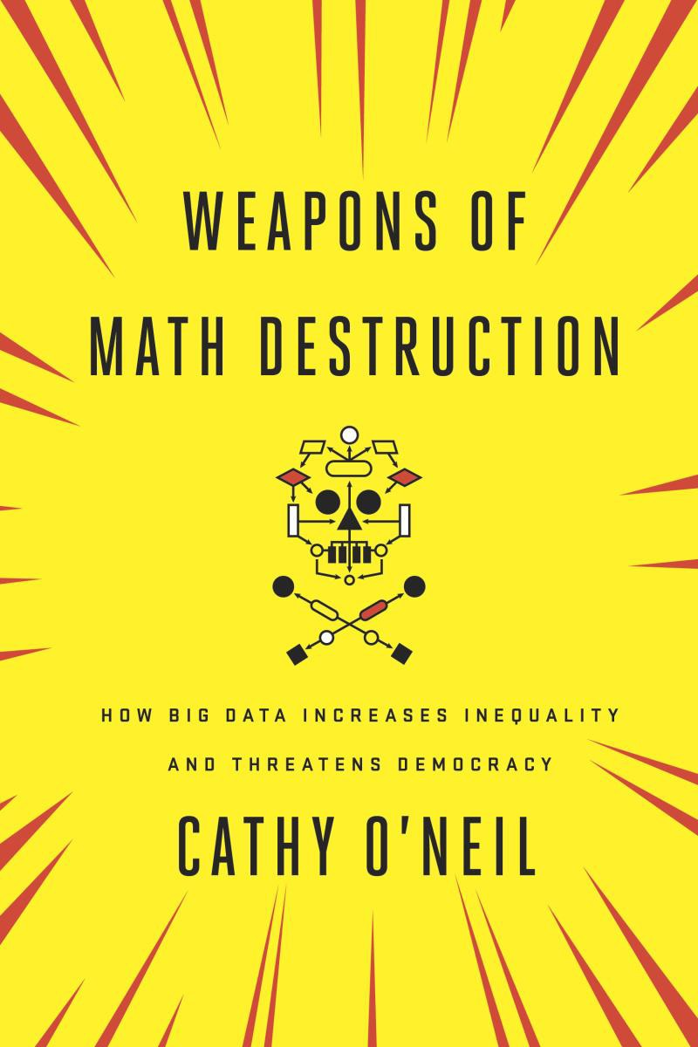
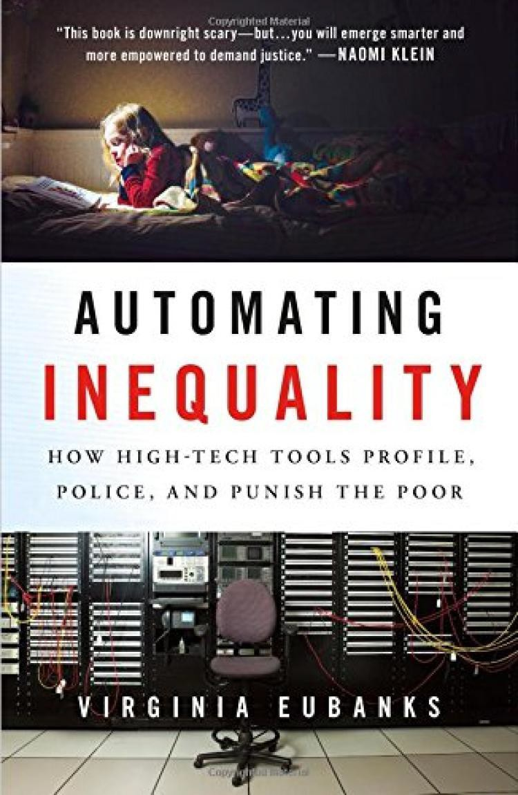



Slide 25
“An algorithm is an opinion embedded in mathematics”
Cathy O’Neil, author of Weapons of Math Destruction
“Algorithms are neither good nor bad,
but they are certainly not neutral”
Kranzberg’s First Law of Technology
Technology and Culture, Vol. 27, No. 3 (July 1986), pp. 544-560
Notes:
WHAT TO REMEMBER ABOUT AI TOOLS
To help you understand what they do, and what they don’t do
An algorithm is an “opinion embedded in mathematics” -- Cathy O’Neil, author of Weapons of Math Destruction
CORRELATION, NOT CAUSATION
Where is the knowledge we have lost in information? -- T.S. Eliot
Not coming up with theories of laws of nature, just patterns
Cassie Kozyrkov, head of Decision Intelligence for Google:
You can use AI to find “patterns in data instead of having to meditate your way to a solution. Do you realize how powerful this is? It means that even if you can’t come up with instructions, you might be able to automate your task anyway.”
“It’s a set of tools for writing software a different way, letting you program with examples (data) instead of explicit instructions.”

Slide 26

Notes:
WHAT ARE WE TALKING ABOUT?
HOW DOES IT WORK?
Simple description for purposes here
‘Learn’ is in quotations because it is not learning they way humans do
‘predict’, and not ‘recommend’ to remind us this is usually statistics and correlation,
NOT reasoning or causation
TALKING ABOUT AI TOOLS THAT MAKE DECISIONS AFFECTING PEOPLE’S LIVES,
NOT TOOLS CONTROLLING MACHINES, IoT, ETC.

Slide 27

Meet the Fourth Party
A partner in resolutions
Lightens administrative loads
Saves money
Builds credibility
Becoming more capable all the time
Always in the parties’ pockets
Able to do things humans can’t (or shouldn’t) do

Slide 28
What can the fourth party do today?
Intake / Diagnosis
Processing Payments
Case administration
Notifications
Document management
Calendars / Scheduling
Assisted negotiation

Slide 29
What will the fourth party do tomorrow?
Research
Case evaluation / ZOPA
Coaching
Reframing / BATNA
Enforcement
Document drafting & submission
Automated negotiation

Slide 30
Potential for LLMs and ODR
Document queries for all documents uploaded into a workspace
AI assisted case filing (natural language)
AI assisted document generation (creating draft settlement agreements)
AI assisted panelist search
AI mediator - AI asking questions, reframing, urging toward settlement
AI tone monitoring - communication de-toxifying
AI arbitrator - evaluates submitted information, asks questions, renders decision

Slide 31
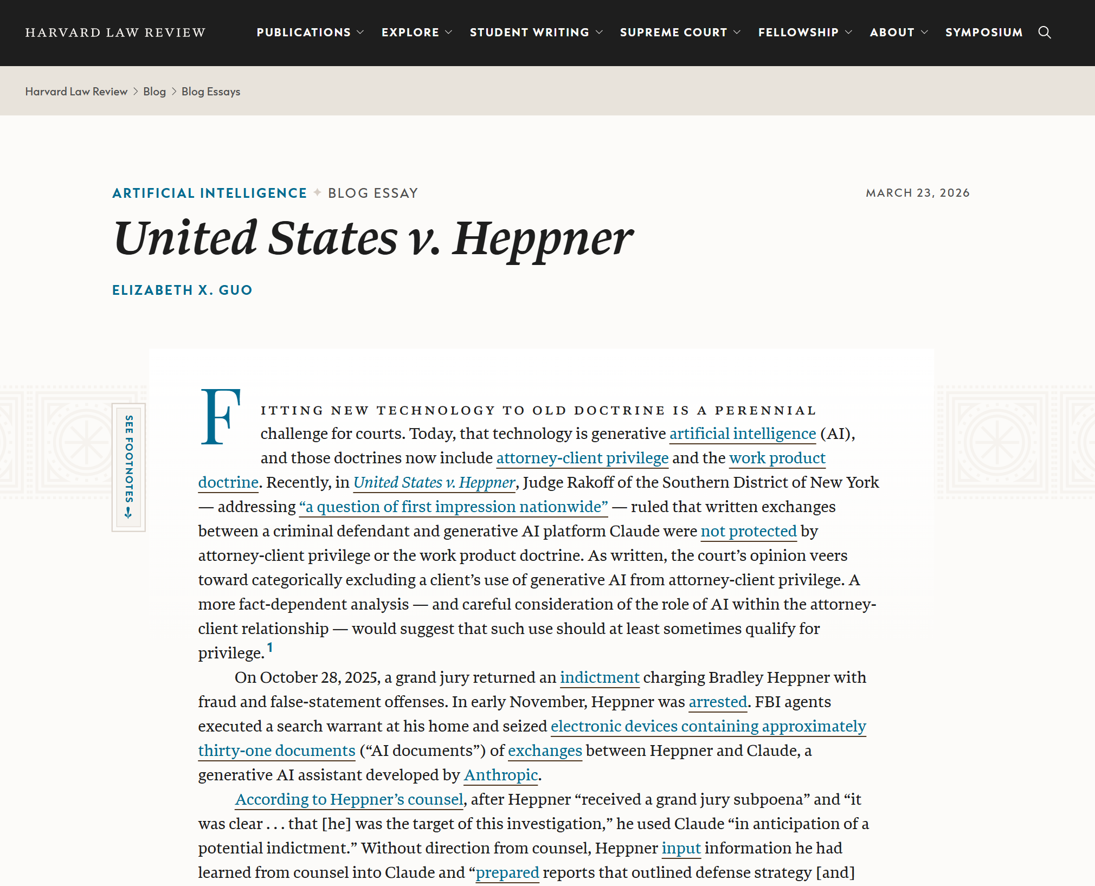
AI and Confidentiality
“Because Claude is not an attorney,” Judge Rakoff wrote, “that alone disposes of Heppner’s claim of privilege.”
Judge Rakoff wrote that the AI documents were not confidential because Heppner “communicated with a third-party AI platform.”
Judge Rakoff pointed to the fact that “when the Government asked Claude whether it could give legal advice, it responded that ‘I’m not a lawyer and can’t provide formal legal advice or recommendations.’”

Slide 32
💬 Basic Chat LLM
What Most Mediators Use Today
What It Is
How It Works
A conversational AI you interact with turn-by-turn. You type a question or request, and it responds. Each session is typically isolated — the AI has no memory of prior sessions and cannot take actions beyond generating text.
1
You type a prompt
Describe your task or question
2
AI generates a response
Text is returned in seconds
Typical Mediator Uses
3
You evaluate & refine
Draft opening statements & settlement clauses
Summarize a document you paste in
Research legal precedents (with caution)
Reframe party positions in neutral language
Generate agenda items or meeting structures
Copy, edit, or ask a follow-up
4
You apply the output
Manual effort required to act on it

Slide 33
⚠️ Where Chat Falls Short
Chat LLMs are powerful writing partners — but they hit a ceiling in professional mediation workflows.
🔒
No Memory
✋
No Action
🔁
Manual Workflow
Forgets everything after the session. Can't recall your client history, case files, or prior negotiations.
Can't send emails, access databases, retrieve documents, or interact with your case management system.
You must manually copy outputs into documents, emails, or other tools — every single time.
🧱
One Step at a Time
🔍
No Real-Time Data
👤
No Personalization
Can't autonomously complete a multi-step task. You're the connector between every step.
Cannot pull live case law, court filings, or current precedents without you pasting content in.
Treats every request as isolated — can't adapt to your specific style, jurisdiction, or dispute domain over time.

Slide 34
Now Meet
🤖
AI Agents
AI that doesn't just answer — it acts.
🎯
Goal-Oriented
🔗
Tool-Connected
🔄
Multi-Step
You define an objective;
the agent plans and executes.
Connects to files, systems,
calendars, and databases.
Chains tasks autonomously
without step-by-step prompting.

Slide 35
🤖 What Makes an Agent Different
AI agents are LLMs enhanced with tools, memory, and the ability to orchestrate multi-step workflows autonomously.
🧠
Persistent Memory
Agents remember context across sessions — your preferred negotiation frameworks, client backgrounds, and jurisdiction-specific practices.
🛠️
Tool Use
Connect to email, document management, calendars, legal databases, and case management systems. The agent can read and write files on your behalf.
📋
Task Planning
Break a complex goal (e.g., 'Prepare a full case brief for tomorrow's session') into sub-tasks, execute each, and compile results.
🔄
Autonomous Loops
Review its own output, check for errors, search for missing information, and iterate — without you prompting each step.
📡
Real-Time Retrieval
Query live legal databases, pull recent case law, or retrieve the latest correspondence from your inbox automatically.

Slide 36
⚖️ Agents in Your Mediation Practice
Concrete workflows agents can run end-to-end for you:
Pre-Session Preparation
Real-Time Research
Agent retrieves case documents, prior correspondence, and precedents. Generates a briefing memo with party positions and suggested talking points — ready before you sit down.
Mid-session, ask the agent to retrieve the current legal standard on a disputed clause. It searches, synthesises, and presents a neutral summary — in seconds.
Agreement Drafting
Party Communication Drafting
From session notes, agent drafts a full settlement agreement, cross-checks jurisdiction-specific requirements, flags gaps, and formats it for signature.
Agent drafts neutral, professionally worded communications to each party, tailored to their known concerns and prior statements, ready for your review and send.
Post-Session Follow-Up
Conflict-of-Interest Screening
Emails agreed action items to parties, updates the case file, schedules follow-up sessions, and generates a session summary for your records.
Before intake, agent scans your existing client roster, court databases, and disclosed relationships to flag any potential conflicts automatically.

Slide 37
Head-to-Head: Chat vs. Agent
💬 Basic Chat LLM
🤖 AI Agent
Memory
None — each session starts fresh
Persistent across sessions & cases
Tool Access
Text output only
Email, files, databases, calendars
Workflow
One question → one answer
Goal → autonomous multi-step plan
Document Work
Summarises pasted text
Retrieves, reads & drafts from files
Research
Based on training data only
Live search & retrieval in real time
Setup Required
None — use immediately
Integration & configuration needed
Best For
Quick drafting & brainstorming
End-to-end case workflows

Slide 38
Benefits
Challenges
Reduce cost of service
Provide faster service
Provide better service
Serve more people
Data & Privacy
Safety
Regulations
Ethics
Our parties will soon use these tools in every area of their lives, and they will expect to use them in their dispute resolution processes as well
Notes:
These new technologies have a great potential but also pose challenges that are more than the technology itself.

Slide 39

Is a submarine good
at swimming?
Notes:
Can stay underwater 3 months
28 miles an hour
53% of US ballistic missiles are on nuclear submarines

Slide 40

Is Michael Phelps a bad submarine?
Notes:
Fastest recorded human swimmer: 5 miles an hour
Olympic champions average 4.8 mph
Hold breath for one or two minutes

Slide 41


Slide 42
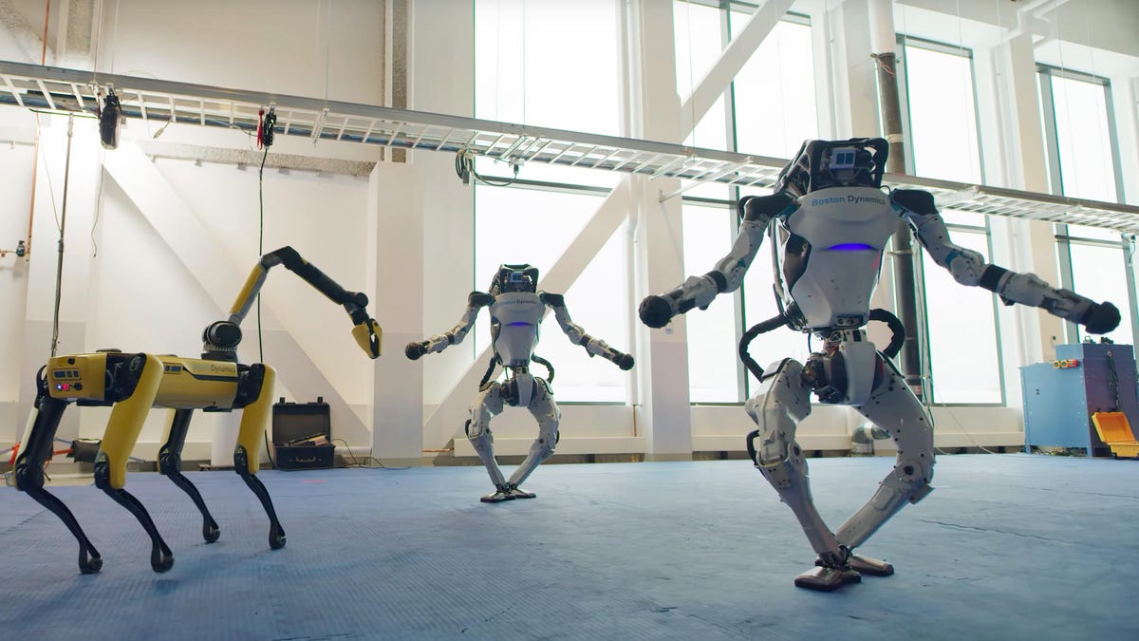

Slide 43
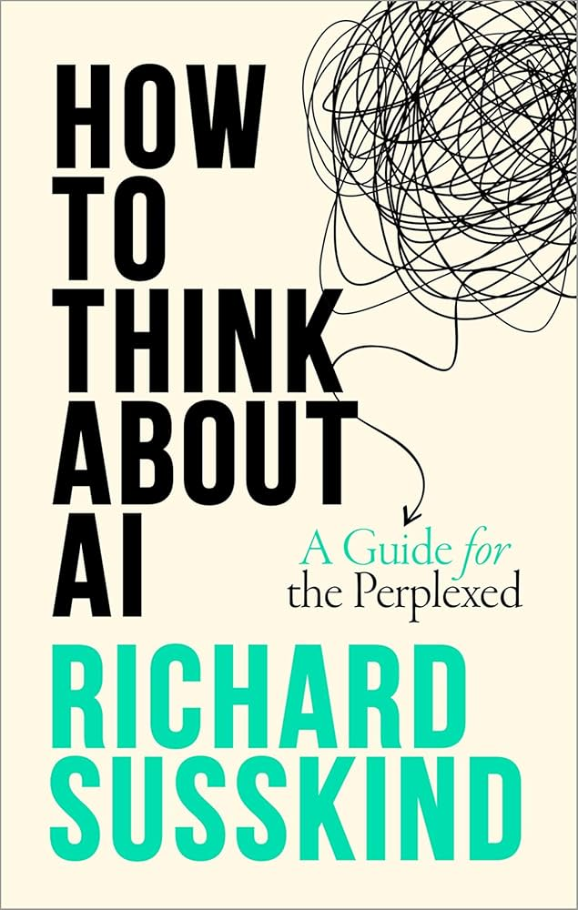
Automation
Innovation
Elimination

Slide 44





Slide 45


Artificial Intelligence fits better with ODR than with the law.
AI is making ODR the first step in every resolution journey.

Slide 46
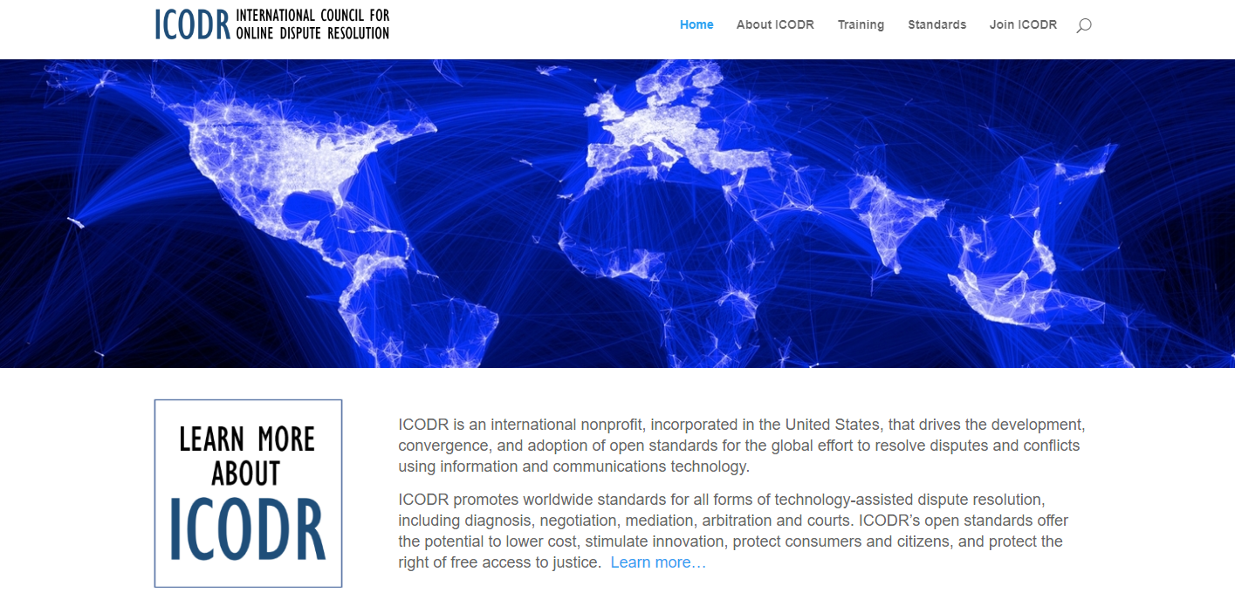
Online Mediator Ethical Standards
Notes:
Court disputes (low value civil cases: e.g. divorce, tenant)
Public disputes (e.g. Property Tax Appeals)
Insurance (e.g. AAA NYNF Process)
Product liability (e.g. Pharmaceuticals)
Consumer (e.g. Ombuds offices, UK CAA)
eCommerce disputes (payments, marketplaces, merchants)

Slide 47

Online
Mediator Ethical Standards
Accessible
Accountable
Competent
Confidential
Equal
Fair/Impartial/Neutral
Legal
Secure
Transparent

Slide 48
Ethics for Platform Designers
Potential for Abuse
  (it’s easy to build an online kangaroo court)
Certifying and auditing ODR systems
Monitoring for ongoing compliance
Processing complaints
Following the money / perverse incentives
Ethics for the use of algorithmic resolution tools

Slide 49
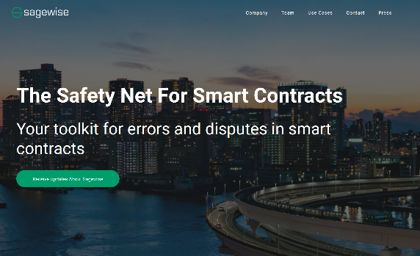
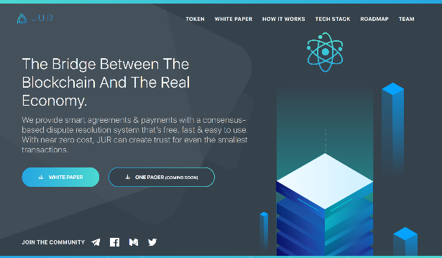
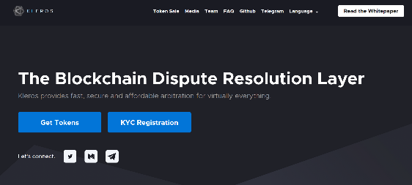
What’s Coming
Smart Contracts
Blockchain
Machine learning
Algorithmic resolutions
Decentralized
justice

Slide 50
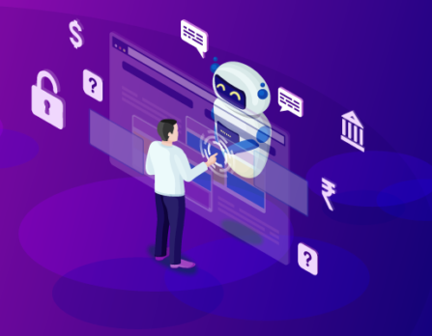
What’s Coming
AI agents will expand access to DR
Parties will expect to leverage AI in the resolution process
AI agents will improve over time
We need to build our own AIs trained on best practices and ethical guidelines

Slide 51
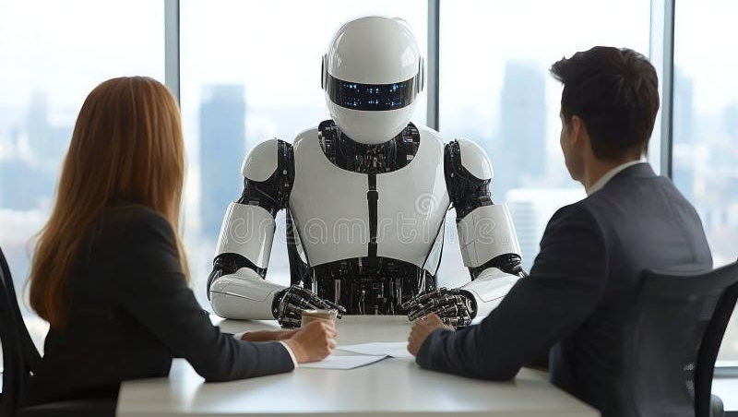

Slide 52
AI Practice Dilemma #1
You are mediating a dispute between two business partners who are dividing a business and trying to determine how much one partner should pay the other to buy them out of their share. They decide to upload all of the company financials to an AI and ask for the AI’s estimation of the appropriate valuation of the business. One partner uploads the financial data and the AI comes up with an estimate, and the partners agree to use that number. But in later reviewing the data the partner uploaded, you suspect that he may have adjusted a key number in the spreadsheet to influence the AI’s calculations. What do you do?

Slide 53
AI Practice Dilemma #2
As a mediator, you use AI to generate a possible solutions to a dispute between two parties in different countries. After some discussion and consideration of different draft agreements generated by the AI, the parties find a solution and sign. Two months later, a lawyer for one of the parties (who did not represent them at the time of the mediation) contacts you and informs you that the legislature in the home geography for their client does not recognize the enforceability of AI generated agreements, and the lawyer is advising their client that the mediation agreement is invalid. What would you do?

Slide 54
AI Practice Dilemma #3
A mediator uses an AI to consult on a case, and after analyzing the information submitted the AI suggests one of the documents shared by the complainant is inauthentic. There is no indication visible to the mediator that the document is illegitimate, but the AI is steadfast in its judgement (and it won’t explain its reasoning). How would you handle this situation?

Slide 55
AI Practice Dilemma #4
A mediator submits case facts to a publicly available AI that does not protect the confidentiality of submissions. The mediator did not realize that the AI integrates information from submissions into its public data, and later when the mediator asks specific questions about the individual case the AI answers them. What would you do?

Slide 56
AI Practice Dilemma #5
A mediator uses AI to generate a settlement agreement and shares it with the parties, and the parties see that one of the points of agreement appears to be hallucinated, so they ask if the mediator used an AI tool to generate the document. The mediator did not inform the parties in advance that they would use AI tools in the mediation. What would you do?

Slide 57
AI Practice Dilemma #6
You are mediating a workplace dispute in a text-based discussion over unpaid wages, and the posts from the business seem oddly generic to you. The former employee keeps asking specific questions and the business manager keeps responding in generalities. You suspect the manager may be generating their responses in an AI program, or an AI program is participating in the process instead of the live manager. What do you do?

Slide 58
AI Practice Dilemma #7
As a mediator, and with the agreement of your parties, you use an AI tool to generate some solution possibilities, and the parties decide to use one of the solutions as the basis for their own agreement. You build an agreement around the solution and the parties sign it. A few months later a news report reveals that the AI tool you utilized was trained on some fake data that could potentially bias the solutions it recommends. One of the parties contacts you expressing concerns that maybe the fake data could have affected the solution it proposed in her case. How would you respond?

