Slide 1

Online Dispute
Resolution in the Age of AI
Online Dispute
Resolution in the Age of AI
Colin Rule
SCU Law
6/25/26

Slide 2
July 1, 2014
June 27, 2026
ICANN’s UDRP
Origins of ICANN
The nature of domain names
Trademark holders vs. “Cybersquatters”
The UDRP
The Providers
How it works
  Documents only arbitration
Absolute enforcement

Slide 3





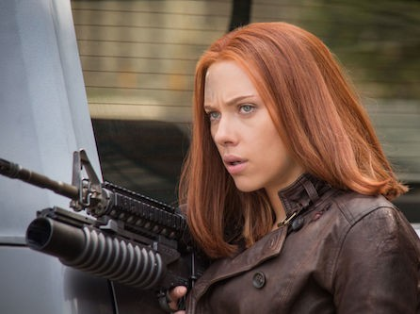
Domains = $$$$
dellfinancialservices.com
kodak.ru: 1 year + 20 lawsuits later
myverizonwireless.com, iphoneverizonplans.com, and verizon-cellular.com:
$33 million later. . .
scartletjohansson.com: Scam sweepstakes to collect e-mail addresses
BBC.com: Had to win back its domain

Slide 4
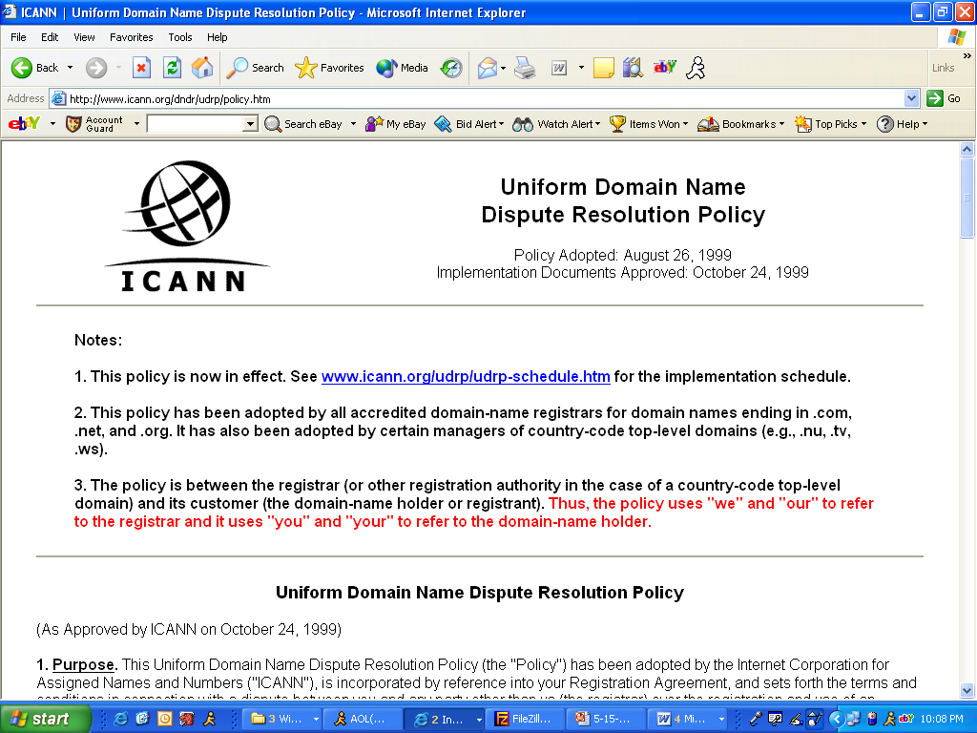
The UDRP

Slide 5
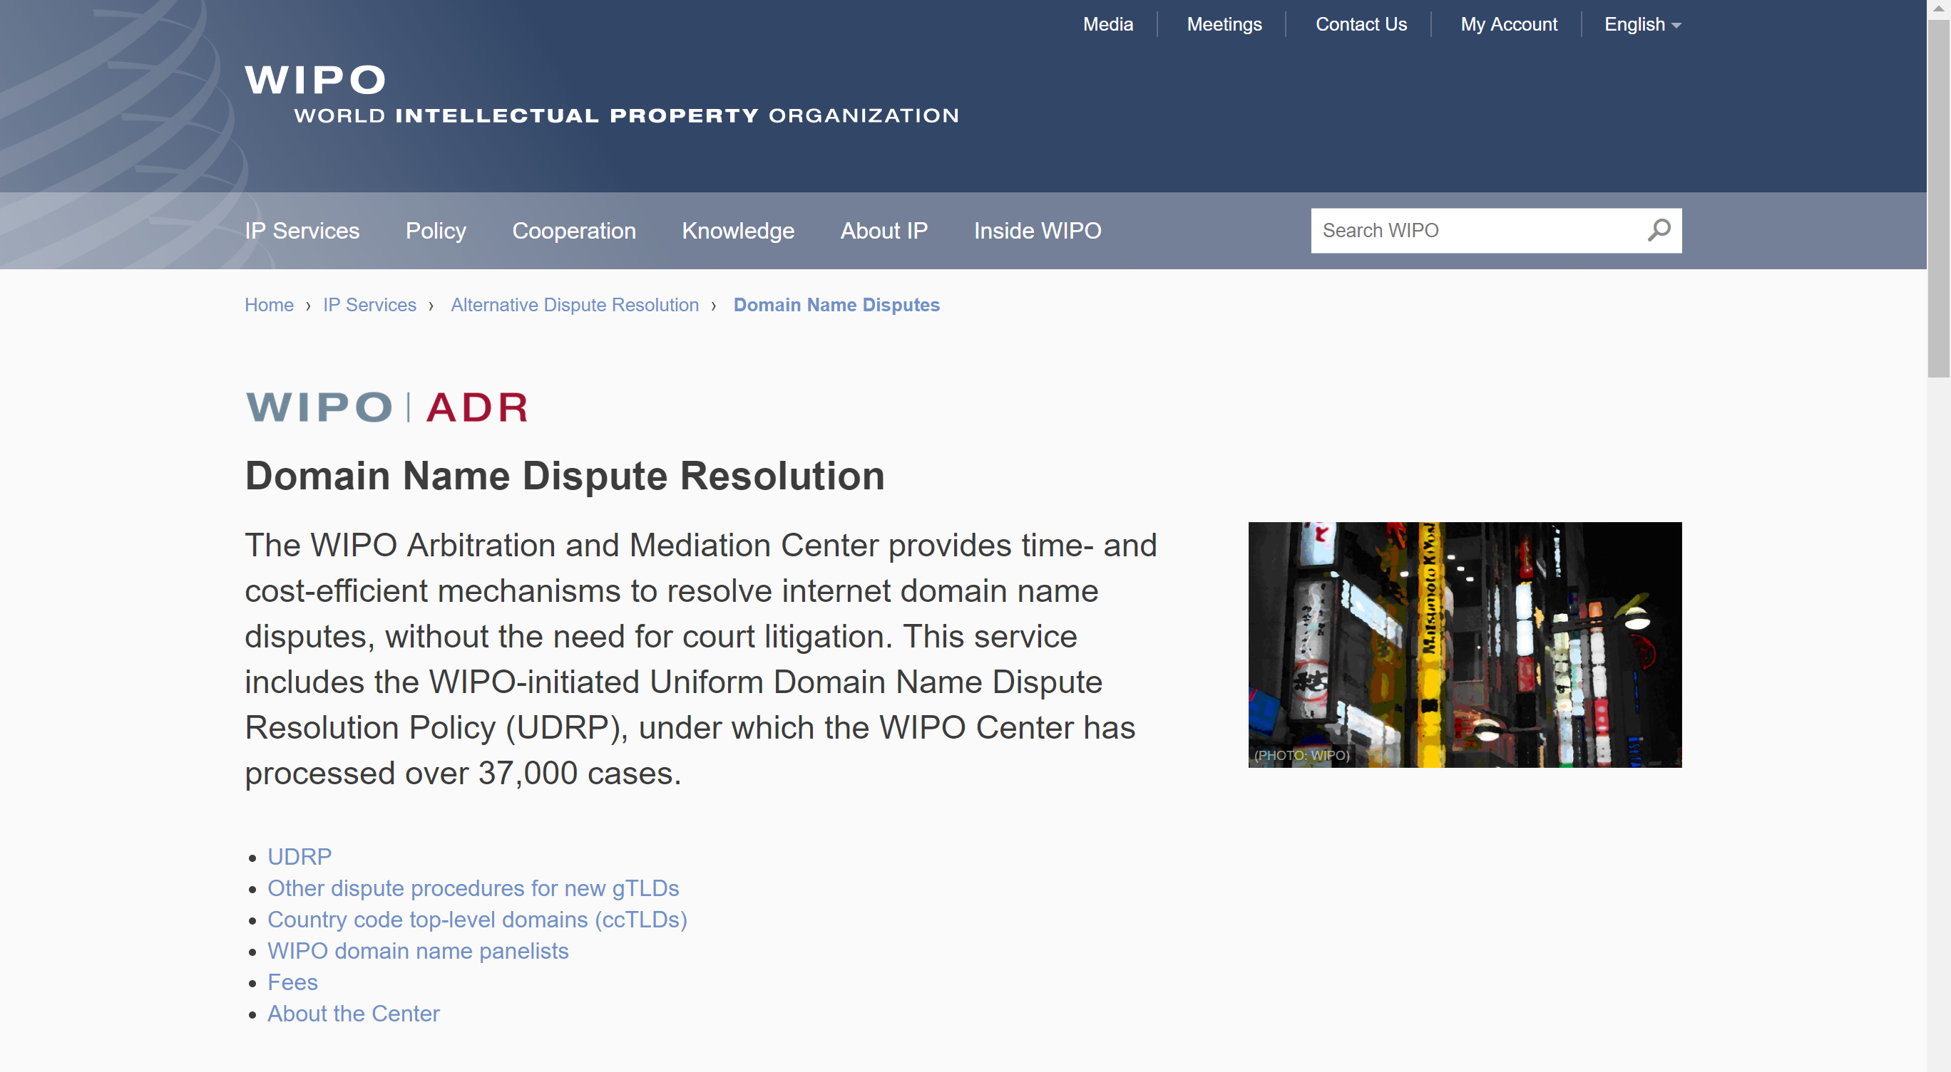
World Intellectual Property Organization

Slide 6
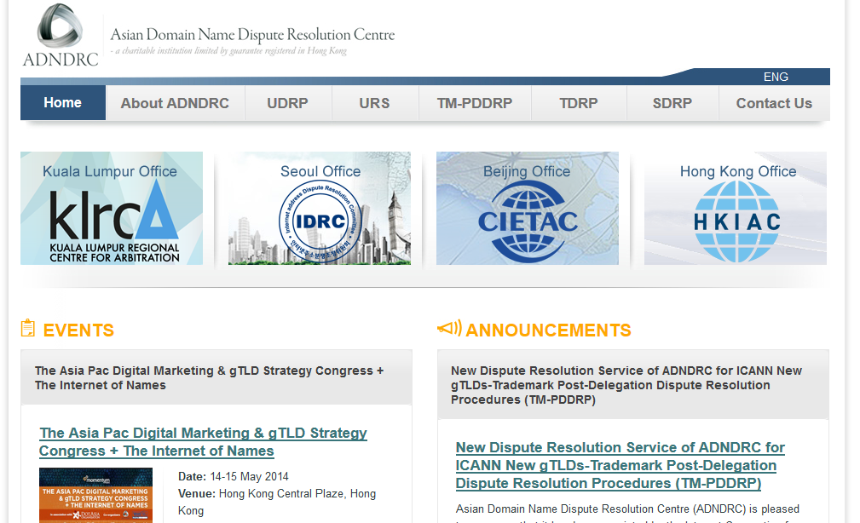
Asian Domain Name Dispute Resolution Centre

Slide 7
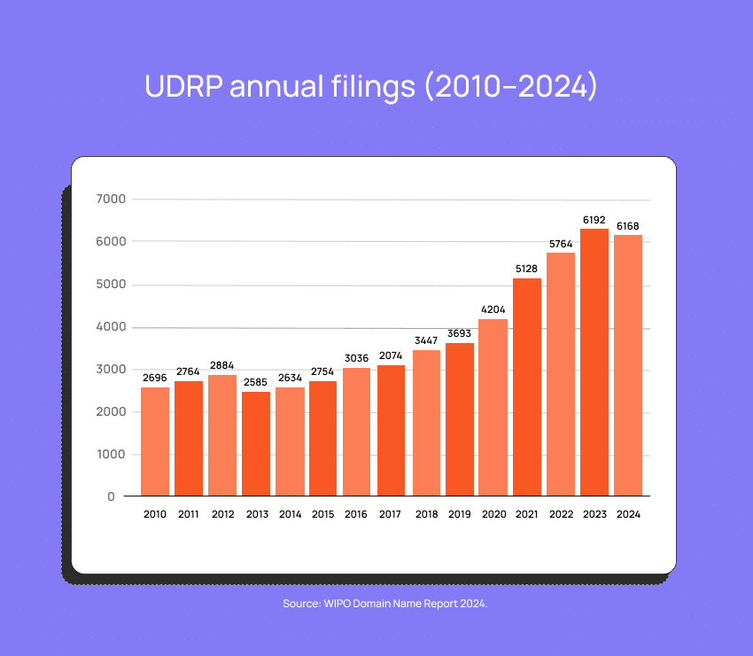
Decisions by Year

Slide 8
Why Dispute/Defend a Domain?
Domain Hijacking (“Cyber Squatting”): Register to resell
Typo Squatting: Registering common misspellings of famous domains to resell or confuse consumers
Reverse Domain Hijacking: Making false cyber squatting claim to force domain transfer
Confusion: Domain is like TM and site markets similar products

Slide 9
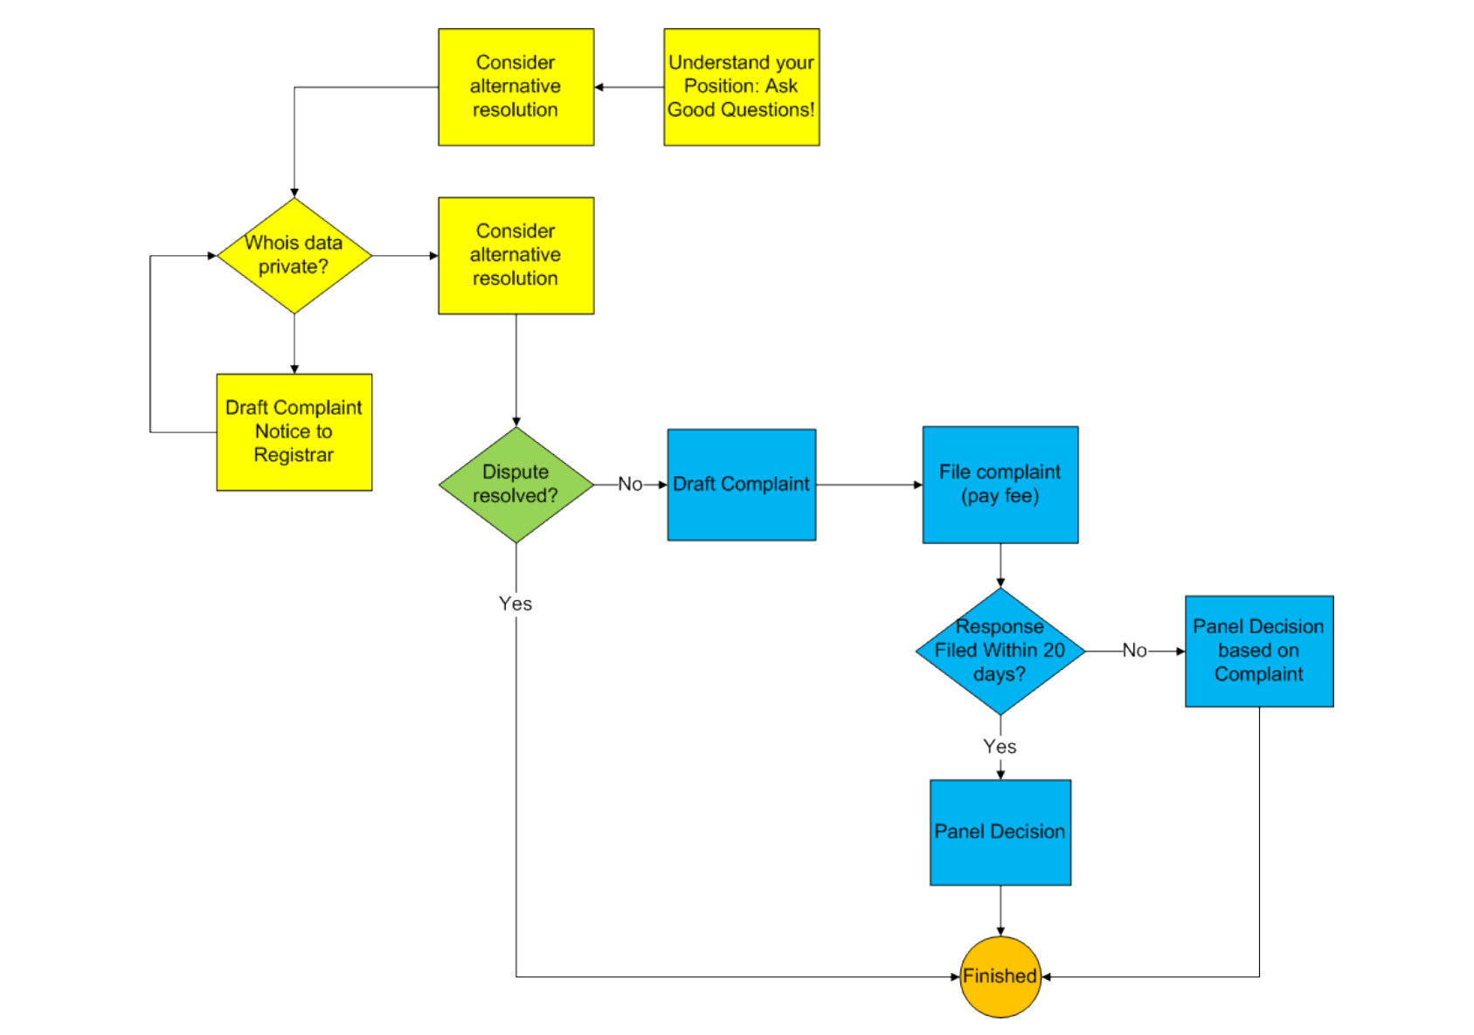
UDRP Process

Slide 10
July 1, 2014
Feb 9, 2020
June 27, 2026
Prove Three Elements
Domain name is identical or confusingly similar to a trademark or service mark in which the complainant has rights
Domain name holder has no rights or legitimate interests in respect of the domain name
The domain name has been registered and is being used in bad faith

Slide 11
Feb 24, 2020
July 1, 2014
Sep 21, 2019
June 27, 2026
Feb 9, 2020
UDRP Controversies
Selection bias
The eResolution Story
Favoring the powerful
  Bodacious-tatas.com vs. Tata & Sons
What resolution rates are appropriate?
Cultural biases
Shortcomings of ICANN
The Ombuds controversy

Slide 12
July 1, 2014
Sep 21, 2019
June 27, 2026
Feb 9, 2020
Feb 24, 2020
UDRP Victories
50,000+ disputes resolved
Sophisticated panelists
The UDRP-DB project
Complete transparency
  Mueller, Geist, ICANNWatch
Non-state precedent setting body of “law”
Expansion of legal principles (free speech)

